Slide 1
Euclidean Geometry
by
By Aryan Gupta
Continued….

Slide 2
Euclidean Geometry
Euclidean geometry is a mathematical system attributed to Alexandrian Greek mathematician Euclid, which he described in his textbook on geometry: the Elements. Euclid's method consists in assuming a small set of intuitively appealing axioms, and deducing many other propositions (theorems) from these. Although many of Euclid's results had been stated by earlier mathematicians, Euclid was the first to show how these propositions could fit into a comprehensive deductive and logical system. The Elements begins with plane geometry, still taught in secondary school (high school) as the first axiomatic system and the first examples of formal proof. It goes on to the solid geometry of three dimensions. Much of the Elements states results of what are now called algebra and number theory, explained in geometrical language.
Continued….

Slide 3
For more than two thousand years, the adjective "Euclidean" was unnecessary because no other sort of geometry had been conceived. Euclid's axioms seemed so intuitively obvious (with the possible exception of the parallel postulate) that any theorem proved from them was deemed true in an absolute, often metaphysical, sense. Today, however, many other self-consistent non-Euclidean geometries are known, the first ones having been discovered in the early 19th century. An implication of Albert Einstein's theory of general relativity is that physical space itself is not Euclidean, and Euclidean space is a good approximation for it only over short distances (relative to the strength of the gravitational field).
Continued….

Slide 4
Euclidean geometry is an example of synthetic geometry, in that it proceeds logically from axioms describing basic properties of geometric objects such as points and lines, to propositions about those objects, all without the use of coordinates to specify those objects. This is in contrast to analytic geometry, which uses coordinates to translate geometric propositions into algebraic formulas.
Continued….

Slide 5
A proof from Euclid's Elements that, given a line segment, one may construct an equilateral triangle that includes the segment as one of its sides: an equilateral triangle ΑΒΓ is made by drawing circles Δ and Ε centered on the points Α and Β, and taking one intersection of the circles as the third vertex of the triangle.
Continued….

Slide 6
Thales' theorem states that if AC is a diameter, then the angle at B is a right angle.
Continued….

Slide 7
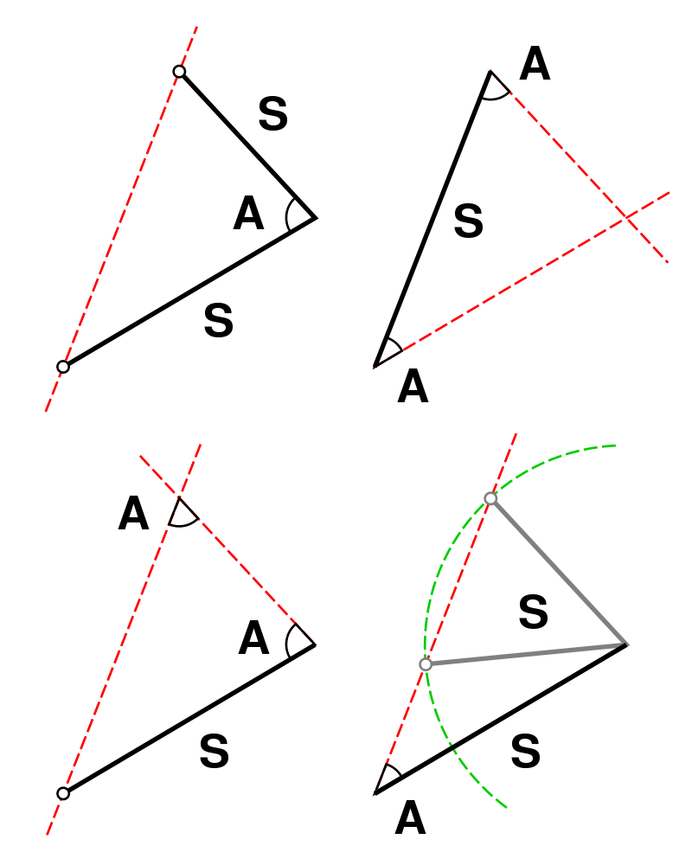
Congruence of triangles is determined by specifying two sides and the angle between them (SAS), two angles and the side between them (ASA) or two angles and a corresponding adjacent side (AAS). Specifying two sides and an adjacent angle (SSA), however, can yield two distinct possible triangles unless the angle specified is a right angle.
Continued….

Slide 8
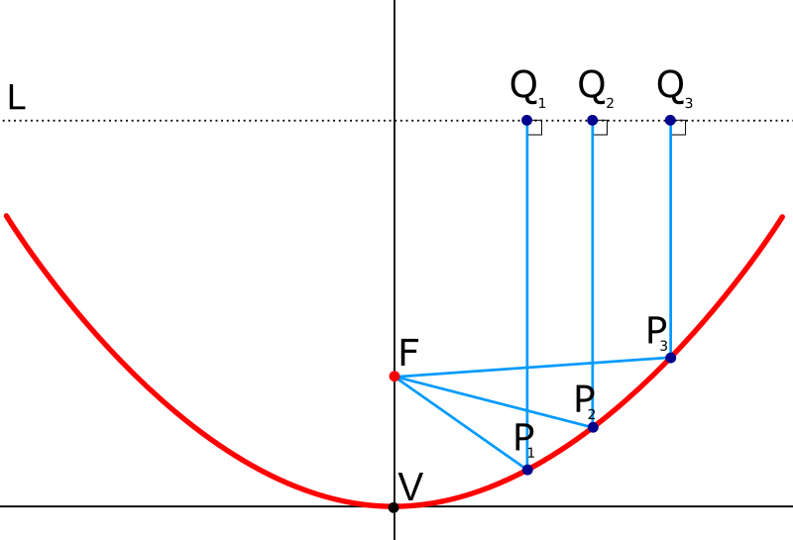
A parabolic mirror brings parallel rays of light to a focus.
Continued….

Slide 9
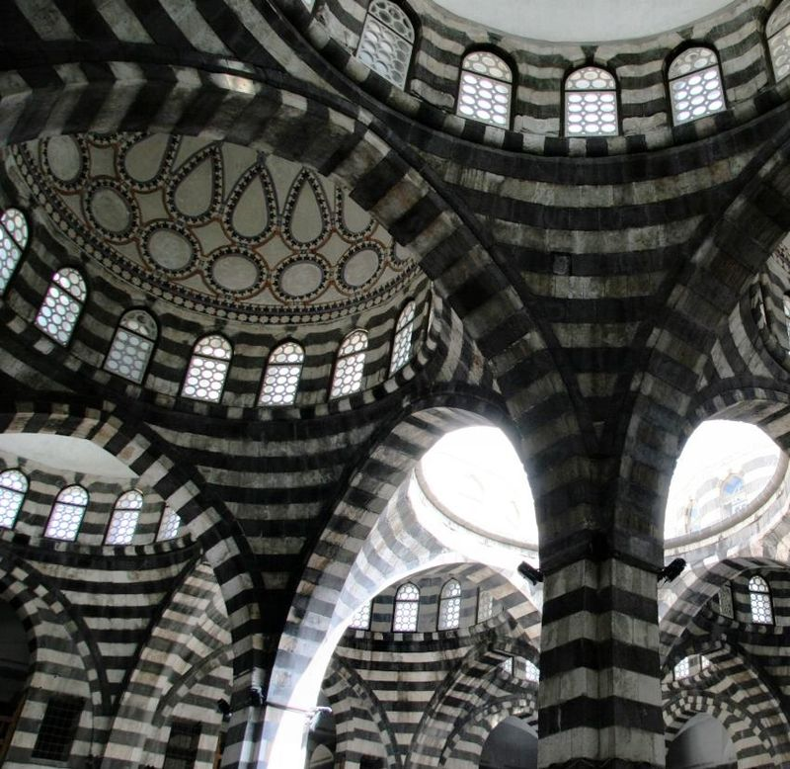
Geometry is used in Art and Architecture.
Continued….

Slide 10
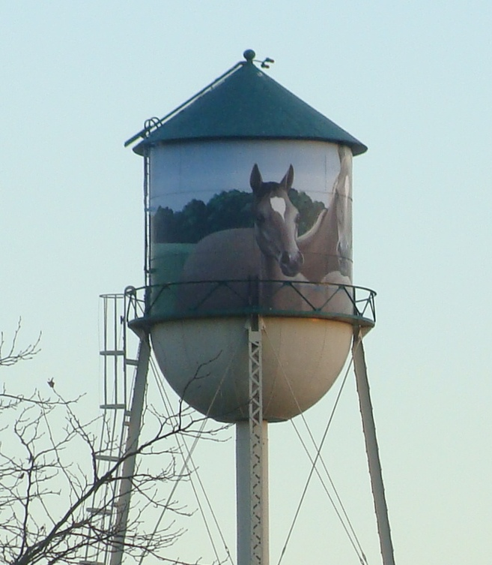
The water tower consists of a cone, a cylinder, and a hemisphere. Its volume can be calculated using solid geometry.
Continued….

Slide 11
Geometry can be used to Design Origami.
Continued….

Slide 12
Motor Electrico 3D de Librerás Gratuitas.
Continued….

Slide 13
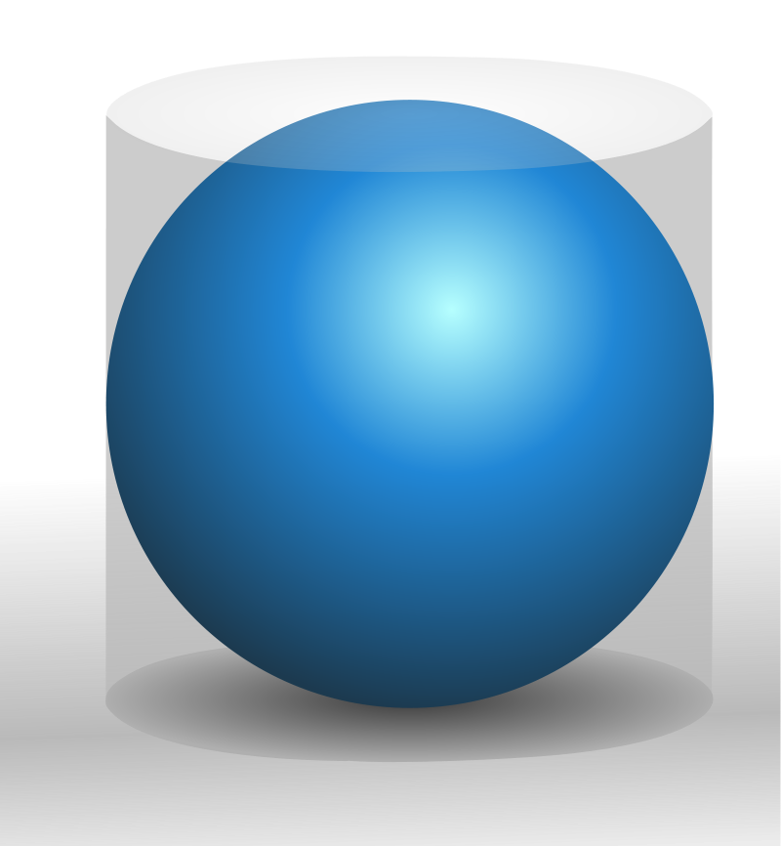
A sphere has 2/ 3 the volume and surface area of its circumscribing cylinder. A sphere and cylinder were placed on the tomb of Archimedes at his request.
Continued….

Slide 14
THANK YOU !
Aryan Gupta,
Class: 9th Section: D,
Carmel Convent School, Ratanpur, Bhopal,
E-mail: aryangp291@gmail.com

