Slide 1


Introduction
ENVIRONMENT POLLUTION
by
Dr. Harish Kumar Gupta,
Environmental Expert/ Specialist,
L. N. M. Infra Projects Pvt. Ltd. BHOPAL (MP)

Slide 2
Present/ Contemporary System of Environment
What is Happening…!!!
Day to day working effects…!!!
Remedial actions…!!!
Future Effects of EP…!!!
Legal Provisions Reg. EP…!!!
1/27/2021
HKG
2

Slide 3
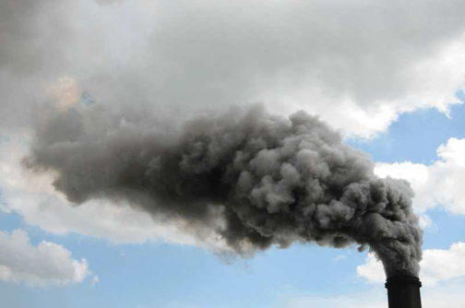
What is happening…!!!
1/27/2021
HKG
3

Slide 4
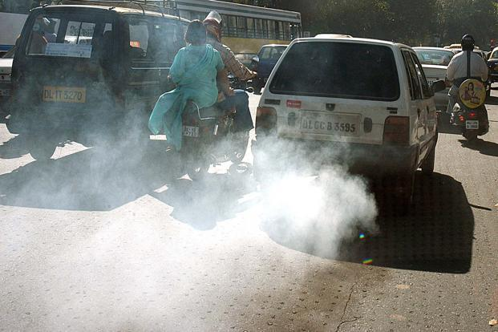
What is happening…!!!

Slide 5
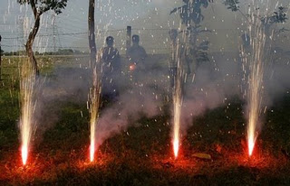
What is happening…!!!

Slide 6
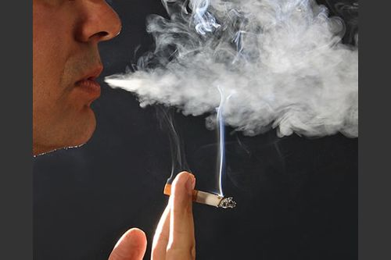
What is happening…!!!

Slide 7
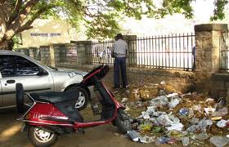
What is happening…!!!

Slide 8
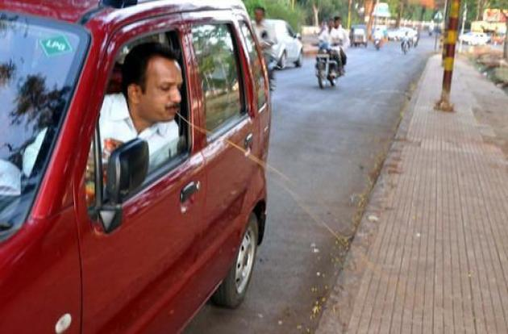
What is happening…!!!

Slide 9
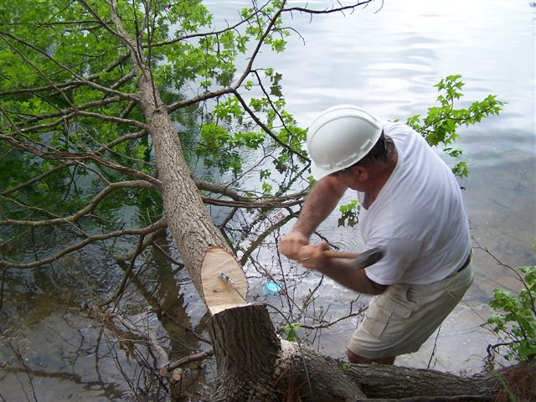
What is happening…!!!

Slide 10
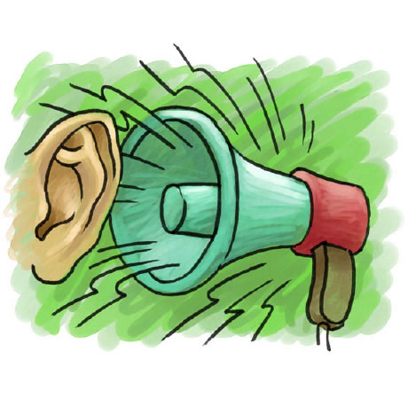
What is happening…!!!

Slide 11
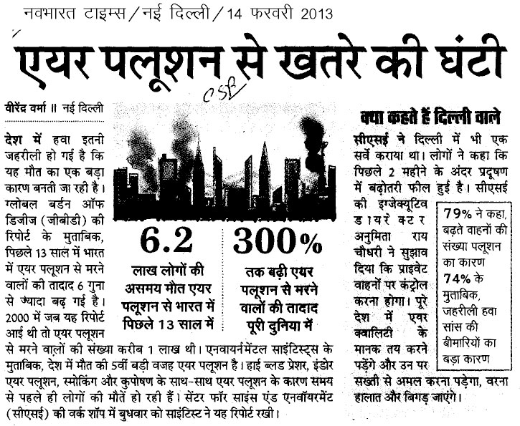
What is happening…!!!

Slide 12
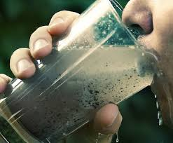
What is happening…!!!

Slide 13
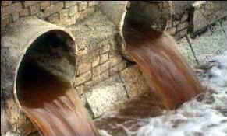
What is happening…!!!

Slide 14
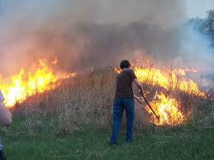
What is happening…!!!

Slide 15
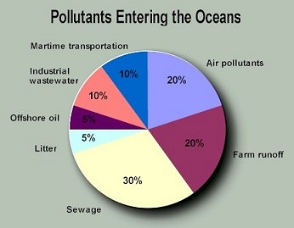
What is happening…!!!

Slide 16

Day to day working effects

Slide 17
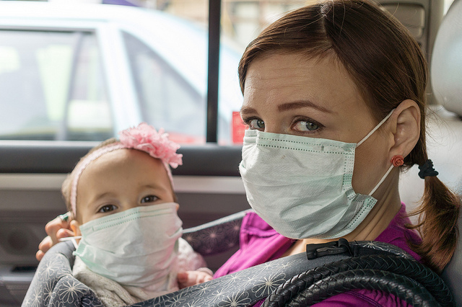
Day to day working effects…!!!

Slide 18
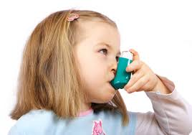
Day to day working effects…!!!

Slide 19
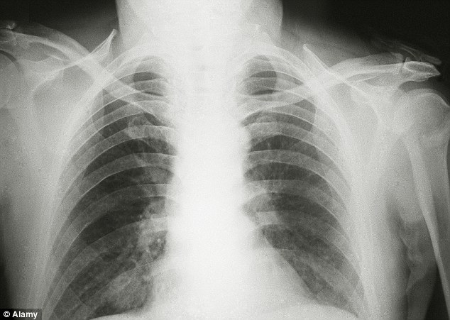
Day to day working effects

Slide 20
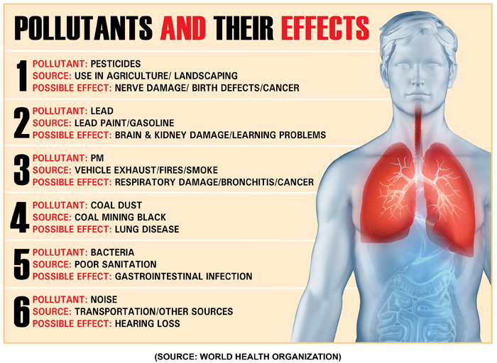
Day to day working effects…!!!

Slide 21
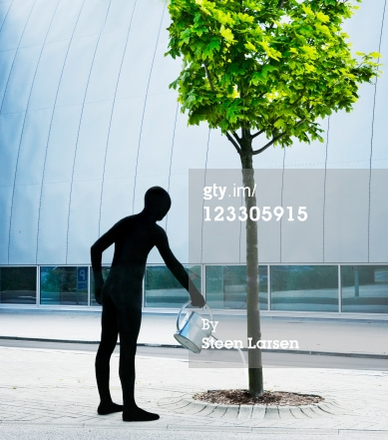
Remedial Actions “GMT”…!!!
Grow
More
Trees

Slide 22
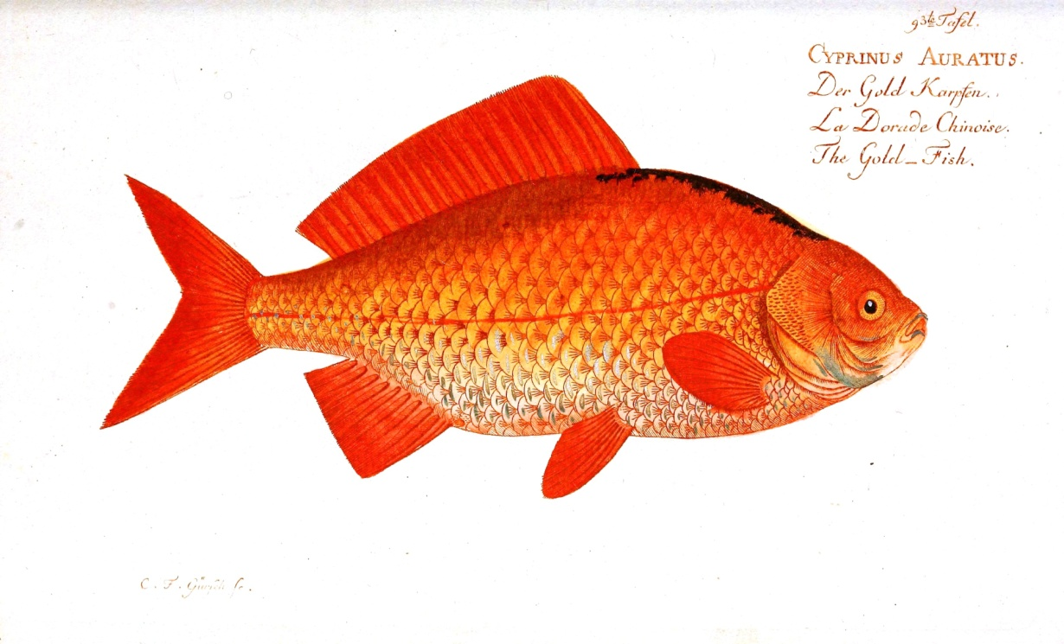
Remedial Actions “PSF”…!!!
Protect
Sea
Friends

Slide 23
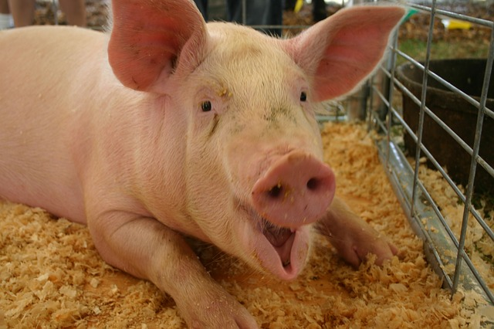
Remedial Actions PNF…!!!
Protect
Nature
Friends

Slide 24
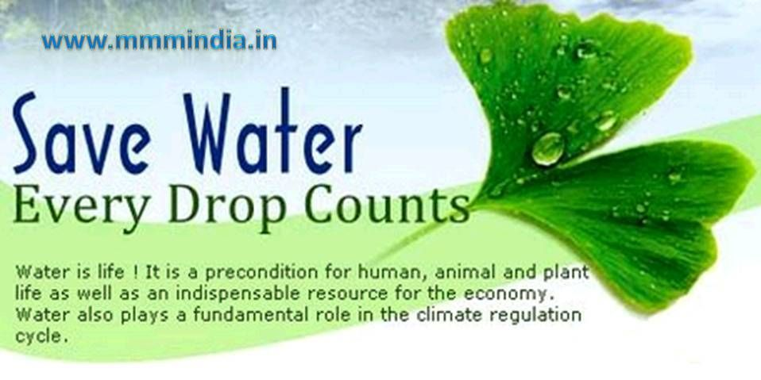
Remedial Actions SW…!!!

Slide 25
Future Effects…!!!
Global Warming;
Reduction/ Deletion of Ozone Layer;
Risk of Black Hole;

Slide 26
Legal Provisions Regarding EP…!!!
Wild Life Protection Act, 1972;
Forest Conservation Act, 1980;
Prevention & control of Pollution Act, 1974;
Environment Protection Act, 1986;

Slide 27

Remedial Actions EC
Everybody’s
Contribution
Let’s Pledge

Slide 28
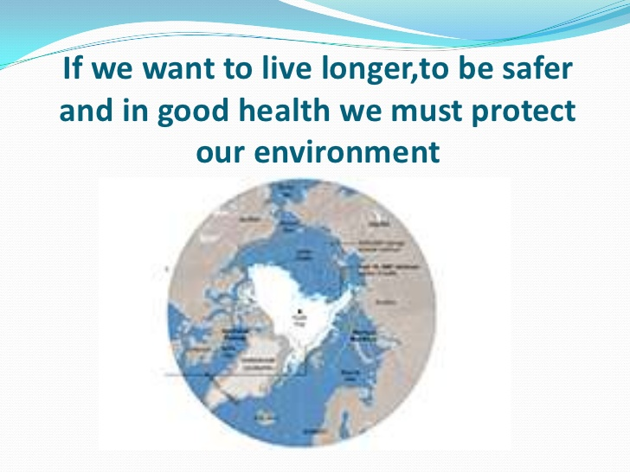
If we want to live longer, to be safer and in good health we must protect our environment…!!!

Slide 29

THANK YOU !
SEE
U
NEXT
TIME
Dr. Harish Kumar Gupta

