Slide 1


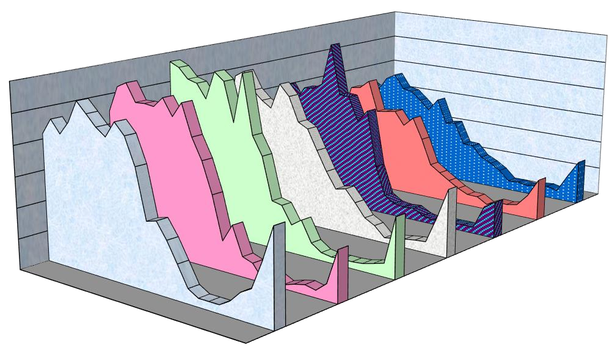
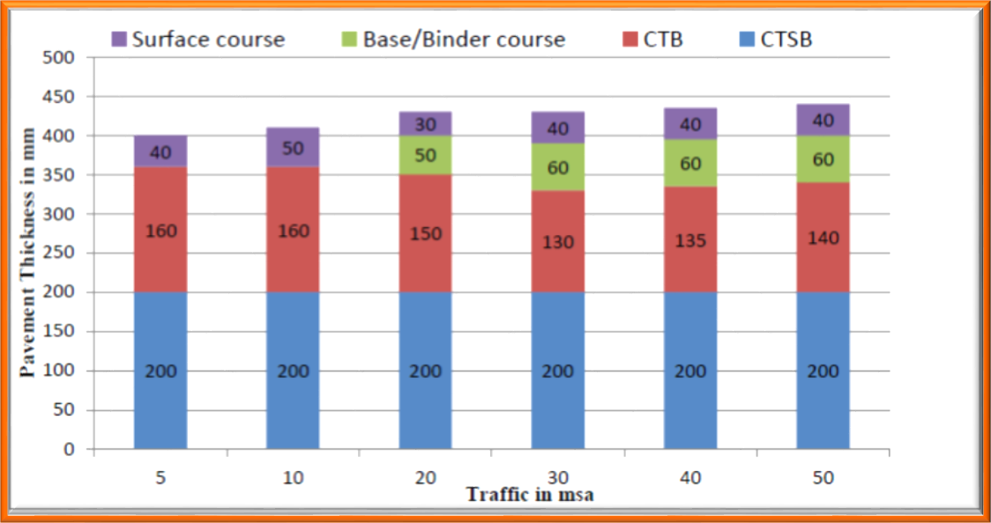

Consultancy Services for Project Management including Construction of High Altitude Hill Roads to “Border Road Organisation” (BRO) under Ditte – Dimme – Moying – Migging Road in the State of Arunachal Pradesh Package – III.
“Initial Environmental Examination” (IEE) Report, Ditte – Dimme – Moying – Migging Road,
BRO (PROJECT – BRAHMANK) – Roads,
Daily Variation of Traffic Volume for 7 Days
600
31-01-16
500
400
300
200
100
0
01-02-16
02-02-16
03-02-16
04-02-16
05-02-16
8-9
11-12
14-15
17-18
06-02-16
20-21
23-00
2-3
5-6
Figure 20 (a): Daily Variations of Traffic Volume at Ditte (Chainage 142+020) to Dimme
– Migging (Chainage 167+100) on Projected Road.
Figure 20 (b): Catalogue for Pavement with Bituminous Surface with CTSB, CTB and SAMI – Effective CBR 10% (Plate – 22).
Table 20: Details of Reserved Forest with Existing and Design Chainage.
Sr. No. | Existing Chainage |  | Design Chainage |  | Length (Km) | Type of Forest
 | Km | Km | Km | Km
1. | 92+250 | 113+650 | 142+020 | 167+100 | 25.080 | Reserved Forest
2. | 113+650 | 142+020 | 167+100 | 189+100 | 22.000 | Reserved Forest

Slide 2
Consultancy Services for Project Management including Construction of High Altitude Hill Roads to “Border Road Organisation” (BRO) under Ditte – Dimme – Moying – Migging Road in the State of Arunachal Pradesh Package – III.
“Initial Environmental Examination” (IEE) Report, Ditte – Dimme – Moying – Migging Road,
BRO (PROJECT – BRAHMANK) – Roads,
The GOI Vide Letter NO. I5 – 2 (03) 12018 – CAMPA dtd. 27 lLl/ 2018 has approved APO 2018 – 19 for an amount of Rs. 259.15 Crore duly approved by Steering Committee in its meeting held on 9th September 2018 for 2017 – 18 and 2018 – 19 vide letter NO. FOR. 01 – 65/ Cons/ 09/ Pt – V/ l07 ll – 20 dtd. 13/ 09/ 2018.
Forest Resources Recorded Area
The recorded forest area in the State is 51,540 Sq. Km., which is 61.55% of the geographical area. Per capita forest in the State is estimated to be about 6.00 Hectare as against national average of 0.10 Hectare. Reserved Forests, Protected Forests and Unclassed Forests constitute 20.460, 18/ 9% and 61.05% of the total forest area respectively. Of the total forest area, 5.138 Million Hectare is State – owned and only 15,500 Hectare are under private ownership as per Data State of Forests Report of “Forest Survey of India” (FSI), Dehradun (Table 21).
Table 21: Details of Classification of Recorded Forests in Arunachal.
Sr. No. | Category of Recorded Forests | Area (Sq. Km) | %age of Recorded Forests | %age of Geographical Area
1. | Reserved Forests | 10,089.99 | 19.58 | 12.05
2. | Protected Plot | 07.80 | o0.02 | o0.01
3. | Anchal Reserve Forests | 325.13 | o0.63 | o0.39
4. | Village Reserve Forests | 300.24 | o0.58 | o0.36
5. | National Parks | 2,468.23 | o4.79 | o2.95
6. | Wildlife Sanctuary | 2,468.23 | 14.33 | o8. 82
7. | Orchid Sanctuary | 100.00 | o0.19 | o0.12
8. | Un – Classified Forests | 0,860.86 | 59.88 | 36.85
 | Total | 51,540.00 | 100.00 | 61.55
Protected Areas
There are 2 (Two) National Parks, 11 (Eleven) Wildlife Sanctuaries and 8 (Eight) Community Reserve in the State covering an area of 2,468.235 Sq. Km. and 7, 487.75 Sq. Km. respectively. The protected area constitutes 11.89% of the geographical area of the State. Arunachal Pradesh has three “Tiger Reserves” (Namdapha, Pakke and Kamlang) covering 3630.185 Sq. Km. In addition, the State has a biosphere reserve named “Dihang – Dibang Biosphere Reserve”, with an area of 5,112 Sq. Km. situated in the higher reaches of “West Siang, Upper Siang and Dibang Valley” Districts of the State.
Forest Cover
The forest cover of the State, based on interpretation of satellite data of November, 2006 – January 2007, is 67,353 Sq. Km., which is 80.43% of the State's geographical area. In terms of forest canopy density classes, the State has 20,858 Sq. Km. very dense Forests, 31,556 Sq. Km. moderately dense forests and14, 939 Sq. Km. open. The district – wise forest cover as per latest State of Forests of “Forest Survey of India” (FSI), Dehradun (Tables 22 to 24):
Table 22: Satellite Data Details of Forest Cover in Arunachal.
Sr. No. | District | Geographical Area (Sq. Km) | Very Dense Forests | Mode of Dense Forests | Open Forests | Total | %age of Geographical Area | Scrub
1. | Changlans | 4,662 | 1,864 | 1.460 | 931 | 4,255 | 91.27 | 00
2. | Dibang Valley and Lower Dibang Valley | 13,029 | 1,696 | 4,999 | 2,622 | 9,317 | 71.51 | 05

Slide 3
Consultancy Services for Project Management including Construction of High Altitude Hill Roads to “Border Road Organisation” (BRO) under Ditte – Dimme – Moying – Migging Road in the State of Arunachal Pradesh Package – III.
“Initial Environmental Examination” (IEE) Report, Ditte – Dimme – Moying – Migging Road,
BRO (PROJECT – BRAHMANK) – Roads,
3. | East Kameng and West Kameng | 11,556 | 3,420 | 4,648 | 2,192 | 10,260 | 88.79 | 35
4. | Lohit and Anjaw | 11,042 | 1,966 | 4,040 | 1,625 | 7,631 | 66.93 | 00
5. | Papum Pare | 3,462 | 990 | 1,556 | 703 | 3,249 | 93.85 | 00
6. | East Siang | 3,655 | 884 | 1,281 | 637 | 2,802 | 76.66 | 00
7. | Upper Siang | 7,050 | 1,633 | 2,633 | 1,325 | 5,597 | 79.39 | 02
8. | West Siang | 7,813 | 2,477 | 2,741 | 1,501 | 6,719 | 86.00 | 00
9. | Lower Subansiri and Kurung Kumey | 9,548 | 3,007 | 4,250 | 1,424 | 8,675 | 90.86 | 28
10. | Upper Subansiri | 7,032 | 1,876 | 2.749 | 1,185 | 5,810 | 82.62 | 25
11. | Tawang | 2,172 | 366 | 484 | 375 | 1.225 | 56.40 | 16
12. | Tirap | 2,362 | 679 | 715 | 419 | 1,813 | 76.76 | 00
 | Total | 83,743 | 20,858 | 3 1.5 56 | 14,939 | 67,353 | 80.43 | 111
Table 23: Forest and Tree Cover in Arunachal.
Sr. No. | Category | Area (Sq. Km) | %age of Geographical Area
1. | Forest Cover | 67.353 | 80.43
2. | Tree Cover | 592 | 0.71
3. | Forest and Tree Cover | 67,945 | 81.14
 | Total | 68,604.35 | 162.28
Table 24: Summary of Outlay for 2017 – 18 and 2018 – 19; Compensatory Afforestation, Wildlife and Biodiversity Conservation in Arunachal.
Sr. No. | Particulars | Outlay for 2017 – 2018 and 2018 | Outlay for 2018 – 2019
1. | Compensatory Afforestation | 2,152.493 | 2,452.268
2. | Net Present Value (NPV) | 10,240.09 | 9,946.57
3. | CAT Plan | ------- | 965.191
4. | Wildlife and Biodiversity | 39.73 | 35.08
5. | Wildlife Conservation | 82.639 | -------
 | Total | 12,541.95 | 13,399.11
ROAD JUNCTIONS/ INTERSECTIONS
Major Bridge/ Minor Bridge/ Submergence and Cross Drainage Work Structures
There is 00 Nos. Vented Cause Way (VCW), 02 Nos. of Flush Causeway, 01 Nos. of Hume Pipe Culvert (HPC), and 63 Nos. Culverts, 00 Nos. of (Arch) Minor Bridges, and 03 Nos. of Minor Bridges along the Existing Road. During inventory and condition survey, the details of culverts wise Improvement Proposal containing Rehabilitation, Widening or Reconstruction. Crust design has been done based on the field CBR evaluated from the samples collected from site during field survey at every 1.0 Km interval and critical CBR has been adopted for crust design in accordance with IRC – 37: 2012, using 10% CBR for sub grade and from the curves

Slide 4
Consultancy Services for Project Management including Construction of High Altitude Hill Roads to “Border Road Organisation” (BRO) under Ditte – Dimme – Moying – Migging Road in the State of Arunachal Pradesh Package – III.
“Initial Environmental Examination” (IEE) Report, Ditte – Dimme – Moying – Migging Road,
BRO (PROJECT – BRAHMANK) – Roads,
as mentioned in IRC: 37 – 2012 pavement thickness were computed for the relevant million standard axles and pavement thickness required for the above designed MSA and as per IRC guidelines is shown in following Tables 25 (a) to (c).
Table 25 (a): Crust/ Pavement Composition Ditte – Dimme – Migging Road.
Sr. No. | Section | Adopted (MSA) | CBR (%) | Crust/ Pavement Composition (mm)
 |  |  |  | BC | DBM | WMM | GSB
A | B | C | D | E | F | G | H
1. | Ditte – Dimme – Migging Road | 05 | 08% | 40 | 60 | 200 | 200
Table 25 (b): Soil Classification Ditte – Dimme – Migging Road.
Chainage |  | Type of Soil
From | To
0,000 | 1,450 | Ordinary Rock
1,450 | 2,150 | All Kind of Soil
2,150 | 3,170 | Hard Rock
3,170 | 4,560 | All Kind of Soil
4,560 | 5,750 | Ordinary Rock
5,750 | 7,760 | Hard Rock
7,760 | 8,950 | Ordinary Rock
8,950 | 9,980 | All Kind of Soil
9,980 | 11,250 | Hard Rock
11,250 | 13,560 | Ordinary Rock
13,560 | 14,630 | All Kind of Soil
13,560 | 16,645 | Hard Rock
The “Place Janbo” is spread in valley which is surrounded by high hills on East and West side. “Army Training Camp” is the last point of project stretch and is spread on a wide flat ground (plateau) surrounded by high hills and it is more or less “16.00 Km” from “Dimme – Migging”. The remaining portion of the project stretch is traversing in hilly terrain “Ditte” (10,298.56 Feet in Height) and ends at “Dimme – Migging” (Approximately 16,633.86 Feet in Height).
Table 25 (c): Existing Bridges, Cross Drainage and Culverts Structures.
Type of Structure (TS) | Major Bridges (MB) | Minor Bridges (MB) | Slab/ Arch/ Box Culvert (S/ A/ BC) | Vented Cause Way (VCW) | Hume Pipe Culvert (HPC) | Flush Cause Way (FCW)
A | B | C | D | E | F | G
Existing Structure 70 Nos. | 00 | 03 | 64 | 02 | 01 | 00
Table 25 (d): Details of Minor Bridge Structures (Bailey Bridge).
Sr. No. | Location | Details of Existing Structures
 |  | Type of Existing Structure | Number of Span × Length of Span | Width of Structure (M) | Condition of Structure | Type of Bridge
A | B | C | D | E | F | G
1. | 146+460 | MNB | 1 × 24.5 | 5.50 | Poor | Bailey Bridge
2. | 160+130 | MNB | 1 × 24.5 | 5.50 | Poor | Bailey Bridge
3. | 160+270 | MNB | 1 × 40.0 | 5.00 | Poor | Bailey Bridge

Slide 5
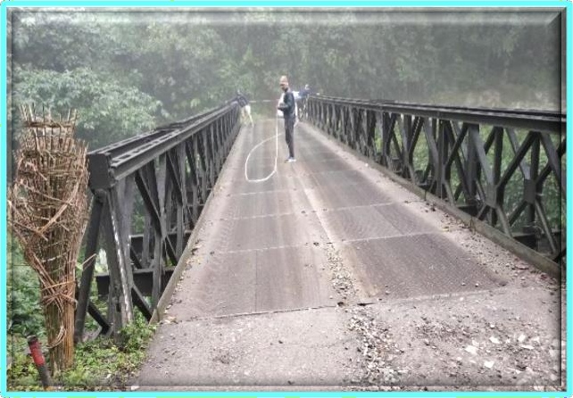
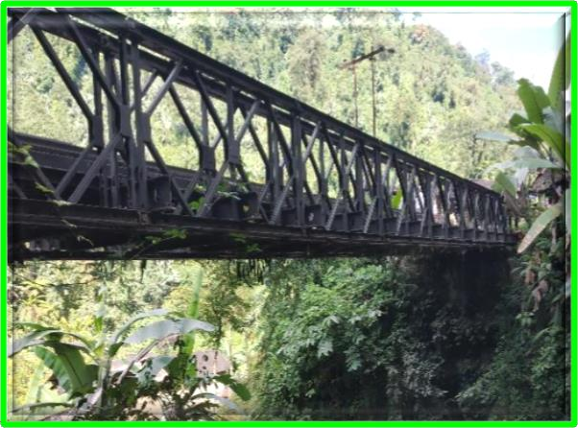
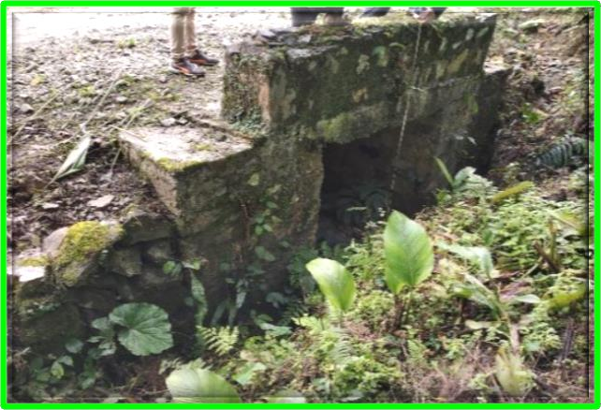
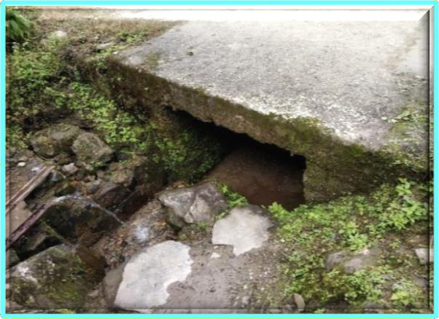
Consultancy Services for Project Management including Construction of High Altitude Hill Roads to “Border Road Organisation” (BRO) under Ditte – Dimme – Moying – Migging Road in the State of Arunachal Pradesh Package – III.
“Initial Environmental Examination” (IEE) Report, Ditte – Dimme – Moying – Migging Road,
BRO (PROJECT – BRAHMANK) – Roads,
Table 25 (e): Details of Existing HPC Culvert Structures.
Sr. No. | Location | Details of Existing Structures
 |  | Type of Existing Structure | Number of Span/ Pipe × Length of Span/ Diameter | Width of Structure (M) | Condition of Structure
A | B | C | D | E | F
1. | 142+550 | HPC | 1 – ROW – 450 | 7.20 | Poor
Table 25 (f): Details of Existing FCW Culvert Structures.
Sr. No. | Location | Details of Existing Structures
 |  | Type of Existing Structure | Number of Span/ Pipe × Length of Span/ Diameter | Width of Structure (M) | Condition of Structure
A | B | C | D | E | F
1. | 155+300 | FCW | 10.0 M | 7.0 | Poor
2. | 165+300 | FCW | 10.0 M | 6.8 | Poor
Minor Bridge at Chainage: 146+460. | Minor Bridge at Chainage: 160+130.
Slab at Chainage: 150+170. | Slab at Chainage: 164+830.

Slide 6
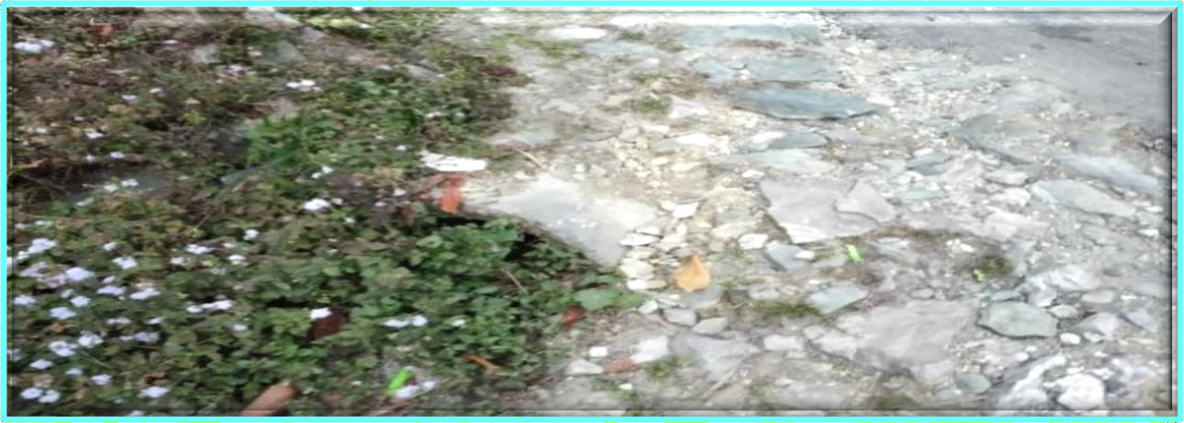
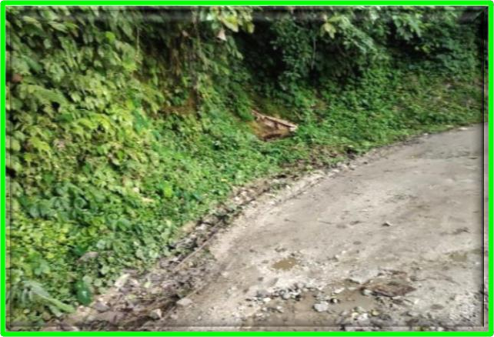
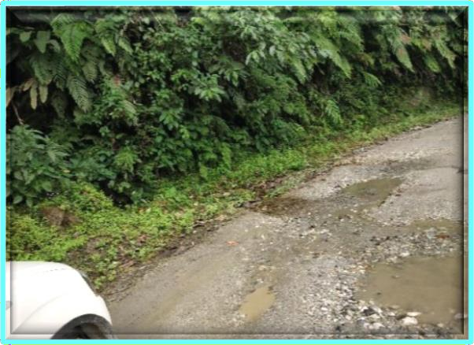
Consultancy Services for Project Management including Construction of High Altitude Hill Roads to “Border Road Organisation” (BRO) under Ditte – Dimme – Moying – Migging Road in the State of Arunachal Pradesh Package – III.
“Initial Environmental Examination” (IEE) Report, Ditte – Dimme – Moying – Migging Road,
BRO (PROJECT – BRAHMANK) – Roads,
HPC at Chainage: 142+550.
FCW at Chainage: 155+350. | FCW at Chainage: 165+300.
TRAFFIC: Characteristics on Projected Road
In this chapter, the report is concerned about Ditte – Dimme – Migging Road. Traffic Survey Locations and Schedules were, as given below (Table 26):
Table 26: Classified Different Average Daily Traffic (ADT) Surveys and Dates of Commencement at Two Locations.
Location/ Chainage (Km) | Date of Traffic Survey |  |  | Duration
 | From | To
DITTE – DIMME – MIGGING
Classified Traffic Volume Count
Near Moying/ 94+000 | 07/ 12/ 2018 |  | 13/ 12/ 2018 | 7 Days/ 24 Hours
Near Janbo/ 145+000 | 07/ 12/ 2018 |  | 13/ 12/ 2018 | 7 Days/ 24 Hours
Survey Location | Average Daily Traffic |  | Average daily PCUs
Near Moying | 165 |  | 198 | -------
Near Janbo | 116 |  | 166 | -------
Type of Vehicles | Survey Location
 | (Km 94+000) |  | (Km 145+000)
AA | BB |  | CC | DD
2 – Wheeler | 76 |  | 32 | -------

Slide 7
Consultancy Services for Project Management including Construction of High Altitude Hill Roads to “Border Road Organisation” (BRO) under Ditte – Dimme – Moying – Migging Road in the State of Arunachal Pradesh Package – III.
“Initial Environmental Examination” (IEE) Report, Ditte – Dimme – Moying – Migging Road,
BRO (PROJECT – BRAHMANK) – Roads,
3 – Seater | 05 | 00 | -------
Car/ Vans/ Jeeps (Taxi) | 35 | 33 | -------
Mini Bus | 00 | 00 | -------
LCVs | 13 | 14 | -------
2 – Axle Trucks | 10 | 09 | -------
3 – Axle Trucks | 00 | 00 | -------
Multi Axle Trucks | 00 | 00 | -------
Tractor | 00 | 00 | -------
Tractor with Trailer | 02 | 06 | -------
Cycle | 00 | 00 | -------
Cycle Rickshaw | 00 | 00 | -------
Army Car | 05 | 10 | -------
Army Bus | 01 | 00 | -------
Army Truck | 18 | 10 | -------
Others | 00 | 00 | -------
Total | 165 | 114
Capacity Analysis
Capacity analysis for section has been carried out in order to define the “Level of Service” (LOS) offered by road sections under the prevailing roadway and traffic conditions. Capacity and design service volumes for various lane configurations specified by IRC: 64 – 1990: “Capacity of Roads in Rural Areas” (CRRA) has been adopted for determining the Level of Service offered by the road sections during design period. Standards for lane width of National Highways and Road developed under Central Sector Schemes in Hilly and Mountainous terrains in circular No.: NH – 150/ 28/ 2018 – P and M Dated, 23rd March 2018 (Table 27).
Table 27: Categorized Average Daily Traffic (ADT) Inventory Reviews and Periods of Instigation at Two Locations.
AVERTAGE DAILY TRAFFIC INVENTORY SURVEY (Date: 07.12.2018 to 13.12.2018)
Road Name: Ditte – Dimme – Migging
Section : Ditte – Dimme – Migging From Km 94+000 To 145+000 Km. |  |  |  |  |  |  |  |  | Direction: Bothways
Location (Km) | Motorised Traffic |  |  |  |  |  |  |  |  |  |  |  |  |  | Non – Motorised Traffic |  | Grand Total
 | Passenger Vehicles |  |  |  |  | Goods Vehicles |  |  |  | Agricultural |  | Army Vehicles |  |  | Passenger
 | Two Wheeler | Three Wheeler | Car/ Jeep | Mini Bus | Bus | Tempo/ LCV | Road Trucks |  |  | Tractor with Trailer | Tractor | Army Car | Army Bus | Army Trucks | Cycle | Cycle Rickshaw | ADT | PCU
 |  |  |  |  |  |  | 2 – Axle | 3 – Axle | M – Axle
PCU Factor | 0.5 | 1.0 | 1.0 | 1.5 | 3.0 | 1.5 | 3.0 | 3.0 | 4.5 | 4.5 | 1.5 | 8.0 | 4.0 | 3.0 | 0.5 | 2.0 | ----- | -----
94+000 | 76 | 05 | 35 | 00 | 00 | 13 | 10 | 00 | 00 | 0.2 | 00 | 5.o | 1.o | 18 | 00 | 00 | 165 | 198
145+000 | 32 | 00 | 33 | 00 | 00 | 14 | 09 | 00 | 00 | 06 | 00 | 10 | 00 | 10 | 00 | 00 | 114 | 165
Average of All Locations | 54 | 03 | 34 | 00 | 00 | 14 | 10 | 00 | 00 | 04 | 00 | 08 | 01 | 14 | 00 | 00 | 140 | 182

Slide 8
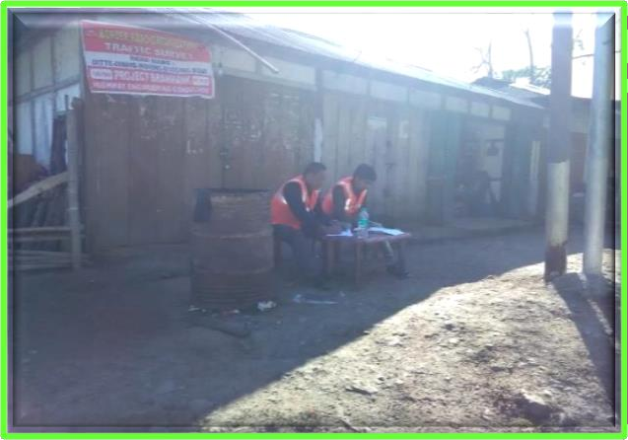
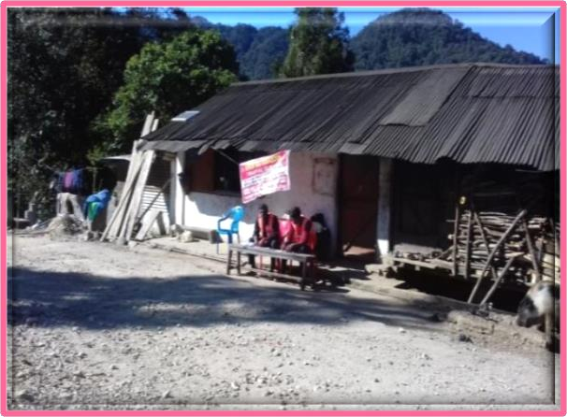
Consultancy Services for Project Management including Construction of High Altitude Hill Roads to “Border Road Organisation” (BRO) under Ditte – Dimme – Moying – Migging Road in the State of Arunachal Pradesh Package – III.
“Initial Environmental Examination” (IEE) Report, Ditte – Dimme – Moying – Migging Road,
BRO (PROJECT – BRAHMANK) – Roads,
Near Moying at Km 94+000
Survey was carried out in Moying Village (94+000). ADT recorded at this station is 165 Nos. / 198 PCU. Fast moving vehicles were recorded as 100% of the Total Traffic (in PCU). Peak hour traffic low is 31 Nos. formed around 18.79% of the total traffic. Peak hour is identified during 2:00 to 3:00 PM.
Near Janbo at Km 145+000
Survey was carried out in Janbo village (145+000). ADT recorded at this station is 116 Nos. / 166 PCU. Fast moving vehicles were recorded as 99.05% of the total traffic (in PCU). Peak hour traffic flow is 16 Nos. formed around 14.40% of the total traffic. Peak hour is identified during 11:00-12:00 AM.
Survey was carried out in “Moying and Janbo Village” (94+000 and 145+000) and “Average Daily Traffic” (ADT) recorded at this station is 165 Nos. / 198 and 116 Nos. / 166. “Passenger Car Unit” (PCU). Fast moving vehicles were recorded as 100% and 99.05% of the Total Traffic (in PCU). Peak hour traffic flow of 31 Nos. formed around 18.79% and 14.40% of the total traffic and peak hour is identified during 2:00 to 3:00 PM and 11:00 to 12:00 AM respectively.
Classified Traffic Continuous Volume Count (TCVC) Survey
The objective of “Traffic Continuous Volume Count” (TCVC) survey is to estimate traffic intensity on the projected road. The classified volume count surveys have been carried out for 7 Days, 24 Hours. The traffic is counted in number of vehicles by vehicle category – wise in each direction over 24 Hrs a day for 7 Days. The counts were recorded in the formats as per IRC – specifications. Classified volume count survey has been carried out at two locations the details are given above in the Table 27. Reconnaissance survey was conducted on the Projected Road for selection of locations for various traffic surveys. While selecting the traffic volume survey location, consultants have considered the aspect of private sector participation in this road development and accordingly, the locations were selected. The first location has been selected near Moying Village at Chainage 94+000, the second TCVC location has been chosen near Janbo Village at Chainage 145+000 respectively.
At Chainage: 94+000 (TVC – 1). | At Chainage: 145+000 (TVC – 1).
“Traffic Continuous Volume Count” (TCVC)
Axle Load Survey
The vehicle damage factor is a multiplier for converting the number of commercial vehicles of different axle loads to the number of standard axle load repetitions. Design of new pavement for additional lane or strengthening of existing pavement is based upon the cumulative number of 80 KN (IRC – 37 – 2018 Clause No. 4.4.2) “Equivalent Standard Axles” (ESA) that will pass over during the 15 – year design period. The classes of traffic which lead to significant axle loads (or damage) to the pavement and accordingly considered for design are: LCVs, Two/ Three axle and Multi Axle Trucks. “Cumulative Standard Axles” (CSA) are calculated in accordance with the guidelines provided in IRC: 37 – 2018 and IRC: 81 – 1997. The overloaded vehicles have serious adverse impact on performance of pavement (Tables 28 to 30). It has been ascertained that the damaging effect of axles on flexible pavement is approximately proportional to the fourth power of the axle load (IRC – 37 – 2018 Clause No. 4.4.3).

Slide 9
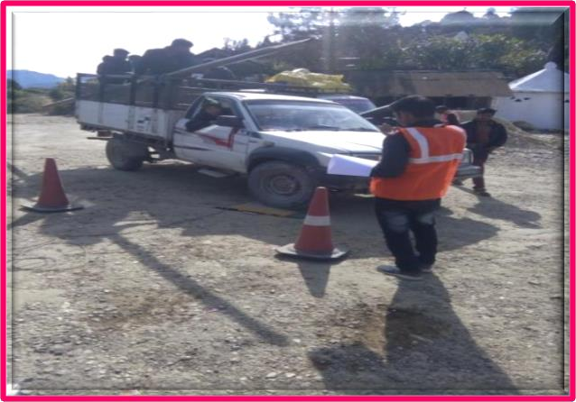
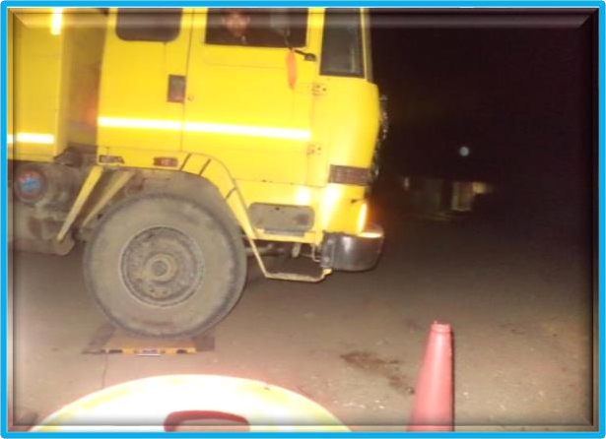
Consultancy Services for Project Management including Construction of High Altitude Hill Roads to “Border Road Organisation” (BRO) under Ditte – Dimme – Moying – Migging Road in the State of Arunachal Pradesh Package – III.
“Initial Environmental Examination” (IEE) Report, Ditte – Dimme – Moying – Migging Road,
BRO (PROJECT – BRAHMANK) – Roads,
At Chainage: 145+000 (Axel Load Survey).
The “Equivalent Single Axle Loads” (ESALs) have been calculated assuming that the project road will be opened to traffic in the year 2022.
Table 28: Classified “Variable Frequency Drive” (VFD) Surveys of Commencement at Two Locations.
LOCATION | DIRECTION | Commercial Vehicle
 |  | LCV | 2 – AXLE | 3 – AXLE | MAV
AA1 | BB1 | CC1 | DD1 | EE1 | FF1
145+000 | Moying to Migging | 00.0066 | 02.0039 | 142.0200 | 142.0200
 | Migging to Moying | 00.0086 | 01.6776 | 142.02000 | 142.0200
Adopted Maximum VDF |  | 00.0086 | 02.0039 | 142.0200 | 142.0200
Table 29: Classified “Million Standard Axle” (MSA) Surveys of Commencement at Two Locations.
Name of the Road | MSA for 15th (145+000) | Adopted Design MSA
Moying – Migging Road | 0.49 | 10
Table 30: Proposed Truck Bay in Arunachal Pradesh State.
Sr. No. | Existing Chainage | Design Chainage | Remarks
1. | 145+260 | 132+500 | Up to Mark
Muck Disposal Area and Camp Site
Tentatively four locations has identified during Site Survey along the Project Road for muck disposal
Figure 21. The same will be ascertained during land acquisition survey (Table 31).
Table 31: Muck Disposal Area and Camp Site in Arunachal Pradesh State.
Sr. No. | Existing Chainage |  | Design Chainage |  | Area in Hectare
1. | 145+030 | 145+430 | 132+260 | 132+660 | 2.0
2. | 152+010 | 152+630 | 139+000 | 139+600 | 3.5
3. | 158+550 | 159+030 | 144+730 | 145+150 | 2.0
4. | 163+050 | 163+600 | 148+900 | 149+460 | 3.5

Slide 10
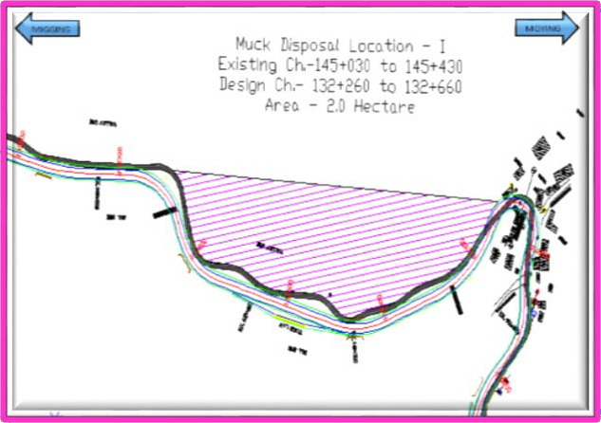
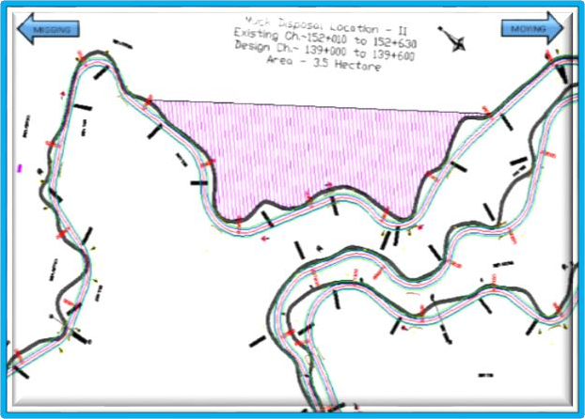
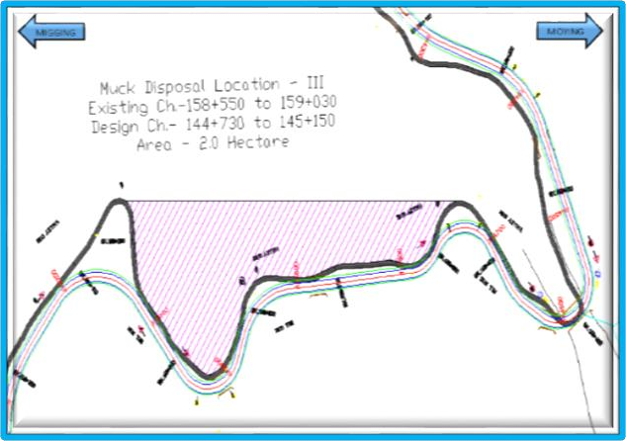
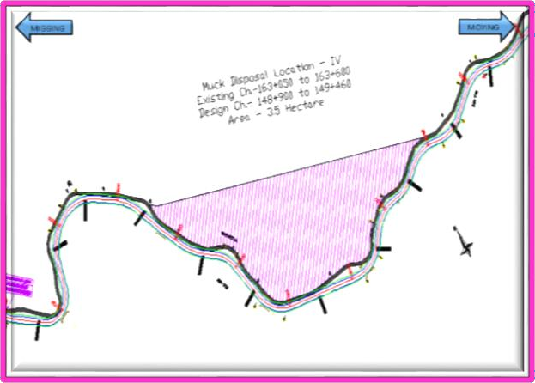
Consultancy Services for Project Management including Construction of High Altitude Hill Roads to “Border Road Organisation” (BRO) under Ditte – Dimme – Moying – Migging Road in the State of Arunachal Pradesh Package – III.
“Initial Environmental Examination” (IEE) Report, Ditte – Dimme – Moying – Migging Road,
BRO (PROJECT – BRAHMANK) – Roads,
Location – I | Location – II
Location – III | Location – IV
Figure 21: Muck Disposal Area and Camp Site.
Traffic Growth Rate
The growth rates estimates were subjected to scenario analysis and the most likely case was adopted for the purpose of the present study. The traffic growth estimates scenario is based on the likely growth of the Indian economy and its relationship to the growth in the state economy. Information presented in the study area reveals that traffic growth is more than 7% in initial years of the project. Adopted growth rate is 5% Ref. IRC – 37, 2018, Page No. 14 Clause 4.2.2 for commercial vehicles along the Section. The growth of remain traffic moving vehicles is taken as 5% “Reference: Ministry of Shipping, Road Transport and Highways, (18th January, 2008 Reference No. RW/ NH – 37011/ 57/ 2006 – PIC) 5% Traffic Growth Rate.” Summary of projected traffic based on adopted growth rate is provided in Table 32 given below:
Table 32: Projected Traffic Volume, Vehicle/ Day and PCU/ Day Moying – Migging Road.
Project Road | Year 2018 | Year 2021 | Year 2026 | Year 2031 | Year 2036
AA2 | BB2 | CC2 | DD2 | EE2 | FF2
Projection of “Average Daily Traffic” (ADT)
Total Fast Moving Vehicle (Motorised Traffic) | 140 | 177 | 227 | 290 | 370
Slow Moving Vehicle (Non – Motorised Traffic) | 000 | 000 | 000 | 000 | 000
Traffic (Number) | 140 | 177 | 227 | 290 | 370
Projection (PCUs/ Day) | (182) | (231) | (295) | (376) | (480)
Note: Values in bracket indicate PCUs/ Day;

Slide 11
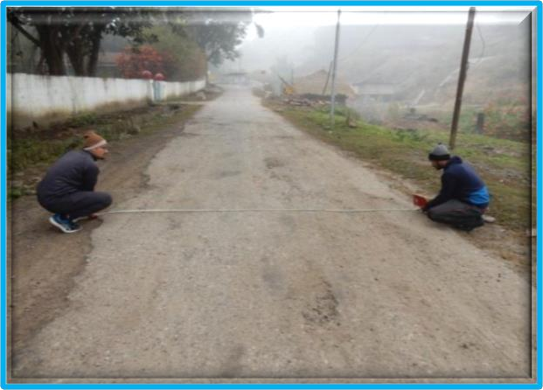
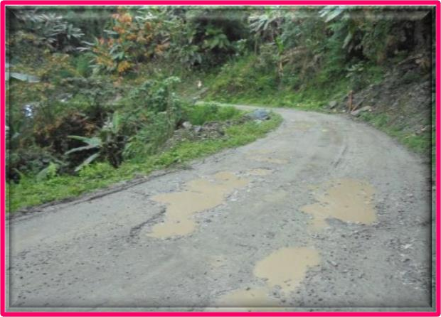
Consultancy Services for Project Management including Construction of High Altitude Hill Roads to “Border Road Organisation” (BRO) under Ditte – Dimme – Moying – Migging Road in the State of Arunachal Pradesh Package – III.
“Initial Environmental Examination” (IEE) Report, Ditte – Dimme – Moying – Migging Road,
BRO (PROJECT – BRAHMANK) – Roads,
PAVEMENT COMPOSITIONS/ CONDITIONS
The flexible pavement is adopted for proposed carriageway reconstruction and Flexible Pavement
design period of 15 year. That has been designed as per “IRC 37: 2018”. The proposed pavement design
standard is presented in table given below and hence the “Design of Proposed Better Crust Thickness
for Flexible Pavement Composition” as is shown in the Table 30. The condition survey of existing pavement includes the assessment of pavement, shoulder, embankment and drainage condition. In pavement condition data regarding pavement distress like cracking, ravelling, potholes are recorded in terms of pavement affected. The edge break is measured in length and rutting is measured in mm depth. Shoulder Condition is assessed as earthen shoulder, corrugation or ruts development in mm and shoulder edge drop in mm.
Existing Pavement Condition and Composition.
Reconstruction Proposal
In order to meet future traffic requirement, the existing carriageway is proposed to upgrade to achieve high speed of travel with comfort and safety. Concentric widening scheme shall be followed to minimise land acquisition issues and to ensure maximum utilisation of existing carriageway. Tables 33 to 35 given below shows relation between existing and proposed chainage and section wise improvement proposed for these section.
Table 33: Design of Existing Chainage for Homogenous Section.
Sr. No. | Homogenous Section | Existing Chainage |  | Length (Km)
 |  | From | to
1. | Package No. – I | 142+020 | 113+650 | 21.400
2. | Package No. – II | 113+650 | 142+020 | 28.370
3. | Package No. – III | 142+020 | 167+100 | 25.080
4. | Package No. – VI | 167+100 | 167+100 | 22.000
 | Total Length in Km |  |  | 96.850
Table 34: Design of Existing – Proposed Chainage for Homogenous Section.
Sr. No. | Homogenous Section | Existing Chainage |  | Proposed Chainage
 |  | From | to | From | to
1. | Package No. III | 142+020 | 167+100 | 129+310 | 152+810

Slide 12
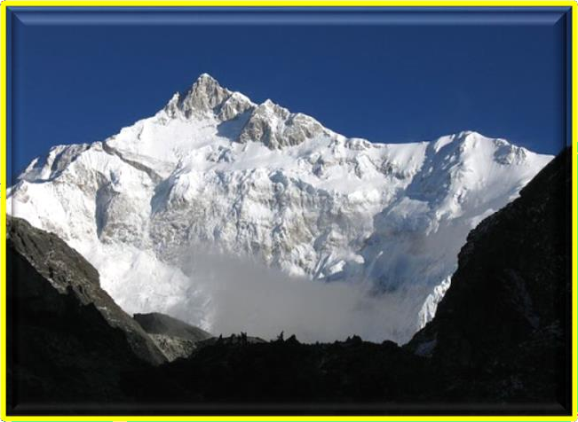
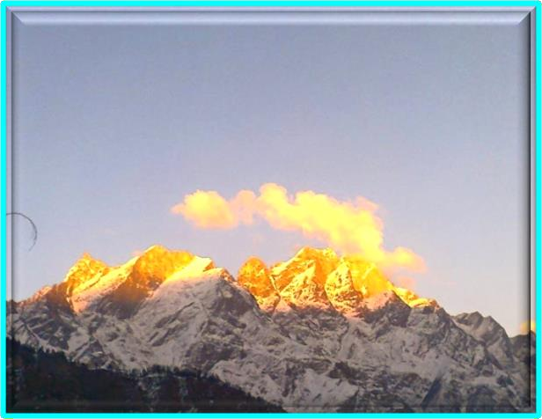
Consultancy Services for Project Management including Construction of High Altitude Hill Roads to “Border Road Organisation” (BRO) under Ditte – Dimme – Moying – Migging Road in the State of Arunachal Pradesh Package – III.
“Initial Environmental Examination” (IEE) Report, Ditte – Dimme – Moying – Migging Road,
BRO (PROJECT – BRAHMANK) – Roads,
Table 35: Design of Proposed Better Crust Thickness for Ridge Pavement Composition.
Sr. No. | Section | CVPD |  |  |  | CBR | Pavement Composition (mm)
 |  | Present Year 2017 | Base Year 2020 | 15 Year | 30 Year | (%) | BC | DBM | CRM | GSB
1. | Ditte – Dimme – Migging Road | 453 | 514 | 1,068 | 2,220 | 10% | 40 | 60 | 200 | 200
ENVIRONMENTAL IMPACT ASSESSMENT OF THE PROJECT
The environmental impact assessment has been carried out and which is based on status of the environment, and impact of proposed four lanning roads/ bridges based on these findings of the “Environmental Management Plans” (EMPs) have been prepared for the implementation in the project. Following section discusses status of the environment, and its complementary impact assessment work plan assigned to “Environmental Management Plans” (EMPs) required for the project development/ implementation system and process.
BASELINE ENVIRONMENTAL INDEX AND STATUS
Demographic and Climatic Conditions
Arunachal has been rated top in the “Planning Commission's Green Ranking” based on quality of air and water, waste management, forest cover and climate change. Environment performance will account for 2% of a state's overall performance. “The Measure is meant to be both an Incentive and Compensation to States for “Green Initiatives”. For allocating funds tied to environmental performance, the government has two options. The first is to devolve 2% of the gross budgetary support on the basis of the performance index. The second is to allocate funds by giving an additional weightage of 2% to the performance criteria of the “Gadgil Formula”. “The Himalayas is divided into five regions i.e., Punjab Himalayas, Kumaon Himalayas, Nepal Himalayas and Assam Himalayas. Himalayas are home to various snow – capped peaks, here is the list of some of the highest peaks of Arunachal”.

Slide 13

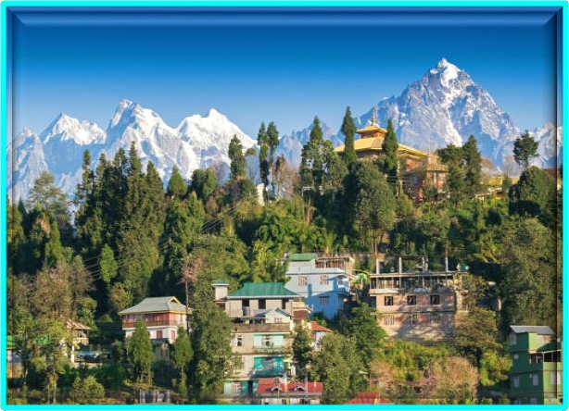
Consultancy Services for Project Management including Construction of High Altitude Hill Roads to “Border Road Organisation” (BRO) under Ditte – Dimme – Moying – Migging Road in the State of Arunachal Pradesh Package – III.
“Initial Environmental Examination” (IEE) Report, Ditte – Dimme – Moying – Migging Road,
BRO (PROJECT – BRAHMANK) – Roads,
Incredibly Best and Beautiful Hilly Areas in Arunachal Pradesh.
The people of Arunachal are warm, simple and friendly with a natural gaiety. The custom and rituals of Arunachalese are as diverse as the ethnic groups that inhabit the land. They have an impressive repertoire of folk songs and dances. People of Arunachal love to celebrated with a gay abandon and their way of life is inextricably bound up with nature along deep ravines and their valleys allowing monsoon to penetrate in the Northern most parts, which nourishes this “Garden of the Himalayas”. At higher altitudes, monsoon mist cling to huge tracts of lichen covered forest, where every conceivable species of Rhododendron and giant magnolia trees, conifers and beautiful flowering plants as Primulas, Gentians, Blue Poppies, Wild Strawberry, Raspberry. All over Arunachal forest and wilderness areas are inhabited by the Snow — Leopard, Thar, Yaks, Wild Ass in the Tibetan Pleatue, Bharal or Blue Sheep, Shapi and the symbol of Arunachal — the endangered Red Panda etc. Amidst the grandeur of the mountain peaks lush valleys, fast flowing rivers, Arunachal offers her visitors a rare and singular experience. Within a matter of an hour one can move from its sub – tropical heat of the lower valleys to the cold of the rugged mountain slopes that reach up to the areas of perpetual snow. An ideal time to visit the Arunachal place is from March to June and October to mid – December. Flowers take a breath taking landscape in April – May. October comes again with a new cycle of flowers. The sky is clear in November as one of the best times to enjoy the scenic splendour of Arunachal Pradesh. It is quite cold in March and December and the monsoon stays from end June to early September.
Climate
The climate of Arunachal Pradesh varies with elevation. The low altitude 100 Meter to 1,500 Meter have a “Humid Subtropical Climate” (HSC). High altitude and very high altitude areas (3,500 Meter to 5,500 Meter) have a subtropical highland climate and alpine climate. Arunachal Pradesh receives 2,000 Millimetres to 5,000 Millimetres (79 Inches to 197 Inches) of rainfall annually, 70% to 80% obtained between May and October. The climate of the state has been roughly divided into the tropical, temperature and alpine zones. For most of the period in a year, the climate is cold and humid as rainfall occurs in each month. The area experiences a heavy rainfall due to its proximity to the Bay of Bengal. The rainfall in North district is comparatively less than of the other districts. The general trend of decrease in temperature with increase in altitude holds good everywhere. Pre — monsoon rain occurs in April – May and monsoon (South — West) operates normally from the month of May and continues up to early October. The climate of project areas is on the whole dry, hot in summer and cold in winter. The year may be divided into five seasons in every state/ region of concern. Weather and Climate Index has a great influence on human activities and it affects on the life style of the population and reduces efficiency of work. Man has made great progress in the field of “Artificial Intelligence” as well as in the field of irrigation, but the food production is still controlled by the climatic condition of any region as a whole around the world. The cold season from March to December is followed by hot season, which lasts till the onset of the North – Westmonsoon. The monsoon withdraws by 15th September and is followed by the Post — Monsoon or the “Transition Period” (TP). Thunderstorms, in association with Pre — Monsoon and Monsoon rains occur mostly during June to September. During the winter also, a few thunderstorms occur in association with the Western Disturbances. A few thunderstorms may be accompanied by hail and hail storms. Occasional dust storm occurs during the hot season and contributes in increasing the level of “Suspended Particulate Matter” (SPM) in the upper atmospheric region, which causes increases of CO2 level and “Global Warming” and “Green House Effect” (GHE).

Slide 14
Consultancy Services for Project Management including Construction of High Altitude Hill Roads to “Border Road Organisation” (BRO) under Ditte – Dimme – Moying – Migging Road in the State of Arunachal Pradesh Package – III.
“Initial Environmental Examination” (IEE) Report, Ditte – Dimme – Moying – Migging Road,
BRO (PROJECT – BRAHMANK) – Roads,
Ditte – Dimme – Moying – Migging (दिते – दिम्मे – मोईगं – दमगदगंग)
Arunachal Pradesh is nestled in the upper Himalayan range and because of the altitude, experiences a tundra or alpine weather patterns. The temperature range hence remains between 8°C – 35°C. Visiting Arunachal can be a pleasant experience for visitors who generally face the heat of the mainland when travelling to other parts of India. The weather in Arunachal can be cool and refreshing and here are listed the details on the best time to visit Arunachal Pradesh. Arunachal is an ideal summer vacation destination for families, solo travellers and even adventure seeking honeymooners. With the temperatures ranging from 20°C – 35°C, it makes an ideal summer vacation for family, honeymooners and even for solo travellers. If travelling in summer, trek and go sightseeing around places like Tawang, Roing, Ziro, Namdapha National Park etc. and this is also the time to see wildlife in abundance in the wildlife reserves or bask in nature around the beautiful waterfalls and find peace in the many temples and monasteries around. Since summer is considered off – season, one can get the best deals on hotels and travel on budget. After summer in the hills, the monsoon season cools the land and nature is bountiful and beautiful. Though monsoon is short – lived, the overall region receives quite a bit of rainfall, close to 2,000 mm to 4,000 mm. At times there can be a sudden change in weather patterns though and often heavy showers and landslides are common. The adventure – seeking type, some tourist attractions that are not to be missed and experienced include Nuranang Falls and Bap Tenges Kang Waterfall. This is the ideal time to visit Arunachal as the weather is cool and pleasant; just the perfect season to go for a sightseeing expedition. Winter is surprisingly the ideal time to go as there is the special attraction of the winter festival. Nyokum Yullo and Chalo Loku are agricultural festivals celebrated during the month of February. Another draw is the Pangsau Pass Winter Festival, celebrated during the month of January, which is one of the most popular tourist attractions of the region.
Itanagar, October 13th: To speed up road projects in Shiyom and Siang Valleys, ADG (East) of BRO Dr. S. S. Porwal inspected and reviewed the progress of works on road from Tato to Manigaon and Bile to Migging. Emphasizing on timely completion of the road projects, Dr. Porwal informed that Ditte – Dime – Migging road would be improved to double lane specification in a time bound manner to ensure smooth mobility of armed forces. Appreciating the current pace of works in the light of difficult terrain and bad weather conditions, he stressed on the need to augment capacity to execute the works through local hiring of plants and machineries and recruitment of highly skilled workers. The Commander of 761 – BRTF S. K. Pradhan apprised the ADG (BR) of the steps taken to improve Moying – Janbo and Ditte – Dime – Yingkiong stretch of the road in last year and the current year’s planning to improve Boling – Ditte – Dime and Janbo – Migging Stretches. Brigadier C. C. Jaleel, Chief Engineer and Lt. Col. Sameer Malik also participated in the review meeting. Boarder Roads Organisation has 9 projects for road development in North Eastern States, out of which 4 Projects are in Aruchal Pradesh. In order to fast track the projects, the government has recently created the office of ADG (BR) East at Guwahati to oversee and facilitate road construction activities on NE states. Dr. S. S. Porwal, VSM is the first ADG (BR) to hold the assignment and was on a 4 days visit to Project Brahmank.
Economic Profile
Arunachal's gross state domestic product for 2004 is estimated at $ 6 Billion in current prices. Born out of partition of Uttar Pradesh, the new state of Arunachal produces about 8% of the output of the old Uttar Pradesh state. The Arunachal Pradesh is the second fastest growing state in India. It's “Gross State Domestic Product” (GSDP) (at constant prices) more than doubled from ₹ 24,786 Crores in FY 2005 to ₹ 60,898 Crore in Financial Year 2012. The real GSDP grew at 13.7% (CAGR) during the FY 2005 – FY 2012 period. The contribution of the service sector to the GSDP of Arunachal was just over 50% during FY 2012. Per capita income in Arunachal is ₹ 1, 03,000 Crore (FY 2013) which is higher than the national average of ₹ 74,920 Crore (FY 2013). According to the Reserve Bank of India, the total foreign direct investment in the state from April 2000 to October 2009 amounted to US $ 46.7 Million. Like most of India; agriculture is one of the most significant sectors of the economy of Arunachal. Basmati rice, wheat, soybeans, groundnuts, coarse cereals, pulses, and oil seeds are the most widely grown crops. Fruits like apples, oranges, pears, peaches, litchis, and plums are widely grown and important to the large food processing industry. Agricultural export zones have been set up in the state for leechi, horticulture, herbs, medicinal plants, and basmati rice. During 2010, wheat production was 831 thousand tonnes and rice production was 610 thousand tonnes, while the main cash crop of the state, sugarcane, had a production of 5,058 thousand tonnes. As 86% of the state consists of hills, the yield per hectare is not very high and 86% of all crop lands are in the plains while the remaining is from the hills.
Other key industries include tourism and hydropower, and there is prospective development in IT, ITES, biotechnology, pharmaceuticals and automobile industries. The service sector of Arunachal mainly includes tourism, information technology, higher education, and banking. During 2005 – 2006, the state

Slide 15
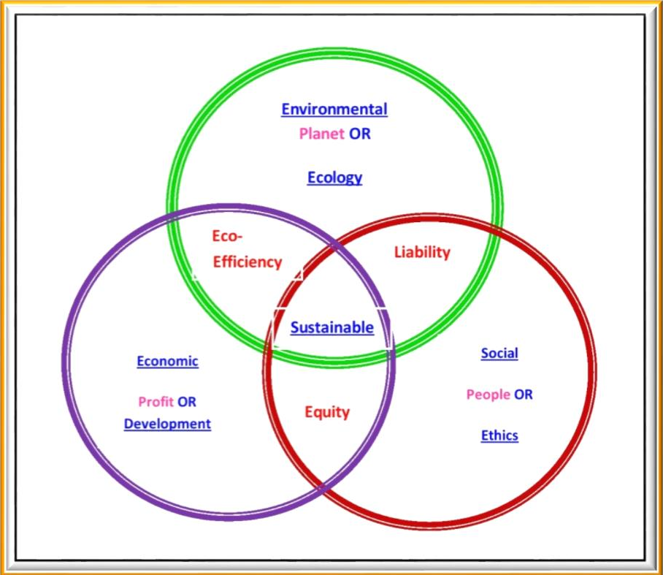
Consultancy Services for Project Management including Construction of High Altitude Hill Roads to “Border Road Organisation” (BRO) under Ditte – Dimme – Moying – Migging Road in the State of Arunachal Pradesh Package – III.
“Initial Environmental Examination” (IEE) Report, Ditte – Dimme – Moying – Migging Road,
BRO (PROJECT – BRAHMANK) – Roads,
successfully developed three “Integrated Industrial Estates” (IIEs) at Haridwar, Pantnagar, and Sitarganj; Pharma City at Selaqui; Information Technology Park at “Sahastradhara” (Dehradun); and a growth centre at “Siggadi” (Kotdwar). Also in 2006, 20 industrial sectors in public private partnership mode were developed in the state.
Sustainable Design and Life Cycle Management: More than any other human endeavour the built environment has direct, complex, and long lasting impact on the “EARTH” and its “BIOSPHERE”. Around one – tenth of global economy is devoted to “CIVIL — CONSTRUCTION” and about one half of world’s major resources are consumed by “CONSTRUCTION” and related industries. The “Three Columns of Sustainability Development – Environmental, Economic and Social” are shown in Figure 22.
Figure 22: Three Columns of Sustainability Development – Environmental, Economic and Social.
While the situation is not so acute in India at present, increasing urbanization may push us in that direction. These statistics underline the importance of changing the “CIVIL CONSTRUCTION PRACTICES” (CCP). To address these challenges, there is a need to develop effective approaches for life cycle design and management of “CONSTRUCTIONS” that will ensure their sustainability in terms of improved physical performance, cost effectiveness, and environmental compatibility. These optimized designs and management systems should provide the owners with the solutions that achieve an optimal balance between three relevant and competing criteria, namely, (i) “Engineering Performance” (e.g., Safety, Serviceability and Durability), (ii) “Economic Performance” (Minimum Life Cycle Costs and Minimum User Costs) and (iii) “Environmental Performance” (Minimum Greenhouse Gas Emissions, Reduced Materials Consumption, Energy Efficiency, etc.).
12. AIR, WATER AND NOISE LEVEL
Air Quality
The results analysis of air samplesis presented in general for all monitoring stations the PM10 values were monitored in the range 110 — 112 µg/ m³. While comparing with the “National Ambient Air Quality” (NAAQ) Standard of 100 µg/ m³ by the “Central Pollution Control Board” (CPCB) all the monitored PM10 values were found to be near the limit (Slightly Higher). This is because of high vehicular location and dryness of the areas. PM2.5 values were ranging from 35 — 38 µg/ m³. While comparing with the

Slide 16
Consultancy Services for Project Management including Construction of High Altitude Hill Roads to “Border Road Organisation” (BRO) under Ditte – Dimme – Moying – Migging Road in the State of Arunachal Pradesh Package – III.
“Initial Environmental Examination” (IEE) Report, Ditte – Dimme – Moying – Migging Road,
BRO (PROJECT – BRAHMANK) – Roads,
NAAQ Standard of 60 µg/ m³ and the monitored PM2.5 values were found to be well within the limit. Similarly monitored values for SOX, NO2 and CO are also found within the limits are as shown in the Table 36.
Table 36: AAQ Monitoring Result of Project Road.
Sr. No. | Parameters | Unit | DITTE Chainage 142+020 | DIMME – MIGGING Chainage 167+100 | Prescribed Limits (µg/m³) | Protocol
Date of AAQ Monitoring |  |  | 29.12.2019 | 30.12.2019
A – 01 | PM10 |  | 98 | 91 | 100 | IS: 5182 (Part – 23), 2006.
A – 02 | PM2.5 |  | 35 | 38 | 60 | CPCB Guidelines.
A – 03 | SO2 |  | 17 | 17 | 80 | IS: 5182 (Part – II), 2001.
A – 04 | NOX |  | 19 | 25 | 80 | IS: 5182 (Part – VI), 2007.
A – 05 | CO |  | 840 | 1,200 | 2,000 | IS: 5182 (Part – 10).
The maximum SO2 and NOX levels monitored were 23.41 µg/ m³ and 35.15 µg/ m³ respectively. While comparing with the NAAQ Standard (80 µg/ m³), the monitoring results were found to be well within the limits. The maximum CO concentration monitored was 1.8 µg/ m³ and most of the CO levels were monitored below the detectable limit of 2 µg/ m³. While comparing the NAAQ Standard, the monitored CO levels were found to be well within the limit. All Hydro — Carbon (HC) values were found to be below the detectable limit of 65 µg/ m³. All Particulate Lead values were found to be below the detectable limit of 0.01 µg/ m³ and within the NAAQ Standard of 1.0 µg/ m³ (24 — Hourly).
Noise Levels
Ambient Noise Standards
Ambient noise standards were established as per the CPCB/ MOEF Gazette Notification dated 26th
December, 1989. It is based on the “A” weighted equivalent noise level, Leq are given in the Table 37.
Table 37: National Ambient Noise Standards.
Area Code | Category of Zones | Day* Limits of Leq {dB(A)} | Night* Limits of Leq {dB (A)}
A | Industrial | 75 | 70
B | Commercial | 65 | 55
C | Residential | 55 | 45
D | Silence Zone** | 50 | 40
Sources**: GOI; CPCB, 1989.
Monitoring Locations and Results
The noise measurement work has been carried out continuously for a period of 24 Hours. At each site 2, 880 data were recorded, each taken at an interval of 30 seconds of which 1, 800 data recorded at day time (07: 00 AM to 10: 00 PM) and 1, 080 at night time (10: 00 PM – 07: 00 AM) as shown in the Table 38.

Slide 17
Consultancy Services for Project Management including Construction of High Altitude Hill Roads to “Border Road Organisation” (BRO) under Ditte – Dimme – Moying – Migging Road in the State of Arunachal Pradesh Package – III.
“Initial Environmental Examination” (IEE) Report, Ditte – Dimme – Moying – Migging Road,
BRO (PROJECT – BRAHMANK) – Roads,
Table 38: Equivalent Noise Level Data.
Sr. No. | Name of Locations | Date of Monitoring | Category of the Area | Leq dB (A), Day | Leq dB (A), Night
1. | DITTE Chainage 142+020 | 01.01.2020 | Educational Area on Site | 52.6 | 35.2
2. | DIMME – MIGGING Chainage 167+100 | 04.01.2020 | Religious Area on Site | 44.2 | 46.6
The monitored noise levels were ranging from 65.2 dB (A) to 54.2 dB (A) While comparing the MOEF Ambient Noise Norms for different categories, Leq noise levels at all locations during day time and during night time, were found to be exceeding their respective limits. This is because of regular movement of diverse vehicles. It may be noted that as the noise survey was carried out at sensitive receptors i.e., School Zones; Domestic Zones; Sensitive Zones; Old People Living Zones; Children Parks; Zoo Parks and Hospital Zones respectively, noise standards is found above the limits at almost all the location.
Water Quality
Water Quality Standard
The rivers, canal, lakes and ponds located along the proposed project road are a source of water for the local, regional inhabitants, for domestic as well as agricultural uses. An analysis of their present status and the quality of the water has been done through and with the help of state/ local/ regional agencies. They have been classified as per the CPCB standard classification norms for best optimum use of data and report used as shown in the Table 39.
Table 39: CPCB Best Use Classification for Surface Water Bodies.
Sr. No. | Parameters | Class – A | Class – B | Class – C | Class – D | Class – E
1. | pH | 6.5 – 8.5 | 6.5 – 8.5 | 6.0 – 9.0 | 6.5 – 8.5 | 6.5 – 8.5
2. | Dissolved Oxygen (as O2), Mg/ l, Minimum. | 6 | 5 | 4 | 4 | -------
3. | BOD, 5 Days at 20°C, Maximum. | 2 | 3 | 3 | ------- | -------
4. | Total Coli – form Organism, MPN/ 100 ML, Maximum. | 50 | 500 | 5,000 | ------- | -------
5. | Free Ammonia (as N), Mg/ l, Maximum. | ------- | ------- | ------- | 1.2 | -------
6. | Electrical Conductivity, Mhos/ Cm, Maximum. | ------- | ------- | ------- | ------- | 2,250
7. | Sodium Absorption Ratio, Maximum. | ------- | ------- | ------- | ------- | 26
8. | Boron (as B), Mg/ l, Maximum. | ------- | ------- | ------- | ------- | 2
Class A | : Drinking Water Source without Conventional Treatment but after Disinfection;
Class B | : Outdoor Bathing (Organized);
Class C | : Drinking Water Source after Conventional Treatment and after Disinfections;
Class D | : Propagation of Wild – Life and Fisheries;
Class E | : Irrigation, Industrial Cooling, and Controlled Waste Disposal;
Below E: Not Meeting A, B, C, D and E Criteria.
Water Quality Variation along the Projected Road
Surface Water Quality: The pH of surface water was found to be in the range 7.10 to 7.91 along the Corridors. Total hardness is found 337 – 234 ppm (parts per million). Lead contents were found to be below the detection limit. In general, surface water quality along the Corridors is good and complies with

Slide 18
Consultancy Services for Project Management including Construction of High Altitude Hill Roads to “Border Road Organisation” (BRO) under Ditte – Dimme – Moying – Migging Road in the State of Arunachal Pradesh Package – III.
“Initial Environmental Examination” (IEE) Report, Ditte – Dimme – Moying – Migging Road,
BRO (PROJECT – BRAHMANK) – Roads,
“CPCB Surface Water Quality Norms”. Details of water quality features are mentioned in Tables 40
(a) and (b) below.
Table 40 (a): Ground Water and Surface Water Quality along the Projected Road.
Sr. No. | Parameters | Units of Measurement | Surface Water Quality Monitoring Result along the Project Road |  |  | Protocol
 |  |  | DITTE | DIMME – MIGGING | Desirable Limit
Date of Sampling |  |  | 18.03.2020 | 19.03.2020 | < OR ≥ OR Nil
1. | Colour | Hazen Units | <5 | <5 | 5 | IS: 3025
2. | Turbidity | NTU | 34 | 7 | <5 | IS: 3025
3. | pH | ------- | 7.91 | 7.09 | 6.5– 8.5 | IS: 3025
4. | Temperature (T) | °C | 14 | 14 | 14 | IS: 3025
5. | Dissolved Oxygen (DO) | mg/l | 3.8 | 4.2 | 4.4 | IS: 3025
6. | Conductivity | µmhos/cm | 1,250 | 674 | 976 | IS: 3025
7. | Total Suspended Solids (TSS) | mg/l | 30 | <4 | <4 | -------
8. | Total Dissolved Solids (TDS) | mg/l | 812 | 316 | 634 | IS: 3025
9. | Alkalinity as CaCO3 | mg/l | 410 | 291 | 370 | IS: 3025
10. | Total Hardness as CaCO3 | mg/l | 234 | 289 | 337 | 300
11. | Calcium as CaCO3 | mg/l | 123 | 198 | 174 | IS: 3025
12. | Magnesium as CaCO3 | mg/l | 111 | 91 | 163 | IS: 3025
13. | Sodium as Na | mg/l | 92 | 41 | 51 | APHA
14. | Potassium as K | mg/l | 86 | 13 | 10 | APHA
15. | Chloride as Cl | mg/l | 98 | 24 | 24 | IS: 3025
16. | Phosphate as PO4 | mg/l | 0.43 | 0.03 | 0.03 | -------
17. | Sulphate as SO4 | mg/l | 29 | 45 | 51 | IS: 3025
18. | Nitrate as NO3 | mg/l | 0.12 | 0.06 | 0.08 | IS: 3025
19. | Oil and Grease (OG) | mg/l | Nil | Nil | Nil | IS: 3025
20. | Phenolic Compounds (PC) | mg/l | <142.0201 | <142.0201 | <142.0201 | IS: 3025
21. | Chemical Oxygen Demand (COD) | mg/l | 97 | <4 | <4 | -------
22. | Biological Oxygen Demand (BOD) | mg/l | 52 | <2 | <2 | IS: 3025
Table 40 (b): Ground Water and Surface Water Quality along the Projected Road.
Sr. No. | Parameters | Units of Measurement | Surface Water Quality Monitoring Result along the Project Road |  |  | Protocol
 |  |  | DITTE | DIMME – MIGGING | Desirable Limit
Date of Sampling |  |  | 21.03.2020 | 22.03.2020 | < OR ≥ OR Nil
23. | Arsenic as As | mg/l | <0.01 | <0.01 | 0.01 | IS: 3025
24. | Mercury as Hg | mg/l | <142.0201 | <142.0201 | 142.0201 | IS: 3025
25. | Lead as Pb | mg/l | <0.01 | <0.01 | 0.01 | IS: 3025
26. | Cadmium as Cd | mg/l | <0.01 | <0.01 | 142.0203 | IS: 3025
27. | Chromium as _{Cr}+6 | mg/l | <0.05 | <0.05 | 0.05 | IS: 3025

Slide 19
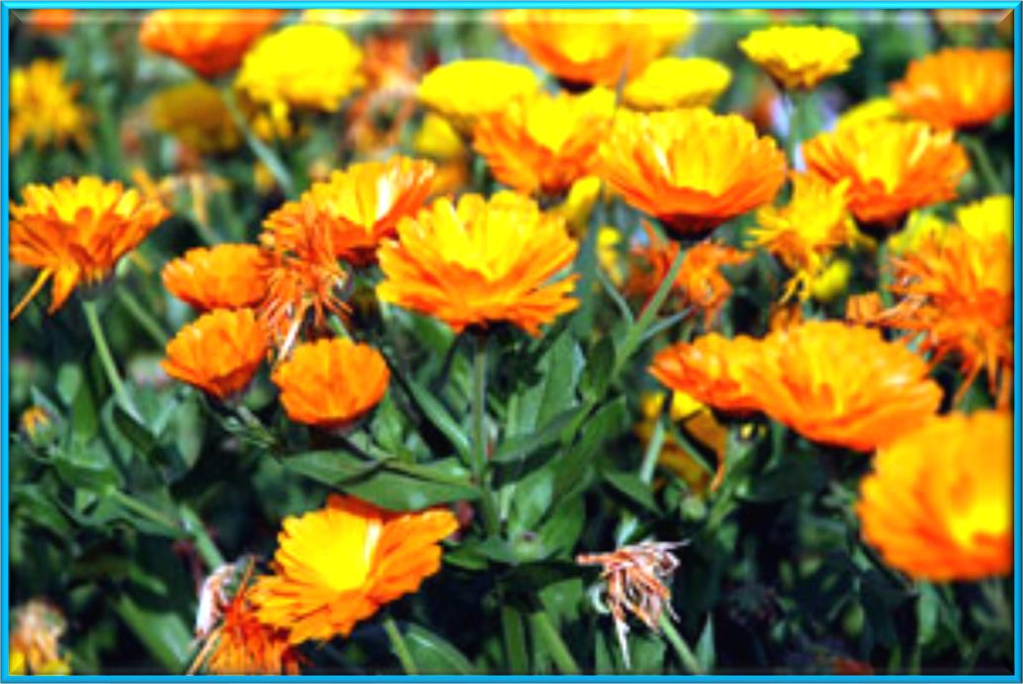
Consultancy Services for Project Management including Construction of High Altitude Hill Roads to “Border Road Organisation” (BRO) under Ditte – Dimme – Moying – Migging Road in the State of Arunachal Pradesh Package – III.
“Initial Environmental Examination” (IEE) Report, Ditte – Dimme – Moying – Migging Road,
BRO (PROJECT – BRAHMANK) – Roads,
28. | Copper as Cu | mg/l | <0.01 | <0.01 | 0.05 | IS: 3025
29. | Zinc as Zn | mg/l | <0.01 | <0.01 | 5 | IS: 3025
30. | Selenium as Se | mg/l | <142.0205 | <142.0205 | 0.01 | IS: 3025
31. | Iron as Fe | mg/l | 0.15 | 0.01 | 0.3 | IS: 3025
32. | Total Coli – form | MPN/ 100 ml | 50 | 28 | ------- | IS: 5401 – (Part – II)
33. | Faecal Coli – form | MPN/ 100 ml | 20 | 13 | ------- | IS: 5401– (Part – II)
ECOLOGICAL AND ENVIRONMENTAL TEXTURE
Flora
Arunachal is endowed with a unique and diverse range of biodiversity. From the snow bound peaks of the Himalayas to the moist Alpine scrub, sub Alpine forests, dry – temperate and moist – temperate forests to moist deciduous forests, the state possesses a wide biodiversity that in return nurtures a large multiplicity of floral and faunal forms. The state is home to nearly 4,048 species of Angiosperms and Gymnosperms belonging to 1,198 genera under 192 families. Of these nearly 116 species are specific to Arunachal i.e., their geographical distribution is limited to the boundaries of the state. Around 161 species of flora found in Arunachal are recognized as rare or threatened under the categorization of the “International Union for Conservation of Nature” (IUCN). Out of the 223 species of Orchids reported from the North Western Himalayas, over 150 have been reported from the State.
The Arunachal flora includes a variety of species of plants. The abundance of flora in the state can be understood from the fact that the forests cover as much as 36% of the total area of Arunachal. There are about 4,000 different types of plants in Arunachal. The rhododendrons form a significant part of the Arunachal flora. They are abundant in the alpine and temperate regions of Arunachal. Near about 35 different varieties of rhododendrons grow in these regions. The flowering time of these plants stretches between May and August. The flowers of these plants decorate the entire region. The rhododendrons are the brightest and most colorful members of the flora at Arunachal. The orchids that grow in the state of Arunachal exhibit a lot of variety. More than 600 different kinds of orchids are found here. These orchids are an important part of the flora of Arunachal. The terrestrial orchids are found in the temperate areas, while the epiphytic orchids are found in the tropical regions.
The ecological studies have been carried out to understand the present status of terrestrial and aquatic ecosystem within 10 Km distance, on either side from the “Right of Way” (ROW) of proposed project. The information provided is based on physical surveys and secondary sources such as information collected from forest department. There is “Reserved Forest” (RF) in this road but no eco — sensitive areas near the project route. “The prominent species include teak mixed with Bamboo, Palm,

Slide 20
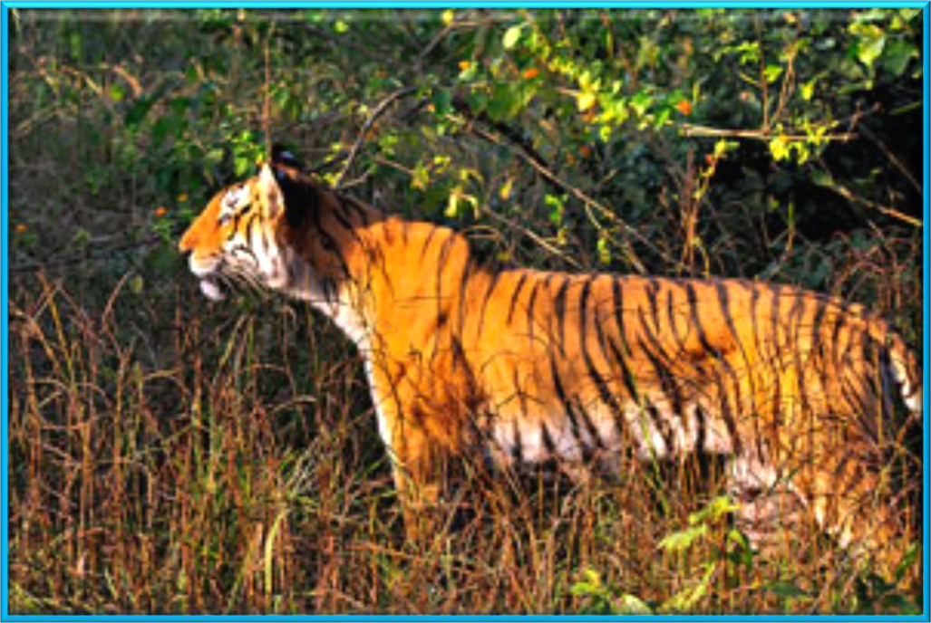
Consultancy Services for Project Management including Construction of High Altitude Hill Roads to “Border Road Organisation” (BRO) under Ditte – Dimme – Moying – Migging Road in the State of Arunachal Pradesh Package – III.
“Initial Environmental Examination” (IEE) Report, Ditte – Dimme – Moying – Migging Road,
BRO (PROJECT – BRAHMANK) – Roads,
Kadamb and Banyan Trees. Other Trees include Neem, Peepal and Mango etc.” There are no endangered species of flora in the area.
Fauna
This great floral diversity supports a wide variety of faunal forms too. It includes about 102 species of mammals, 623 species of birds, 124 species of fish, 69 species of reptiles and 19 species of amphibians. Highly endangered species like the Snow Leopard, Musk Deer, Tiger, Asian Elephant, Bharal, Himalayan Monal, Cheer Pheasant, and King Cobra etc. find suitable habitat in the forests of Arunachal. This precious natural wealth is our common heritage. In order to conserve this heritage, the state has declared twelve areas as “Protected” including 6 National Parks and six Wildlife Sanctuaries. Nearly 65% of the geographical area of the State is under forest cover, of which over 12% comes under the “Protected Area Network” (PAN). This exceeds the national average by a fair margin and is a reflection of the state’s commitment to conservation. The Corbett National Park, established in 1936 is the first National Park of the Asian mainland. The “Nandadevi Biosphere Reserve”, established under the “Man and Biosphere” programme of UNESCO has the honour of being Arunachal’s only and the country’s second “Biosphere Reserve”. This biodiversity wealth is the pride of Arunachal.
The natural vegetation of forests may be divided into:
Trans – Himalayan Zone; Sub – Alpine and Alpine Zone;
Montane or Temperate Region;
Sub – Mountain and Sub – Tropical Region; Tropical Wet Evergreen and Semi Evergreen Region;
The original fauna of Arunachal in its Southern low lands of height of 800 Feet to 5,000 Feet include Laurel, Fig, Bamboo and Sal Tree. These plantations have been greatly reduced for providing farming land. At a height of 5,000 Feet to 13,000 Feet, one can find temperate trees like chestnut, oak, birch, maple, magnolia, silver fir and alder. The alpine region of height more than 13,000 Feet is covered with cypress, juniper and rhododendron. Therefore, the flora in Arunachal varies with the height of a place. The world of Arunachal fauna exhibits a great deal of variety. There are as many as 550 types of birds in the state. Some of the well – known birds include Eagles, Giant Lammergeier Vultures, Minivet, Whistling Thursh, Pheasant and Bulbul. Some of the birds of Arunachal belong to the endangered species. Some important members of the fauna of Arunachal are the birds of the place. The zoologists have discovered that the forests of this state of India are crowded with more than 400 different species of butterflies. The Arunachal Rivers house a variety of fish like salmon, trout and carp. Among the animals, the Red Panda dwells at a height of 6,000 to 12,000 Feet on treetops. Yak is very closely associated with this mountainous state of India. These animals are quite economically viable for the people of the region.

Slide 21
Consultancy Services for Project Management including Construction of High Altitude Hill Roads to “Border Road Organisation” (BRO) under Ditte – Dimme – Moying – Migging Road in the State of Arunachal Pradesh Package – III.
“Initial Environmental Examination” (IEE) Report, Ditte – Dimme – Moying – Migging Road,
BRO (PROJECT – BRAHMANK) – Roads,
Blue sheep found here is a kind of squirrel that can fly. Tahr, Binturong and Marmot are found in the greeneries of the state, mainly in the Kangchendzonga National Park. The wild animals, which are found in this area/ site/ region, include the Nilgai (Boselaphus Tragocamelus), Antelok (Anelok Cervicapra), Pig (Sus Scrofa), Wolf (Canis Lupus), Jackal (Conis Aureus), Fox (Vulpes Bengalensis), Hare (Lupus Ruficandatus), Monkey (Macaca Mulatta), Wild Cat (Felis Bengalensis) and the Porcupine (Hystric Leucura). The game – birds of the area include the usual varieties found throughout the plains as well as hilly areas. Among them mention may be made of the Peafowl (Pavo Cristatus), the Black Partridge (Frencolinus Francolinus) and the Gray Partridge (Francalinus Pondicervanus). The area is famous for the number and variety of water fowls, which visit it during the winter season. The Goose (Anser Anser), Common Teal (Anas Crecca), red – crested Pochard Duck (Netta Rufina), White – Eyed Pochard (Aythya Rufa) and Widgeon (Mareca Penelope) visit the area/ site/ region only in Winter Season and inhabit the fringes of Rivers, Lakes, Ponds, Stream Channels and Swamps etc.
Aquatic Life
Snakes are common in the area especially in the rural areas or sites, the chief being the Cobra (Naja Naja), Karait (Bungarus Caeruleus), and Rat – Snake (Ptyas Mucosus). Indian Crocodile or Naka (Crocodilus Pulustris), and the Ghariyal (Gavialis Gangeticus) are also found in the rivers or lakes. Fish of almost all the varieties that occur elsewhere in the state are found in the rivers, lakes and ponds of this area, the common species being Rohu (Lebeo Rohita), Bhakur (Catla Catla), Nain (Cirrhina Mrigala), Parhin (Wallagonia Attu), Krunch (Lebeo Calbasu), Tengan (Mystus Seenghla) etc.
Archaeological and Historical Sites
There is no archeologically protected monument or historical sites along the project route or roadways network of construction site.
Environmental Impacts
Impact on Topography
During the construction of the proposed project, the topography will change due to excavation of borrow areas, fills for project road, especially construction of project related cross drainage structures and intersections etc. Provision of construction camp/ yard for material handling will also alter the existing topography. There will be change in topography at re – alignments as these re – alignments have been proposed through agriculture farming fields. The change in topography will also be due to the probable induced developments of the project. With adequate planning, all topographical impacts or signature could be made to enhance the local aesthetics. Similarly, it will invite benefits in the form of land leveling and tree plantations in the vicinity/ region/ area/ site of the projected road.
Impact on Climate
The widening and strengthening of project is not going to have impact on micro as well and macro – climate of the region on the site or area/ region.
Impact on Air Quality
There will be rise in “Suspended Particulate Matter” (SPM) levels due to the construction activities, because the project runs entirely in plain areas. Since the emission will be fugitive in nature and it is difficult to quantify the SPM standards even expected to be violated, as the background values are not alarming rate at many places. “Affected Persons” (APs) should be completely well – versed even; if it is exceeded then it will be for very short time period. There will be some increase in levels of gaseous pollutant also, which are highly harmful to all or whole ecosystem surviving/ sustaining on this “Precious Planet Earth”. The impact on ambient air quality has been assessed using “AERMOD – Lakes Environmental Software” and “CALINE4 – A Dispersion Model for Predicting Air Pollution Concentrations near Roadways or Road Network”. The air quality predictions have been done for the horizon years 2010, 2020 and 2030. The results of various or numerous types of mathematical modelling applications shows that CO, SO2, NOX, HC, “Respirable Particulate Matter” (RPM) stuff concentration will remain within the limits of CPCB tills the end of project life. The SPM levels are well within limit at present also. But significant contribution of SPM is expected from vehicular emissions; transportation; industrial as well as domestic activities in future as given in Figure 23.

Slide 22
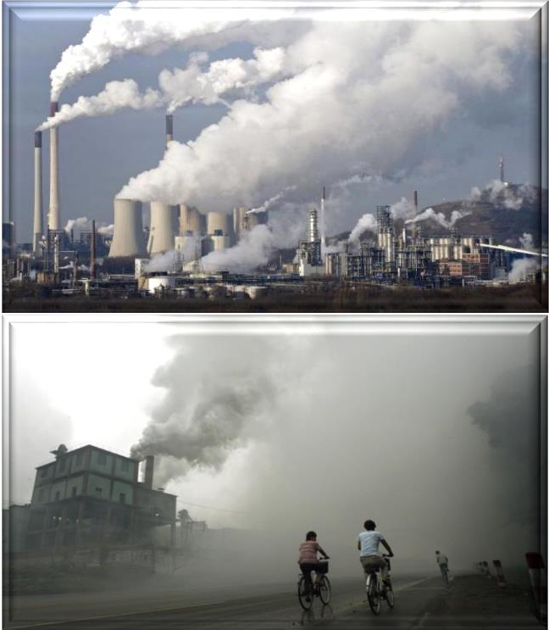
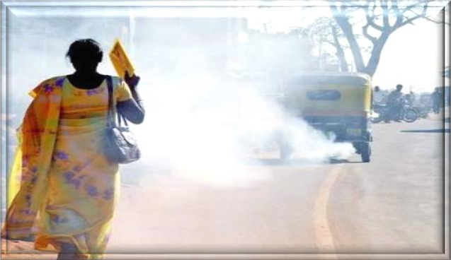
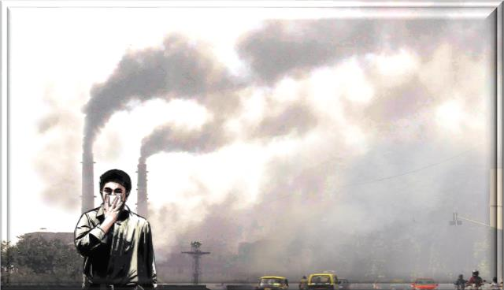
Consultancy Services for Project Management including Construction of High Altitude Hill Roads to “Border Road Organisation” (BRO) under Ditte – Dimme – Moying – Migging Road in the State of Arunachal Pradesh Package – III.
“Initial Environmental Examination” (IEE) Report, Ditte – Dimme – Moying – Migging Road,
BRO (PROJECT – BRAHMANK) – Roads,
“Affected Persons” (APs) should be fully informed of their rights and responsibilities from the very beginning of the process to achieve transparency and understanding between the APs and the project implementers.
Primary stakeholders include the APs, the beneficiaries of the project, the host population, the “Project Partner Agencies” (PPAs) such as “Urban Development Authority” (UDA), and more importantly the project proponent and the “Ministry of Defence and Urban Development” (MOD and UD), Ministry of Finance and Ministry of Land and Land Development. The secondary stakeholders are those who have an interest in the project such as the National Government, the political authority, policy – makers, advocacy groups, NGOs and other private and public sectors which have indirect involvements with the project.
Therefore, PPA need to be assisted more closely in explaining and guiding them in resolving the issues in a more productive manner more favourable to the APs, as per involuntary resettlement principles and guidelines. This nature of consultation with the project APs and their profiling are mandatory as per the requirements of preparing the “Resettlement Action Plans” (RAP), which needs to be carried out as socio – economic and census surveys as an integral part of detailed designing.
 | Involve APs in decision – making committees;
 | Involve APs in monitoring and evaluation;
Implementation Stage | Establish “Grievance Redress Committee” (GRC) procedures, representatives of APs;
 | Arrange APs inputs to entitlements, income restoration and resettlement options;
 | Consultations with APs on alternatives;
 | Involve APs in assessing project impacts.

Slide 23
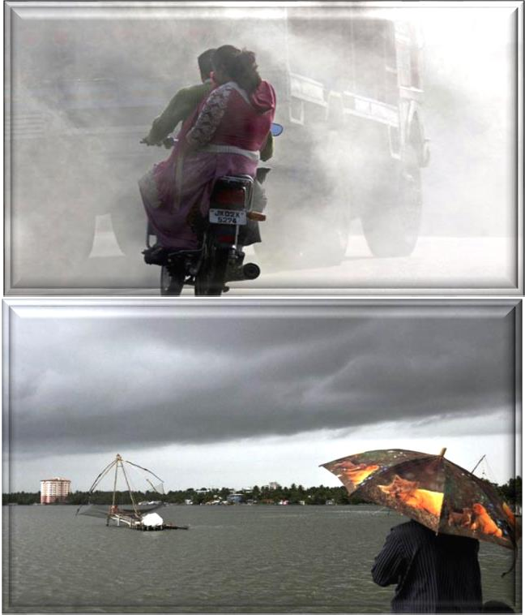
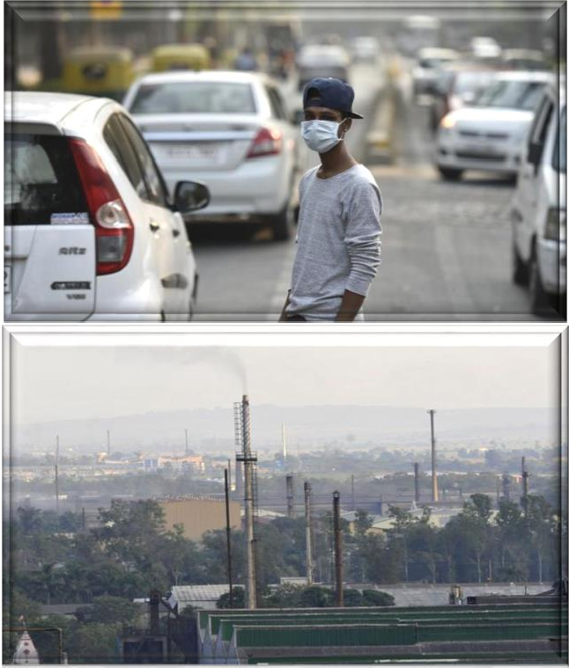
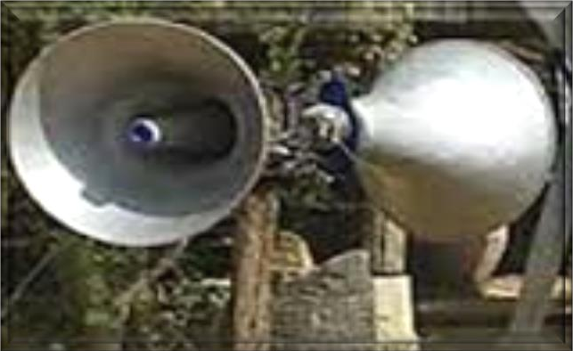

Consultancy Services for Project Management including Construction of High Altitude Hill Roads to “Border Road Organisation” (BRO) under Ditte – Dimme – Moying – Migging Road in the State of Arunachal Pradesh Package – III.
“Initial Environmental Examination” (IEE) Report, Ditte – Dimme – Moying – Migging Road,
BRO (PROJECT – BRAHMANK) – Roads,
Figure 23: Increase in Levels of Pollutant – Emissions – Impact on Future Generated Aspects/ Prospects from Various Sources.
Impact on Noise Levels
The impact of noise levels from the proposed project on the neighbouring communities is addressed by carrying out Noise Modelling using “FHWA Model” developed by “Federal High Way Administration” (FHWA). It has been concluded after Mathematical Modelling that both day time and night time equivalent noise levels are within the permissible limits as right from start of project life. Noise sensitive receptors have been identified along the projected road site/ area. The noise sensitive receptors include school, hospitals, colleges; old orphan people’s sensitive house zones (Ashrams) and other nearby housing transportation activities along the road side etc. The predicted levels indicate that the noise levels in future years will not exceed permissible limits right from start of project life as given in Figure 24. Hence there is no need to protect these noise sensitive receptors.

Slide 24
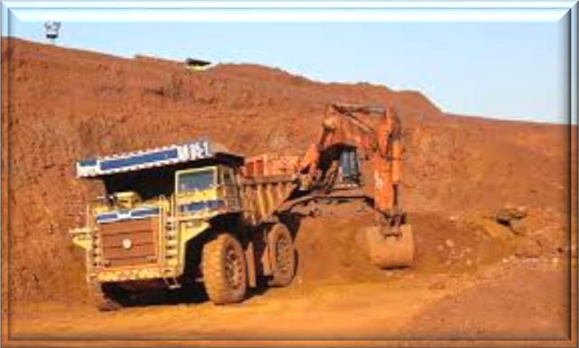

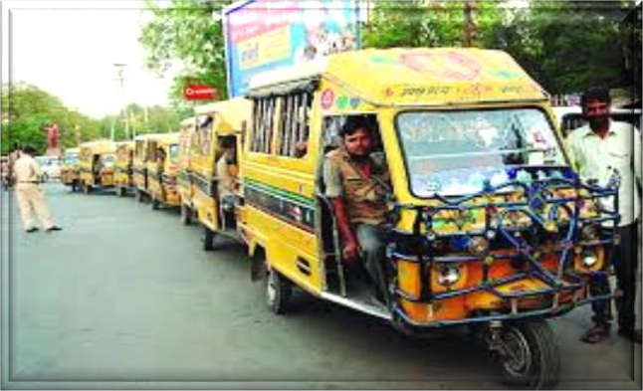
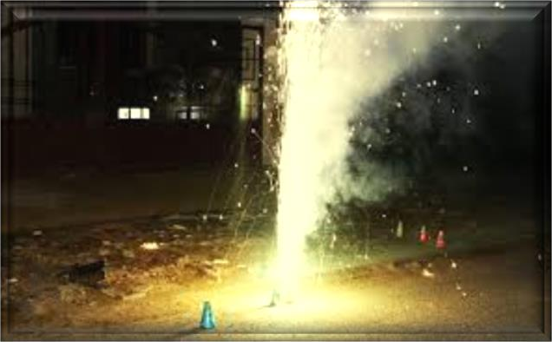
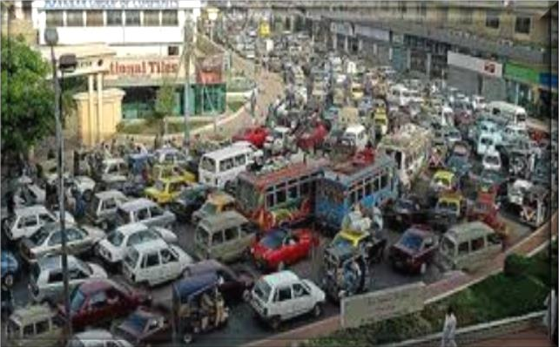
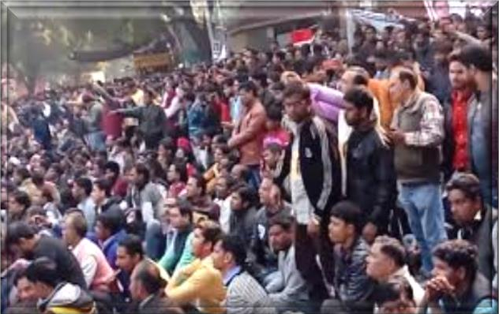
Consultancy Services for Project Management including Construction of High Altitude Hill Roads to “Border Road Organisation” (BRO) under Ditte – Dimme – Moying – Migging Road in the State of Arunachal Pradesh Package – III.
“Initial Environmental Examination” (IEE) Report, Ditte – Dimme – Moying – Migging Road,
BRO (PROJECT – BRAHMANK) – Roads,
Figure 24: Noise Levels Impact Must Not Exceed the Permissible Limits in Sensitive Zones along Road Side.
Impact on Water Resources and Quality
The construction and operation of the proposed project roads will not have any major impacts on the surface water and the ground water quality in the area projected site/ region. Contamination to water bodies may results due to spilling of construction materials, oil, grease, fuel and paint in the equipment yards and “Asphalt Crusher Plants” (ACP) or “Hot Mixing Plants” (HMP). This will be more prominent in case of locations where the project road crosses water streams; major canals distributaries, minor/ major ponds and minor/ major small lakes etc. Mitigatory measures have been planned; generated; Initialized and finalized to avoid contamination of these water bodies are given in Figure 25.

Slide 25
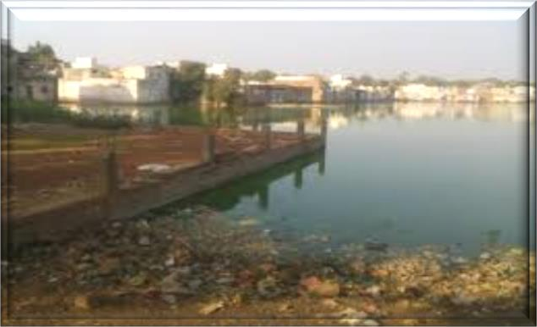
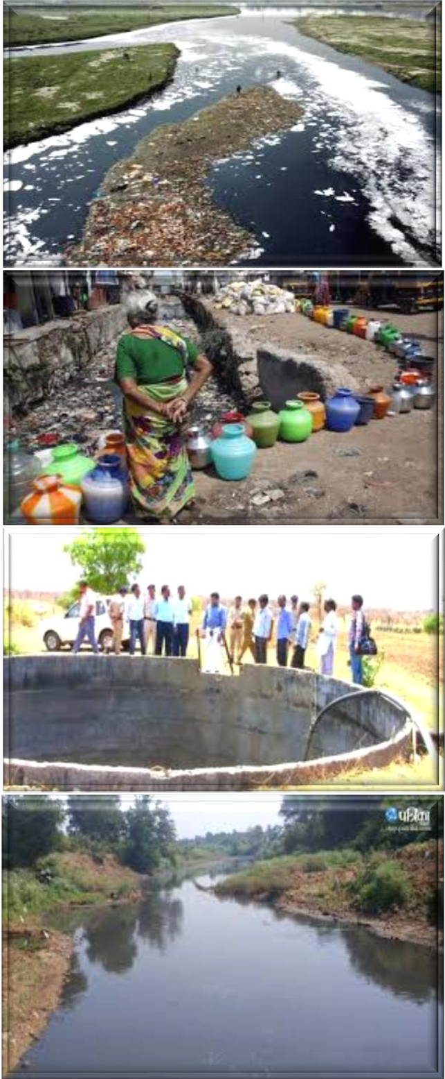
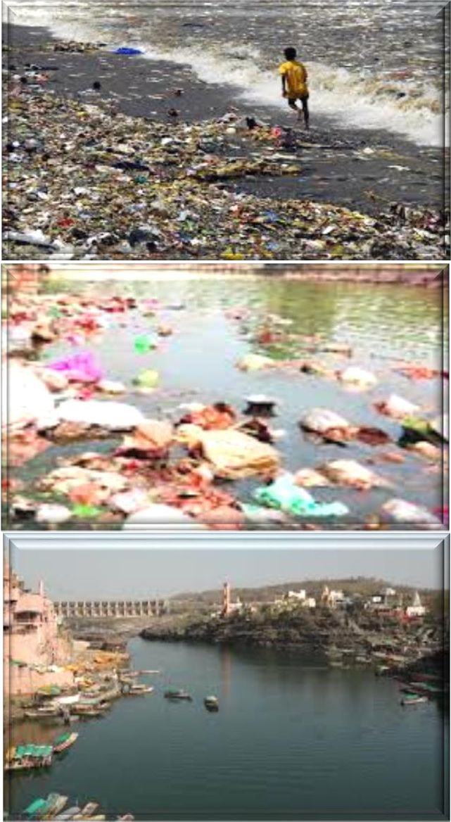
Consultancy Services for Project Management including Construction of High Altitude Hill Roads to “Border Road Organisation” (BRO) under Ditte – Dimme – Moying – Migging Road in the State of Arunachal Pradesh Package – III.
“Initial Environmental Examination” (IEE) Report, Ditte – Dimme – Moying – Migging Road,
BRO (PROJECT – BRAHMANK) – Roads,
Figure 25: Mitigatory Measures Plans Generated; Initialized and Finalized to Avoid Contamination Impact on Water Resources and Quality.
Impact on Ecological Resources and Soil Quality
There is no wildlife sanctuary in the close vicinity of the projected road. The study area passes primarily through agricultural land in plain areas. There will be temporary impact on terrestrial ecology, as trees will be cut. But after construction no impact is anticipated as compensatory a forestation is planned. There are no endangered species or rare species of flora and fauna in the projected area. There is no major loss of vegetation; hence adverse impact in terms of availability of nesting sites for the bird doesn’t arise in the region. Furthermore; there is no sensitive Environmental/ Natural/ Ecological area near the existing

Slide 26
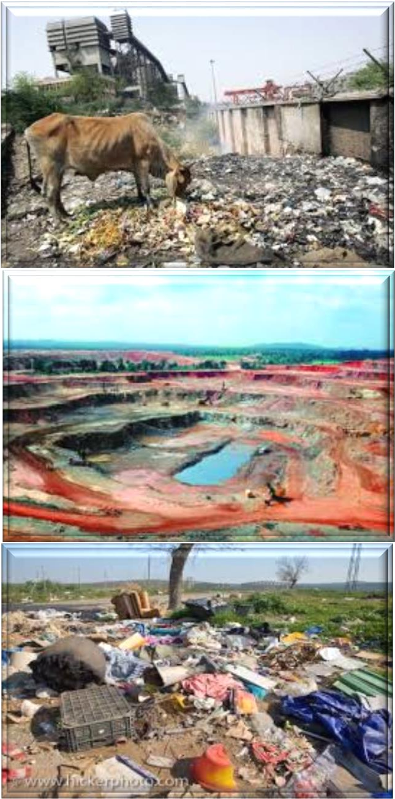
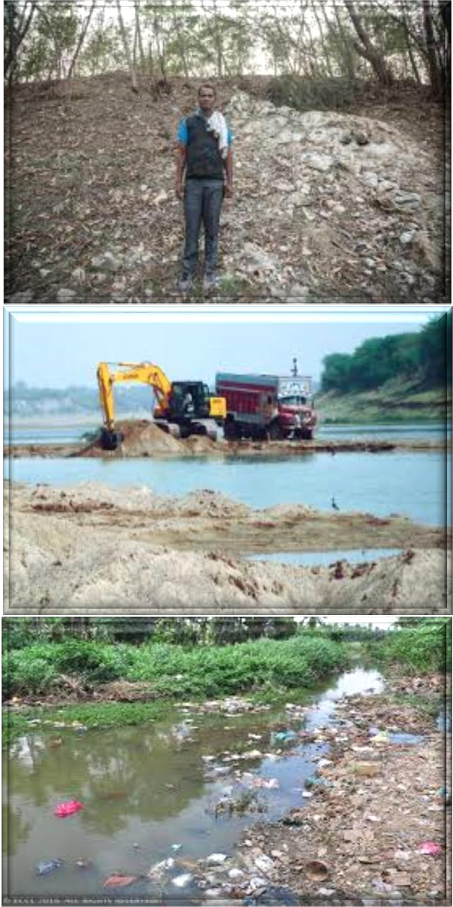
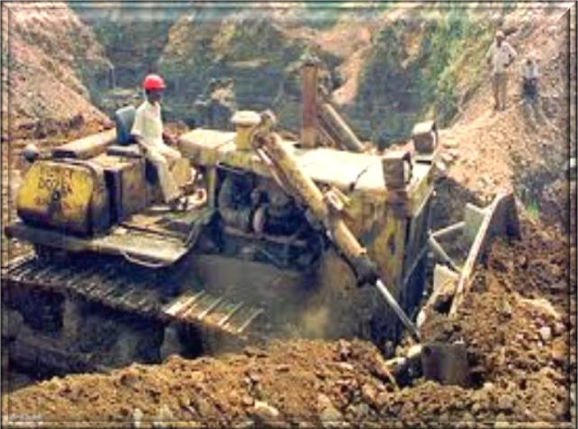
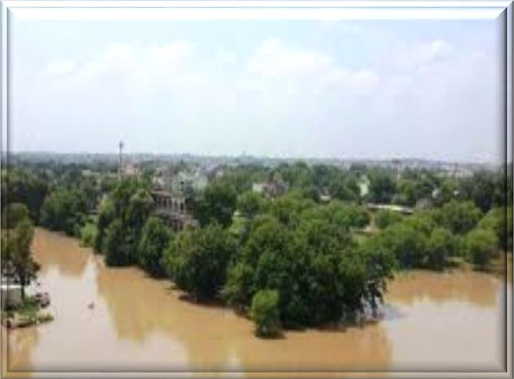
Consultancy Services for Project Management including Construction of High Altitude Hill Roads to “Border Road Organisation” (BRO) under Ditte – Dimme – Moying – Migging Road in the State of Arunachal Pradesh Package – III.
“Initial Environmental Examination” (IEE) Report, Ditte – Dimme – Moying – Migging Road,
BRO (PROJECT – BRAHMANK) – Roads,
projected roads, so the impact will be insignificant or inconsequential. Brief potential impacts are shown in
Figure 25 and are presented in matrix below in the Table 41.
Figure 26: Plan Mitigatory Measures to Avoid Soil Contamination Impact on Agricultural Land and Other Sensitive Zones in Environmental/ Natural/ Ecological Vicinity/ Area/ Site.

Slide 27
Consultancy Services for Project Management including Construction of High Altitude Hill Roads to “Border Road Organisation” (BRO) under Ditte – Dimme – Moying – Migging Road in the State of Arunachal Pradesh Package – III.
“Initial Environmental Examination” (IEE) Report, Ditte – Dimme – Moying – Migging Road,
BRO (PROJECT – BRAHMANK) – Roads,
Table 41: Potential Environmental Impacts.
Project Activity | Pre – Construction | Construction Phase |  |  |  |  |  | Operation Phase
Component Affected | Land Acquisition | Site Clearance | Earth Moving (Borrow Pits) | Contractor Camps | Quarries Areas | Construction of Highway | Asphalt Crusher Plants | Operation
Soil | Loss of productive agricultural land | Loss of crops, and increase in soil erosion | Loss of top soil and erosion | ------- | Increase in erosion, siltation and slope instability | Soil pollution | Pollution due to spills | Soil contamination due to surface runoff
Ground Water | ------- | ------- | ------- | Water Extraction for drinking | ------- | Exploitation of water for construction | ------- | Maintenance of trees/ shrubs
Surface Water | ------- | Change in water quality and siltation | Water logging and mosquito breeding | Water pollution from sanitary and other wastes | Water logging problems | Change in water quality | Water pollution due to spill into water bodies | Degradation due to spill – over sand road run off
Drainage | ------- | Change in natural drainage pattern | Change in drainage pattern | ------- | Modification in natural drainage | Interference with natural drainage, water logging | ------- | Cleaning and maintenance
Air Quality | ------- | Increase in air pollution | Particulate matter pollution | Atmospheric pollution due to fuel burning | Dust pollution | Dust pollution | SPM, SO2 | Increase in SPM, NOX, CO
Noise Quality | ------- | Reduced buffering of noise | Increase in noise levels due to machinery | ------- | Vibration from blasting operations | Vibrators, concrete batching plants noise etc. | Increase in noise | Increase in noise levels due to increased traffic
Forest | ------- | Habitat loss, and vegetation | Loss of forest | Encroachment into forest areas | Loss of habitat/ cover | Loss of forest | ------- | -------
Trees | Tree cutting clearance | Loss of trees | Loss of trees | Cutting of trees | Tree cutting | Loss of trees | ------- | -------
Temples/ Mosques | Clearance | Removal/ rehabilitation | ------- | ------- | ------- | ------- | ------- | -------
Impact on Drainage Pattern
The proposed widening and strengthening will not alter drainage pattern of the area as adequate cross drainage structures have been planned along the new alignments and existing culverts along the project road are planned for “Rehabilitation and Resettlement” (R and R). Construction of bridges across water streams may result in siltation of water body, which can affect aquatic life and fauna in the region/ area or proposed site. Proper mitigatory measures have been recommended in “Environmental Management Plans” (EMPs).

Slide 28
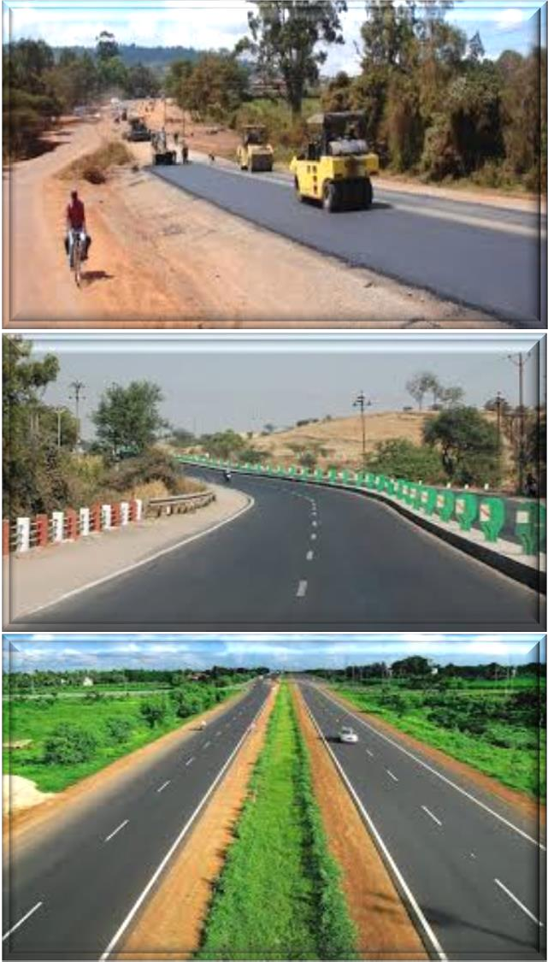
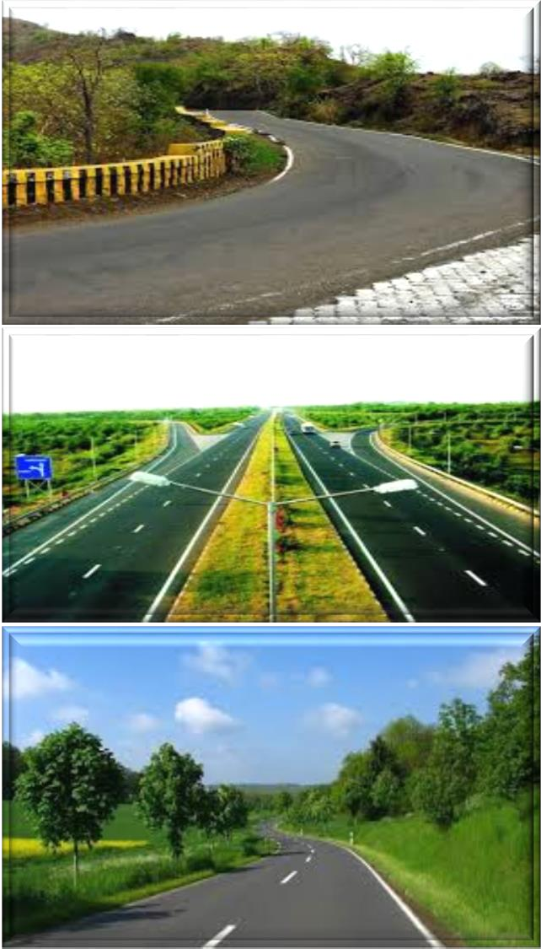
Consultancy Services for Project Management including Construction of High Altitude Hill Roads to “Border Road Organisation” (BRO) under Ditte – Dimme – Moying – Migging Road in the State of Arunachal Pradesh Package – III.
“Initial Environmental Examination” (IEE) Report, Ditte – Dimme – Moying – Migging Road,
BRO (PROJECT – BRAHMANK) – Roads,
Impact on Human Use Values
Impact on human use values are including “Precious Planet Earth’s”, common property resources such as temples, mosques, wells, hand pumps, stream channels, stream fountains and tube well etc. Impact on these has been minimized through proper planning of the alignments along roadside/ location site. The environmental impacts have been summarized as in Figures 27 (a) to (d) and Table 36 given below.
Mitigation Avoidance and Enhancement Measures
The mitigation measures have been planned for identified adverse environmental impacts alignment enhancement design phase is being applied along roadside to reduce tree cuttings as compensatory plantation process or relevance. These mitigation measures have been identified as “Environmental Management Plans” (EMPs) during “Planning, Construction and Operation Phase”.
Design Phase
Figure 27 (a): Mitigation Enhancement as per Alignment Design Phase to Reduce Tree Cutting and Compensatory Plantation Relevance.

Slide 29
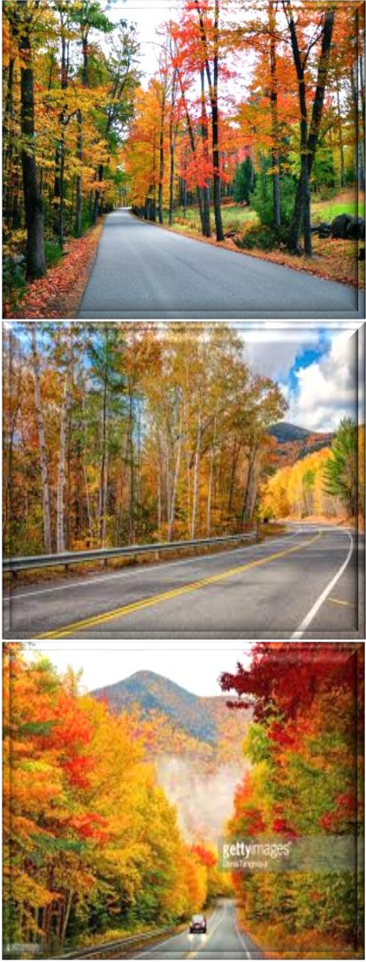
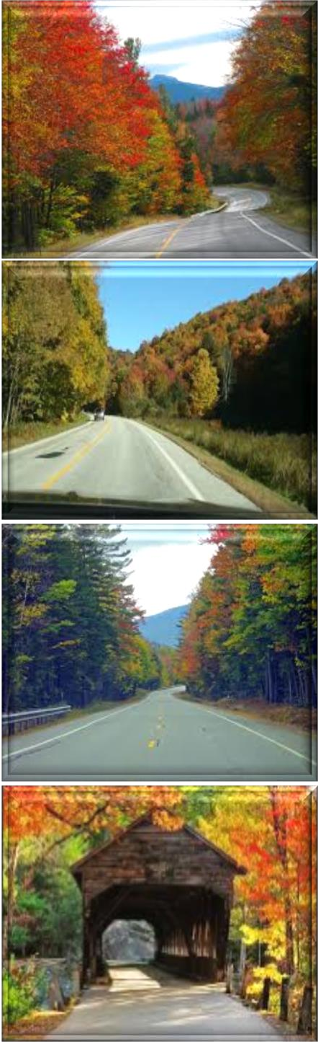
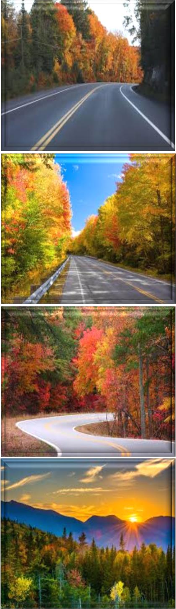
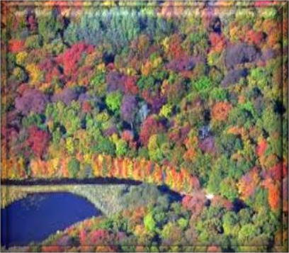
Consultancy Services for Project Management including Construction of High Altitude Hill Roads to “Border Road Organisation” (BRO) under Ditte – Dimme – Moying – Migging Road in the State of Arunachal Pradesh Package – III.
“Initial Environmental Examination” (IEE) Report, Ditte – Dimme – Moying – Migging Road,
BRO (PROJECT – BRAHMANK) – Roads,
Anticipated; Recommended and Refined Enhancement Measures of Road Design Phase for ZERO Pollution Level…!!!

Slide 30
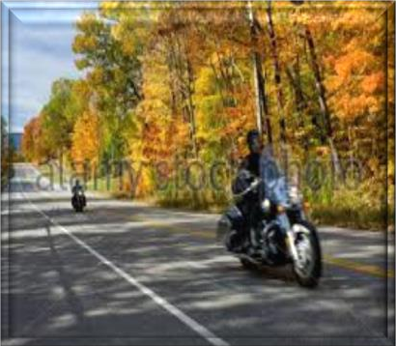





Consultancy Services for Project Management including Construction of High Altitude Hill Roads to “Border Road Organisation” (BRO) under Ditte – Dimme – Moying – Migging Road in the State of Arunachal Pradesh Package – III.
“Initial Environmental Examination” (IEE) Report, Ditte – Dimme – Moying – Migging Road,
BRO (PROJECT – BRAHMANK) – Roads,
Figure 27 (b): Anticipated Refined Enhancement Measures of Road Design Phase as per Alignment to Reduce Tree Cutting and Compensatory Plantation Relevance for ZERO Pollution Level.

Slide 31










Consultancy Services for Project Management including Construction of High Altitude Hill Roads to “Border Road Organisation” (BRO) under Ditte – Dimme – Moying – Migging Road in the State of Arunachal Pradesh Package – III.
“Initial Environmental Examination” (IEE) Report, Ditte – Dimme – Moying – Migging Road,
BRO (PROJECT – BRAHMANK) – Roads,
Figure 27 (c): Recommended Refined Enhancement Measures of Road Design Phase as per Alignment to Reduce Tree Cutting and Compensatory Plantation Relevance for ZERO Pollution Level.
Road Designing Phase for ZERO Pollution Level

Slide 32








Consultancy Services for Project Management including Construction of High Altitude Hill Roads to “Border Road Organisation” (BRO) under Ditte – Dimme – Moying – Migging Road in the State of Arunachal Pradesh Package – III.
“Initial Environmental Examination” (IEE) Report, Ditte – Dimme – Moying – Migging Road,
BRO (PROJECT – BRAHMANK) – Roads,
Figure 27 (d): Road Designing Phase as per Alignment to Reduce Tree Cutting and Compensatory Plantation Relevance for ZERO Pollution Level.
Impacts during design phase is limited to removal of trees, acquisition of land and structures, relocation of water ways, water parks, water bodies, water locations, water streams or channels identification and management of borrow pits are as mentioned in Table 42.
Table 42: Impacts during Design Phase.
Impacts | Mitigation Measures
Land Acquisition | Alignment design to minimize the land acquisition whenever applicable;
Major Displacement | Bypasses and detours to be considered preciously;
Removal of Trees | Alignment design to reduce the number, widening on the side of the road where less trees are required to be cut. Compensatory plantation to be planned;
Impact on Public Utilities e.g., Community Wells etc. | Alignment design to be considered. In case of removal alternate arrangement to be done before;
Impact on Cultural Sites | Alignment design to be considered. Public consultation may be needed if impact cannot be avoided;
Relocation of Waterways | Hydrology to be considered. Public consultation will be needed, wherever applicable;
Access Restriction | Required alternatives, underpasses, proper signposts for people should be included in design all types of roads constructions;
Congestion in Settlement Areas | Service road to be provided everywhere all over the road network;
Borrow Pits | Locations to be selected considering minimum loss of productive land and redevelopment and resettlement;
Environmental Specifications for Contractors | Environmental qualifications specification should be included in pre – qualification packages for the contractors and structure designers.

Slide 33
Consultancy Services for Project Management including Construction of High Altitude Hill Roads to “Border Road Organisation” (BRO) under Ditte – Dimme – Moying – Migging Road in the State of Arunachal Pradesh Package – III.
“Initial Environmental Examination” (IEE) Report, Ditte – Dimme – Moying – Migging Road,
BRO (PROJECT – BRAHMANK) – Roads,
Construction Phase
Environmental management during construction phase is more crucial, because major impacts during construction like earthworks road network, movement of heavy machineries etc. causes lot of disturbances and management becomes essential at this stage during construction work. The construction workers camp will be located at least 500 Meters away from habitations. The construction yard, “Hot Mix Plants” (HMPs) and crushers like “Asphalt Crusher Plants” (ACP) etc. will be located at 500 Meters away from habitations and in downwind directions. The minimum distance of these will be kept 3.0 Km. from reserve forest areas. Adequate cross drainage structures have been planned to maintain proper cross drainage. “In order to compensate negative impacts on floral species due to cutting of trees the project plans compensatory plantation in the ratio of 1: 3 i.e., for everyone has to be applied… if one tree is cut…!!! Then three or more trees will be planted”. The acquisition of forest area will be minimal and will be compensated through compensatory afforestation. The noise barriers have been planned closed to educational institute so that post project noise levels are within the specified limits. The project will take an opportunity to provide “Environmental Enhancement Measures” (EEM) to improve aesthetic activities in the projected area. The planned “Environmental Enhancement Measures” (EEM) include ponds enhancement, plantation in median and in available clear space in “Right of Way” (ROW), seating arrangements around trees must be installed or placed in the specific region. The pond “Enhancement Measures” (EM) will include such as stepped access; washing platforms and seating arrangements ought to be applied etc. Some of ditches will be filled up due to embankment construction in the “Right of Way” (ROW). In order to avoid contamination of water bodies during construction sedimentation chambers, oils and grease separators, oil interceptors at storage areas and at construction yard have been planned. The bill of quantities for mitigation and enhancement measures has been given in respective “Environmental Management Plans” (EMPs) of construction packages. Table 43 below summarizes impacts and its Environmental Management Plan during Construction Period.
Table 43: Environmental Management Plan during Construction Period.
Impacts | Mitigation Measures
Soil Erosion | Proper planning for slope stabilization, topsoil storage, plantation and turf on slopes;
Loss of Topsoil | Arable lands will be avoided for earth borrowing network. If needed, topsoil will be separated and refilled after excavation on operational site/ region/ area;
Borrowing of Fill Materials | Excavation from pre – selected locations. After excavation the borrow pits will be dressed to match with the surroundings. In specific cases borrow pits can be excavated in consultation with local people to use those pits as water harvesting point locations in particular areas/ sites;
Disposal of Construction Waste | No haphazard dumping of construction waste. Only pre – selected location maintaining local environmental regulations activities/ performance will be used for operational site;
Disposal of Human Waste by Construction Workers | Specific landfill sites should be identified to manage solid waste generated from habitation of construction workers on operational site/ area/ specified region;
Generation of Dust | Water will be sprayed during construction phase, in earth handling sites, asphalt mixing or crushing sites and other excavation areas for suppression of dust on operational site; In case fly ash is used, dust emission during its unloading, storage at open place and handling for road construction should be suppressed by water sprinkling at regular interval and operation with space and time; Dust emission from piles of excavated material should also be controlled by spraying water on the piles located areas/ sites/ regions; Special care should be taken when working near schools and medical facilities and other sensitive zones.
Environmental issues change during operation phase and its mitigation plans are also related with vehicular movement, road safety and management of ecological as well as natural/ environmental/ ordinary issues. Environmental aspects are thus more or less related to vehicular emission; domestic; industrial or anthropogenic activities in the surrounding areas. The mitigation measures for different environmental aspects are discussed in Table 44 below.
Table 44: Environmental Management during Operation Phase.
Impacts | Mitigation Measures
Dust | Bad road maintenance of road gives high rise to dust pollution. Road Surface will be maintained properly and constantly;

Slide 34

Consultancy Services for Project Management including Construction of High Altitude Hill Roads to “Border Road Organisation” (BRO) under Ditte – Dimme – Moying – Migging Road in the State of Arunachal Pradesh Package – III.
“Initial Environmental Examination” (IEE) Report, Ditte – Dimme – Moying – Migging Road,
BRO (PROJECT – BRAHMANK) – Roads,
Gaseous Pollution | All vehicles should be checked for “Pollution Under Control (PUC)”, certificates and occasional spot testing of emission from vehicles will be carried out in specified regions;
Noise | Noise level for different automobiles has been prescribed in Environment (Protection) Rules, 1986. Signs will be posted to restrict blowing of horns with high tons in front of highly sensitive locations or zones;
Surface Runoff | Surface runoff from the road will not be disposed directly in the water – bodies or surfaces used by people for bathing and washings purposes etc. It should also not be disposed directly in to any watercourse with good water quality;
Wild Life | There should be speed restrictions through specific forest area in the night and day time to prevent accident with wild animals. There will be proper signs and indications for the drivers to inform about these activities happening in the region/ area or site;
Flora | Tree plantations will be monitored continuously on regularly basis;
Safety | Safety signs and signals should be kept always clean and updated on regular basis;
Public Amenities | Bus stops, underpasses etc. should be kept in order for specified zones on the site/ region or area.
Waste Water and Solid Treatment Process
Current treatment strategies are directed towards reducing the amount of solid waste that needs to be land filled, as well as recovering and utilizing the materials present in the discarded wastes as a resource to the largest possible extent. Different methods are used for treatment of solid as well as waste water and the choice of proper method depends upon refuse characteristics, land area available and “Disposal of Human Waste by Construction Workers” with disposal cost as they are given below in pyrolysis process as shown in the Figure 28:
Figure 28: Process of Pyrolysis in Solid and Waste Water Treatment.
Pyrolysis: Pyrolysis is defined as thermal degradation of waste in terms of may be water or solid in the absence of air to produce char, pyrolysis oil and syngas, e.g., the conversion of wood to charcoal also it is defined as destructive distillation of waste in the absence of oxygen. External source of heat is employed in this process. Because most organic substances are thermally unstable they can upon heating in an oxygen – free atmosphere be split through a combination of thermal cracking and condensation reactions into gaseous, liquid and solid fraction.
Incineration process;
Compaction process;

Slide 35

Consultancy Services for Project Management including Construction of High Altitude Hill Roads to “Border Road Organisation” (BRO) under Ditte – Dimme – Moying – Migging Road in the State of Arunachal Pradesh Package – III.
“Initial Environmental Examination” (IEE) Report, Ditte – Dimme – Moying – Migging Road,
BRO (PROJECT – BRAHMANK) – Roads,
Pyrolysis process;
Gasification process;
Composting process.
Solid Waste Handling Practice
Proper method should be adopted for management of solid waste disposal in a soil. Industrial wastes can be treated physically, chemically and biologically until they are less hazardous. Acidic and alkaline wastes should be first neutralized; the insoluble material, if biodegradable should be allowed to degrade under controlled conditions before being disposed off into the soil. As a last resort, new areas for storage of hazardous waste should be investigated such as deep well injection and more secure landfills. Burying the waste in locations situated away from residential areas is the simplest and most widely used technique of solid waste management.
Environmental and aesthetic considerations must be taken into consideration before selecting the dumping site’s soil condition and quality. Incineration of other wastes is expensive and leaves a huge residue and adds to air, water and soil as major pollutant in terms of residue as well. “Pyrolysis Practice or Technique” is a process of combustion in absence of oxygen or the material burnt under controlled atmosphere of oxygen as Solid Waste Handling Pyrolysis Technique shown Figure 29. It is an alternative to incineration. The gas and liquid thus obtained can be used as fuels. Pyrolysis of carbonaceous wastes like firewood, coconut, palm waste, corn combs, wheat pod, cashew shell, rice husk, paddy straw, barley pod, maize husk and saw dust, yields charcoal along with products like tar, methyl alcohol, acetic acid, and acetone and fuel gases.
Figure 29: Solid Waste Handling Pyrolysis Technique.
Environment Baseline: Environmental, ecological and societal profile of the study region/ vicinity of project location are based on secondary data of Physiographic, Topology, Climate, Water Quality, Biological outline of town. The study has to be incorporated regarding “Sewage Treatment Plant” (STP) both in terms of theoretically and technically applicability for the specific region. The working model of Sewage Treatment Plant or principal subject matter has to be applied in the town so that it must play significant role for the people and its cultural civilization of the society as shown in the Figure 30. The flora and fauna recognized in the study spot are commonly found and not precise to the province due to the deficiency of forest in the study zone.

Slide 36

Consultancy Services for Project Management including Construction of High Altitude Hill Roads to “Border Road Organisation” (BRO) under Ditte – Dimme – Moying – Migging Road in the State of Arunachal Pradesh Package – III.
“Initial Environmental Examination” (IEE) Report, Ditte – Dimme – Moying – Migging Road,
BRO (PROJECT – BRAHMANK) – Roads,
Figure 30: Sewage Treatment Process (STP) of Wastewater Layout.
13. INSTITUTIONAL REQUIREMENTS AND ENVIRONMENTAL MONITORING PLANS
“National Highway Authority of India” (NHAI) has a well – established “Environmental Management Unit” (EMU), Head by a Senior Officer “Indian Forest Services” (IFS) from “Ministry of Environment and Forest” (MOEF), who is supported by an officer of Dy. G. M. rank from “State Pollution Control Board” (SPCB). Main responsibility of EMU will be established to monitor the progress regarding “Environmental Management Plan” (EMP). “Environmental Management Plan” will be the responsibility of contractors and will be closely coordinated by the “Engineer” (Supervision Consultant). Table 45 as given below discusses about the remedial measures components, locations/ regions/ areas, time frame work and institutional responsibility with applicable criteria.
Table 45: Institutional Responsibility of Remedial Measures.
Environmental Components | Remedial Measures Components | Locations/ Regions/ Areas | Time Frame Work | Applicable Responsibility Criteria
Design – Phase
Major Resources (Alignment, Public Amenities and Public Utilities)
Alignment | Avoid impacting school, health facilities, water bodies and residential quarters. | Throughout the Project Corridor. | During Design | Design Consultant
Public Amenities | Provision of service roads, underpasses, safety signs, bus stops, lay bees, parking spaces etc. | Throughout the Project Corridor as Mentioned in EIA Report. | During Design | Design Consultant
Closure of Public Utilities e.g., Tube – Wells, Wells, Bus Stops etc. | Alternative arrangement. | Throughout the Project Corridor as Mentioned in Social Impact Assessment (SIA). | At the Beginning of Construction Activities. | Contractor, Supervising Engineer
Construction – Phase
Water Resources and Pollution (Water Bodies, Rivers, Drinking and Wastewater Water)

Slide 37
Consultancy Services for Project Management including Construction of High Altitude Hill Roads to “Border Road Organisation” (BRO) under Ditte – Dimme – Moying – Migging Road in the State of Arunachal Pradesh Package – III.
“Initial Environmental Examination” (IEE) Report, Ditte – Dimme – Moying – Migging Road,
BRO (PROJECT – BRAHMANK) – Roads,
Water Bodies | Construction of embankments, de – siltation and environmental enhancement as mentioned in EIA report. | Water Bodies As Mentioned in EIA Report. | Throughout Construction Phase | Contractor, Supervising Engineer
Rivers/ Nallahs | Prevention of pollution of water. | Rivers/ Nallahs Mentioned in EIA Report. | Throughout Construction Phase | Consultant, Contractor, Supervising Engineer
Water Requirement for Construction | Arrange water without affecting local requirement. Do not use local water bodies. Drill boreholes with required permission. No water collection within forest area. | Throughout the Project Corridor. | Throughout Construction Phase. | Contractor, Supervising Engineer
Drinking Water Requirement | Arrange water without affecting local requirement. | Workers’ Camps Working Site. | Throughout Construction Phase. | Contractor, Supervising Engineer
Wastewater from Workers’ Camp | Ensure proper sanitation and drainage. No direct wastewater discharge in water bodies or the rivers/ Nallahs. | Workers’ Camps | Throughout Construction Phase | Contractor, Supervising Engineer
Air and Noise
Dust Generation | Spraying of water, proper handling of fly ash. | Throughout the Project Corridor. | Throughout Construction Phase. | Contractor, Supervising Engineer
Dust Generation near Sensitive Locations | Spraying of water, work during scheduled period only. | Schools, PHCs as Mentioned in EIA Report. | During Construction Near the Vulnerable Sites. | Contractor, Supervising Engineer
Asphalt Plant | Location away from sensitive areas. | Throughout the Project Corridor. | Throughout Construction Phase. | Contractor, Supervising Engineer
Stone Crushers | Implementing proper air pollution control measure as per law. | Stone Crushers. | Throughout Construction Phase. | Contractor, Supervising Engineer
Gaseous Emission from Construction Work Vehicles | Ensure checking of vehicular emission and obtaining Pollution Under Control (PUC) certificate. | Throughout the Project Corridor. | Throughout Construction Phase. | Contractor, Supervising Engineer
Noise from Machineries and Construction | Ensure machineries meeting noise level standards. Blasting to be done with required caution. | Throughout Projected Locality/ Region | Throughout Construction Phase | Contractor, Supervising Engineer
Noise at Sensitive Locations | Work only at scheduled period. Construct noise barrier if suggested. No work during night in forest areas. | At Schools, PHCs as Mentioned in EIA Report. In Forest Areas. | During Construction Near the Vulnerable Sites. | Contractor, Supervising Engineer
Land and Soil
Storage of Construction Materials, Debris. Fly Ash, etc. | Prevent siltation from washing of construction materials. | Throughout the Project Corridor. | During Rainy Seasons. | Contractor, Supervising Engineer
Soil Erosion | Proper planning for slope stabilization, topsoil storage, plantation and turf on slopes. | Throughout the Project Corridor. | Throughout Construction Phase. | Contractor, Supervising Engineer
Borrow Pits and Queries | Excavation from pre – selected locations. After excavation the borrow pits will be dressed to match with the surroundings. | Selected Borrow Pits and Quarries as given in EIA Report. | Throughout Construction Phase. | Contractor, Supervising Engineer
Solid Waste from Construction Work | Ensure dumping outside city area with permission from local authority or used as landfill material. | Throughout Project Area/ Site/ Region | Throughout Construction Phase. | Contractor, Supervising Engineer
Flora (Plants’ Life)
Tree Felling | Ensure plantation of trees on both sides of road and around in consultation with forest department. | Throughout the Project Corridor and Beyond. | Throughout Construction Phase. | Design Consultant, Contractor, Supervising Engineer
Fauna (Plants’ Life)

Slide 38
Consultancy Services for Project Management including Construction of High Altitude Hill Roads to “Border Road Organisation” (BRO) under Ditte – Dimme – Moying – Migging Road in the State of Arunachal Pradesh Package – III.
“Initial Environmental Examination” (IEE) Report, Ditte – Dimme – Moying – Migging Road,
BRO (PROJECT – BRAHMANK) – Roads,
Forest Area | No work after evening. No use of water bodies, safety regulations, no workers’ camp. | In the Forest Area. | Throughout Construction Phase | Contractor, Supervising Engineer
Others (Public, Religious and Aesthetics)
Workers’ Camp | Ensure providing camp of proper dimension and environmental quality as given in EIA report. | Workers’ Camps. | Throughout Construction Phase. | Contractor, Supervising Engineer
Public Facilities | Ensure access to all important locations. | Throughout the Project Corridor. | Throughout Construction Phase. | Contractor, Supervising Engineer
Religious Places | Ensure minimum disturbance during festival time. | Throughout the Project Corridor. | Religious Festivals. | Contractor, Supervising Engineer
Aesthetics | Planting flowering creepers on medians, slope vegetations, suitable design of restaurants etc. | Throughout the Project Corridor. | Throughout Construction Phase. | Contractor, Supervising Engineer
Operation – Phase
Sources (Dust, Gaseous Pollution, Forest, Safety and Public Amenities)
Dust | Road maintenance. | Throughout the Project Corridor. | Throughout Operation Phase. | Contractor, Supervising Engineer
Gaseous Pollution | Check the vehicles for pollution control. | Throughout the Project Corridor. | Throughout Operation Phase. | Contractor, Supervising Engineer, Traffic Department
Forest | Speed restriction safety signs underpass maintenance. | In Forest Areas. | Throughout Operation Phase. | Contractor, Supervising Engineer, Traffic Department
Safety | Maintain all safety provisions. | Throughout the Project Corridor. | Throughout Operation Phase. | Contractor, Supervising Engineer, Traffic Department
Public Amenities | Bus stop and other amenities to be properly kept. | Throughout the Project Corridor. | Throughout Operation Phase. | Contractor, Supervising Engineer, Traffic Department
14. PRINCIPAL COMPONENT ANALYSIS (PCA) INDICATORS
Significant Indicators as “Principal Component Analysis” (PCA) performed also indicates that indicators, which play significant role in explaining vulnerability among the districts states. Amongst all the indicators considered in particular sector indicators with weights greater than the average weight of all indicators are considered as important in explaining vulnerability study applications. Table 46 gives the list of significant indicators in order of their importance for each sector. These indicators can play important role in decision making process/ system/ methodology in a goal to reduce vulnerability.
Table 46: Principal Component Analysis as Significant Indicators of Remedial Measures.
Sr. No. | Principal Indicators Analysis/ Aspects | Conceptual Basis
(A) | Social Aspects/ Analysis
1. | Population Served Per Health Centre (Community, Primary and Sub Health Centers); | Adaptive Capacity
2. | Percentage of Households With Access To Sanitation Facilities; | Adaptive Capacity
3. | Level of Urbanization; | Adaptive Capacity
4. | Percentage of Households With Access to Safe Drinking Water; | Adaptive Capacity
5. | Density of Population; | Sensitivity
6. | Number of Slum Dwellers Per Slum; | Sensitivity
7. | Percentage of Households Owning Radio, Transistor, Television and Telephones; | Adaptive Capacity
8. | Proportion of Elderly Population Aged 65 and Above; | Sensitivity

Slide 39
Consultancy Services for Project Management including Construction of High Altitude Hill Roads to “Border Road Organisation” (BRO) under Ditte – Dimme – Moying – Migging Road in the State of Arunachal Pradesh Package – III.
“Initial Environmental Examination” (IEE) Report, Ditte – Dimme – Moying – Migging Road,
BRO (PROJECT – BRAHMANK) – Roads,
9. | Proportion of Child Population in The Age Group 0 – 6; | Sensitivity
10. | Literacy Rate and Growth; | Adaptive Capacity
(B) | Economic Aspects/ Analysis
11. | Agricultural Credit Societies Per Lakhs of Population; | Adaptive Capacity
12. | Loan Disbursed by Agricultural Credit Societies Per Cultivator; | Adaptive Capacity
13. | Scheduled Commercial Banks Per Lakhs of Population; | Adaptive Capacity
(C) | Agricultural Aspects/ Analysis
14. | Percentage of Land Holdings Below 1 Hectare; | Sensitivity
15. | Fertilizer Consumption and Utilization; | Adaptive Capacity
16. | Percentage of Net Irrigated Area to Geographical/ Physical/ Environmental Area By Surface Water; | Adaptive Capacity
17. | Percentage of Bio – Farming Villages in Total Villages; | Adaptive Capacity
18. | Percentage Share and Contribution of Agricultural And Cultivators Main Workers; | Sensitivity
19. | Yield and Capitulate of All Crops; | Adaptive Capacity
(D) | Water Aspects/ Analysis
20. | Crop Water Stress, Strain and Sprain (Evapo – transpiration/ Potential Evapo – transpiration); | Sensitivity
21. | Surface Water Availability and Accessibility; | Adaptive Capacity
(E) | Climate Aspects/ Analysis
22. | Warm Nights – Days, When Minimum Temperature > 90th Percentile; | Exposure
23. | Warm Days – Cool Nights – Days, When Maximum Temperature > 90th Percentile; | Exposure
24. | Warm Spell Duration Indicator (Annual count of days with at least 6 consecutive days when maximum temperature > 90th percentile); | Exposure
25. | Cool Days – Cool Nights – Days, When Maximum Temperature < 10th Percentile; | Exposure
26. | Cool Nights – Days, When Minimum Temperature < 10th Percentile; | Exposure
27. | Flood Discharge; | Exposure
28. | Extremely Wet Days – Annual Total Rainfall, When Rainfall > 99th Percentile; | Exposure
(F) | Health Aspects/ Analysis
29. | Percentage of People Having Diarrhea and Other Dieses; | Sensitivity
30. | Index, Directory, Catalog, Guide, Manifestation or Indicator of Malaria; | Sensitivity
(G) | Pollution Aspects/ Analysis
31. | Pollution of Rivers/ Wetlands, Degradation of Forests and Biodiversity Loss is Being Observed; | Exposure
32. | Effective Industrial Waste Management and Pollution Control; | Exposure
33. | With Increasing Pollution Increase in Respiratory Diseases and Allergies is Also Predicted to Increase on the Site; | Exposure
34. | Water Pollution is another Big Concern for the State. Depletion of Water Resources and Deterioration of Water Quality is Big Concern for the State; | Exposure
35. | Use of More Efficient Technology to Reduce Pollution. Effective Industrial Waste Management and Pollution Control; | Exposure
36. | Climate Change (CC) could Increase Air Pollution Levels by Accelerating the Atmospheric Chemical Reactions that Produce Photochemical Oxidants due to a Rise in Temperature; | Exposure
37. | Long Term Targets – By achieving renewable sources of environmental factors/ parameters through agriculture – ecosystem management, implementation of main schemes as soil carbon storage and metersing, enhancing soil health, reducing ground water pollution specially harmful chemicals and enhancing biodiversity modifications; | Exposure
38. | The other serious issues of groundwater quality are high concentration of fluorides (mainly in granitic terrain), agricultural, municipal and industrial or anthropogenic pollutions; | Exposure
(H) | Forest Aspects/ Analysis
39. | Percentage of High Density Forest Area to Geographical Area; | Adaptive Capacity
40. | Non – Timber Forest Products (NTFPs) Diversity (Number of Varieties); | Adaptive Capacity
41. | Number of Joint Forest Management (JFM) Communities, Neighbourhood – Area – District – Groups of People; | Adaptive Capacity
(I) | Soil Aspects/ Analysis
42. | Dependence on natural resources is the way of life but unsustainable practices of harvesting, irrigation, elimination of crop residue, forest degradation, deteriorating soil and water quality are augmenting the problems besides other impacts of Climate Change (CC) occur in the state; | Adaptive Capacity
43. | Mono – cropping reduces the crop diversity and adversely affects the soil health in the state or region; | Sensitivity
44. | Soil and water conservation innovative ideas must be applied through demonstration of best engineering practices; | Sensitivity
45. | Set up a knowledge management network to avail information on land – use pattern, soil types, weather or climatic conditions, genotypes of crops, water availability, pasture, off – season crops and agro – forestry practices etc. | Adaptive Capacity
46. | Develop capacity to run agriculture related climate models, decipher their projections, to understand the impact on crops, soils and water like precious and important factors etc. in the region/ area or state; | Adaptive Capacity

Slide 40



Consultancy Services for Project Management including Construction of High Altitude Hill Roads to “Border Road Organisation” (BRO) under Ditte – Dimme – Moying – Migging Road in the State of Arunachal Pradesh Package – III.
“Initial Environmental Examination” (IEE) Report, Ditte – Dimme – Moying – Migging Road,
BRO (PROJECT – BRAHMANK) – Roads,
47. | Soil testing – practice and packages must be applied during civil construction work (soil kit to the farmers); | Exposure
48. | Undertake and revise soil resource mapping at village/ local/ regional or state level; | Exposure
49. | Promote use of water and soil conservation techniques, namely dry land farming, drip irrigation, intermittent flooding, drying sowing use of high yielding drought resistant cultivars as appropriate etc. in different areas or states; | Adaptive Capacity
50. | Promote agro – forestry and agro – climatic or weather conditions to increase forest biomass and hence soil moisture; | Exposure
51. | Identify critical unspecified areas within forests for soil and water conservation; | Exposure
52. | This effort would not only provide fodder to the animals, but also would curb or reduce further land degradation and soil erosion; | Exposure
53. | Soil moisture stress to the crops leading to their stunted growth in the region or state; | Exposure
54. | Soil and water conservation technologies will need to be strongly adopted after observing or seeing the rising temperatures and decreasing water conditions in the state; | Adaptive Capacity
55. | Soil and water conservation through demonstration of best practices: Application of mulching techniques, drip irrigation, and micro/ macro irrigation practices, techniques and methodologies etc. should be encouraged; | Adaptive Capacity
56. | Soil conditions may pose threat problems with an expected increase in acidity, alkalinity and salinity; | Sensitivity
57. | Soil temperature may increase in spring hence the planting time may also vary accord to space and time; | Sensitivity
58. | Further, it would be worthwhile to build and strengthen capacity in the state to run climate models, interpret their projections, and use the same to run the various bio physical models to understand the impact of “Climate Change” (CC) on crops, soils, water etc. and then to design appropriate adaptation strategies during construction of civil work or human made or designed, but not natural process; | Adaptive Capacity
59. | In some regions mono – cropping of soybean wheat is rendering the soil infertile, sterile, unproductive, barren, unfruitful, arid, uncultivable and may lead to over use of artificial fertilizer which may be detrimental in the long run; | Sensitivity
60. | Promoting and managing agro – forestry, agro – climatic specific crops farming practices and management including that of water, soil, pests, crops, cropping cycle and practices for harnessing the full productivity potential of the different zones should be done on high priority basis for regional areas or site locations; | Adaptive Capacity
61. | This would mean promoting measures for soil moisture conservation through development of watersheds and small catchments that would also increase biomass production and increase the fertility of the “Precious Soil” as well on “Precious Planet Earth”; | Adaptive Capacity
62. | Also as the evapo – transpiration rate increases with increase in temperature, it will lead to depletion in moisture retention capacity of the different soil types and can pose a threat to agricultural activities; | Sensitivity
63. | Expansion of area of cultivation under mono – cropping of profitable crops without nutrition management is leading to rapid decline in soil fertility of these farms and agricultural fields; | Adaptive Capacity
64. | Simple soil and water conservation techniques, methodologies, applications, processes and overall watershed development including the rejuvenation of tanks is proposed to be the focus; | Adaptive Capacity
65. | Low capacity of natural water recharge and resources system in the sub – soil in most of the areas of “Arunachal Pradesh” is also a major concern; | Sensitivity
66. | Water logging in canal command areas leads to soil salinity and needs immediate attention towards conjunctive use of surface streams, channels and ground water; | Sensitivity
67. | The state is characterized by a great diversity of parent rocks and minerals, which have weathered under different climatic conditions, vegetative covers and topographic situations to form soils with different characteristics in different zones; | Exposure
68. | Shifting of rainfall pattern affects cropping and farming patterns. Mono – cropping reduces the crop diversity and adversely affects the precious and significant soil health conditions. | Sensitivity
Aspects of Transparent Skeleton – Flowers in Rainy Season, Diphylleia Grayi Rare – Plants.

Slide 41


Consultancy Services for Project Management including Construction of High Altitude Hill Roads to “Border Road Organisation” (BRO) under Ditte – Dimme – Moying – Migging Road in the State of Arunachal Pradesh Package – III.
“Initial Environmental Examination” (IEE) Report, Ditte – Dimme – Moying – Migging Road,
BRO (PROJECT – BRAHMANK) – Roads,
Figure 31 (a): TCS: TYPICAL CROSS SECTION FOR 2 – LANE CARRIAGEWAY. TYPICAL CROSS SECTION – I
Figure 31 (b): TYPICAL CROSS SECTION: FOR 2 – LANE CARRIAGEWAY. TYPICAL CROSS SECTION – II

Slide 42


Consultancy Services for Project Management including Construction of High Altitude Hill Roads to “Border Road Organisation” (BRO) under Ditte – Dimme – Moying – Migging Road in the State of Arunachal Pradesh Package – III.
“Initial Environmental Examination” (IEE) Report, Ditte – Dimme – Moying – Migging Road,
BRO (PROJECT – BRAHMANK) – Roads,
Figure 31 (c): TYPICAL CROSS SECTION: FOR 2 – LANE CARRIAGEWAY. TYPICAL CROSS SECTION – III
Figure 31 (d): TYPICAL CROSS SECTION: FOR 2 – LANE CARRIAGEWAY. TYPICAL CROSS SECTION – IV

Slide 43


Consultancy Services for Project Management including Construction of High Altitude Hill Roads to “Border Road Organisation” (BRO) under Ditte – Dimme – Moying – Migging Road in the State of Arunachal Pradesh Package – III.
“Initial Environmental Examination” (IEE) Report, Ditte – Dimme – Moying – Migging Road,
BRO (PROJECT – BRAHMANK) – Roads,
Figure 31 (e): TYPICAL CROSS SECTION: FOR 2 – LANE CARRIAGEWAY. TYPICAL CROSS SECTION – V
Figure 31 (f): TYPICAL CROSS SECTION: FOR 2 – LANE CARRIAGEWAY. TYPICAL CROSS SECTION – VI

Slide 44


Consultancy Services for Project Management including Construction of High Altitude Hill Roads to “Border Road Organisation” (BRO) under Ditte – Dimme – Moying – Migging Road in the State of Arunachal Pradesh Package – III.
“Initial Environmental Examination” (IEE) Report, Ditte – Dimme – Moying – Migging Road,
BRO (PROJECT – BRAHMANK) – Roads,
Figure 31 (g): TYPICAL CROSS SECTION: FOR 2 – LANE CARRIAGEWAY. TYPICAL CROSS SECTION – VII
Figure 31 (h): TYPICAL CROSS SECTION: FOR 2 – LANE CARRIAGEWAY. TYPICAL CROSS SECTION – VIII

Slide 45


Consultancy Services for Project Management including Construction of High Altitude Hill Roads to “Border Road Organisation” (BRO) under Ditte – Dimme – Moying – Migging Road in the State of Arunachal Pradesh Package – III.
“Initial Environmental Examination” (IEE) Report, Ditte – Dimme – Moying – Migging Road,
BRO (PROJECT – BRAHMANK) – Roads,
Figure 31 (i): TYPICAL CROSS SECTION: FOR 2 – LANE CARRIAGEWAY. TYPICAL CROSS SECTION – IX
Figure 31 (j): TYPICAL CROSS SECTION: FOR 2 – LANE CARRIAGEWAY. TYPICAL CROSS SECTION – X

Slide 46


Consultancy Services for Project Management including Construction of High Altitude Hill Roads to “Border Road Organisation” (BRO) under Ditte – Dimme – Moying – Migging Road in the State of Arunachal Pradesh Package – III.
“Initial Environmental Examination” (IEE) Report, Ditte – Dimme – Moying – Migging Road,
BRO (PROJECT – BRAHMANK) – Roads,
Figure 31 (k): TYPICAL CROSS SECTION: FOR 2 – LANE CARRIAGEWAY. TYPICAL CROSS SECTION – XI
Figure 31 (l): TYPICAL CROSS SECTION: FOR 2 – LANE CARRIAGEWAY. TYPICAL CROSS SECTION – XII

Slide 47


Consultancy Services for Project Management including Construction of High Altitude Hill Roads to “Border Road Organisation” (BRO) under Ditte – Dimme – Moying – Migging Road in the State of Arunachal Pradesh Package – III.
“Initial Environmental Examination” (IEE) Report, Ditte – Dimme – Moying – Migging Road,
BRO (PROJECT – BRAHMANK) – Roads,
Figure 31 (m): TYPICAL CROSS SECTION: FOR 2 – LANE CARRIAGEWAY. TYPICAL CROSS SECTION – XIII
Figure 31 (n): TYPICAL CROSS SECTION: FOR 2 – LANE CARRIAGEWAY. TYPICAL CROSS SECTION – XVI

Slide 48


Consultancy Services for Project Management including Construction of High Altitude Hill Roads to “Border Road Organisation” (BRO) under Ditte – Dimme – Moying – Migging Road in the State of Arunachal Pradesh Package – III.
“Initial Environmental Examination” (IEE) Report, Ditte – Dimme – Moying – Migging Road,
BRO (PROJECT – BRAHMANK) – Roads,
Figure 31 (o): TYPICAL CROSS SECTION: FOR 2 – LANE CARRIAGEWAY. TYPICAL CROSS SECTION – XV
Figure 31 (p): TYPICAL CROSS SECTION: FOR 2 – LANE CARRIAGEWAY. TYPICAL CROSS SECTION – XVI

Slide 49


Consultancy Services for Project Management including Construction of High Altitude Hill Roads to “Border Road Organisation” (BRO) under Ditte – Dimme – Moying – Migging Road in the State of Arunachal Pradesh Package – III.
“Initial Environmental Examination” (IEE) Report, Ditte – Dimme – Moying – Migging Road,
BRO (PROJECT – BRAHMANK) – Roads,
Figure 31 (q): TYPICAL CROSS SECTION: FOR 2 – LANE CARRIAGEWAY. TYPICAL CROSS SECTION – XVII
Figure 31 (r): TYPICAL CROSS SECTION: FOR 2 – LANE CARRIAGEWAY. TYPICAL CROSS SECTION – XVIII

Slide 50





Consultancy Services for Project Management including Construction of High Altitude Hill Roads to “Border Road Organisation” (BRO) under Ditte – Dimme – Moying – Migging Road in the State of Arunachal Pradesh Package – III.
“Initial Environmental Examination” (IEE) Report, Ditte – Dimme – Moying – Migging Road,
BRO (PROJECT – BRAHMANK) – Roads,
Figure 32: BOTHER... SAFEGUARD; PROTECT; CONSERVE AND PRESERVE OUR PLANET EARTH’S NATURAL – MOTHER... (ECO – NATURAL – GREEN – ENVIRONMENT)...!!!
***************************
*********************

Slide 51
Consultancy Services for Project Management including Construction of High Altitude Hill Roads to “Border Road Organisation” (BRO) under Ditte – Dimme – Moying – Migging Road in the State of Arunachal Pradesh Package – III.
“Initial Environmental Examination” (IEE) Report, Ditte – Dimme – Moying – Migging Road,
BRO (PROJECT – BRAHMANK) – Roads,
CHAPTER – 2: ENVIRONMENT SCREENING REPORT
  GENERAL DESCRIPTION
The “Initial Environmental Examination” (IEE) is carried out to assess the potential environmental impacts likely to be triggered by the project road. The project road will be reconstructed without any land acquisition and displacement of people. The project road belongs to Category C projects as per BRO's recent Environmental Assessment Guidelines and requires an IEE to be carried out. IEE report will be prepared based on the IEE format of “Advanced Data or Design Systems” (ADS) with due consideration to environmental legislation e.g., “Environmental (Protection) Rules, 1986 of Government of India” (GOI). The Project Road for Ditte – Dimme – Migging Road is situated in Arunachal Pradesh. The alignment of the project road connects Ditte – Dimme – Migging Road respectively.
The objectives of IEE are as following:
    To provide information about the general environmental settings around the sub project area as baseline data;
    To provide information on potential impacts of the project and characteristic of impacts, magnitude, distribution and their duration;
    To provide information on potential mitigation measures to minimize the impact;
    To provide information on the basis of “Environmental Management Plans” (EMPs);
    The field visits were made to collect the requisite information from various government departments and from other secondary sources (including limited public consultation in the form of focused group discussions).
In the “IEE Activities Proposed” to be undertaken as part of this project will be considered and the potential impacts will be analyzed.
  DESCRIPTION OF THE PROJECT
The Project Road for Ditte – Dimme – Migging Road is situated in Arunachal Pradesh. The proposed project road at present has single lane carriageway. The road will be widened for intermediate lane. It is planned to reconstruct the existing road with provisions for side drains, bridges, culverts etc. The project road will be implemented within the existing “Right of Way” (ROW) without any land acquisition. The terrain is flat with very minor changes in elevation, and the landscape is open and devoid of forest cover. The only noticeable changes from the flat terrain occur in the few places, where the road briefly descends through ravines carved out by streams and then climbs back to the level plain. Settlements are sparse; the road runs largely through open fields/ barren lands. Many hand pumps are placed alongside the roadways or roadside for obtaining drinking water.
  BRO REQUIREMENTS
The BRO classifies projects such as “Scientific Research and Experimental Development” (SRED)
into one of three categories based on a screening of their expected environmental impacts:
    Category “A”: Category “A” Projects are defined by the BRO as "Projects expected to have significant adverse environmental impacts. An “Environmental Impact Statement/ Assessment” (EIS/ A) (as defined by the BRO regulations) is required to address significant impacts."
    Category “B”: Category “B” Projects are defined as "Projects judged to have some adverse environmental impacts, but of a lesser degree and/ or significance than those for Category A projects. An “Initial Environmental Examination” (IEE) is required to determine whether or not significant environmental impacts warranting an EIA are likely. If an EIA is not needed, the IEE is regarded as the “Final Environmental Assessment Report” (FEAR)."
    Category “C”: Category “C” projects are defined as "Projects unlikely to have adverse environmental impacts. No EIA or IEE is required, although environmental implications are still reviewed."
  GOVERNMENT OF INDIA REQUIREMENTS
The following is provided for informational purposes. The “IEE OR FEAR” in hand has not been prepared to meet the specific criteria/ strategies/ goals/ objectives in actual on priority basis, and does not support to meet “Government of India” (GOI) requirements that may ultimately be determined to be applicable to certain “Scientific Research and Experimental Development” (SRED) activities. As of this writing, it is not anticipated that any GOI’s process/ system concerning EIAs will be required. Careful planning of those activities that of necessity occur outside the existing “Right of Way” (for example: placement of labour camps,

Slide 52
Consultancy Services for Project Management including Construction of High Altitude Hill Roads to “Border Road Organisation” (BRO) under Ditte – Dimme – Moying – Migging Road in the State of Arunachal Pradesh Package – III.
“Initial Environmental Examination” (IEE) Report, Ditte – Dimme – Moying – Migging Road,
BRO (PROJECT – BRAHMANK) – Roads,
extraction of fill from borrows areas, placement of temporary approaches to river crossings during bridge replacement), combined with proper contracting and procurement measures should keep all SRED activities below the thresh – hold limit that would trigger or activate the mechanism, which is in actual practice the need for an EIA OR EIS.
    Central Government Requirements
      Primary responsibility for administration and implementation of the GOI policy with respect to conservation, ecologically or environmentally sustainable development and pollution control rests with the “Ministry of Environment and Forest” (MOEF) and the regulations established pursuant to the National Conservation Strategy; National Forest Policy; the Policy for Abatement or Mitigation Strategies of Pollution (1992); and the Indian Environmental Protection Act – 1986 (29th of 1986), revised in the year 1997.
      Guidance for the preparation of “Environmental Impact Assessments/ Statements” (EIA/ S) within this overall framework for environmental clearance of new development proposals is provided and suggested by the GOI's Handbook of Environmental Procedures and Guidelines (1994).
      Additional guidelines for road projects are provided by the “Ministry of Road Transport and Highways” (MORTH) in its publication entitled Environmental Guidelines for Rail/ Road and Highway Projects. The Guidelines include the summary questionnaire to be submitted to MOEF for the preparation and planning of EIAs for domestic road projects requiring EIA as noted above in the paragraphs.
      MOEF Circular No. 21012/ 26 – 99 – la – 111 dated 22nd August, 2013 exempts linear projects with ROWs of less than 40 metros (including the existing “Right of Way” (ROW) and land acquisition as may be required by the project) from most review processes. Projects entirely contained within the existing “Right of Way” (ROW) are considered as maintenance, which is generally not subject to MOEF review.
      Thus, road projects limited to actions as per instructions such as those are proposed and implemented by “Scientific Research and Experimental Development” (SRED) are generally exempted from GOI/ EIA requirements. The Project will not include construction of any new high level bridges and thus will not require significant changes and variations to the existing roadsides/ ways alignment or grade level quality construction of civil work.
    State Forest Department Requirements
Removal of Trees along the Right of Way (ROW): Trees will have to be removed within the existing “Right of Way” (ROW) in some places to allow for widening of the carriageway, construction of shoulders, or to meet and follow current road safety standards. It should be noted that trees within the Right of Way are considered to be within the purview of the “State Forest Department” (SFD). Therefore, an application will be required pursuant to MOEF Letter Ref. No. 4 – 1/97' – FC, dated 18th February, 1998, which provides revised guidelines for applicability of the Forest Conservation Act (1980) to linear infrastructure projects such as rail and road projects. Clearance by the “State Forest Department” is assumed to have been granted/ decided/ approved/ fixed and established unless there is an indication to the contrary within 30 days.
Impacts to Reserved Forests: In the event of potential impacts to Reserved Forests, a “Notice of Compliance” (NOC) is required from the “State Forest Department” (SFD). In the event that a submission to MOEF is required, the NOC must be obtained prior to action by MOEF as an esteemed organisation.
    State Pollution Control Board Requirements (SPCB)
      Certain actions to be included in SRED (e.g., the locations and operations of asphalt crushing or mixing plants) will require submission of an application to the SPCB pursuant to the water (Prevention and Control of Pollution) Act of 1974, Cass Act of 1977, and Air (Prevention and Control of Pollution) Act of 1981.
      The SPCB generally establishes a review panel or board/ section/ group/ jury members and circulates the application for public review and comment in each affected district. At least one public hearing is held in each affected district following not less than 30 days notice in local and regional newspapers/ media network/ news channels etc.
      A state – level hearing is also required, taking all comments received from the districts into account and assuming acceptability of the SPCB issues as per NOC status and standard maintained for civil construction road network.
      The SPCB's NOC, as well as the Forest Department's NOC is required before MOEF action on any required EIA can be considered complete or whole comprehensive and inclusive report work.
2.5 DESCRIPTION OF THE ENVIRONMENT
Data and information required for preparation of the “Initial Environmental Examination” (IEE) report have been collected from various government departments or agencies/ well established organizations, secondary sources and through actual field visits/ tours/ on site/ area/ location fieldworks etc. Environmental conditions for applicability index of the area are discussed below one by one in detail:

Slide 53
Consultancy Services for Project Management including Construction of High Altitude Hill Roads to “Border Road Organisation” (BRO) under Ditte – Dimme – Moying – Migging Road in the State of Arunachal Pradesh Package – III.
“Initial Environmental Examination” (IEE) Report, Ditte – Dimme – Moying – Migging Road,
BRO (PROJECT – BRAHMANK) – Roads,
(i)
Physical Resources
Weather and Climate Index
Ditte – Dimme – Moying – Migging (दिते – दिम्मे – मोईगं – दमगदगंग)
  Arunachal Pradesh is nestled in the upper Himalayan range and because of the altitude, experiences a tundra or alpine weather patterns. The temperature range hence remains between 8°C – 35°C. Visiting Arunachal can be a pleasant experience for visitors who generally face the heat of the mainland when travelling to other parts of India. The weather in Arunachal can be cool and refreshing and here are listed the details on the best time to visit Arunachal Pradesh. Arunachal is an ideal summer vacation destination for families, solo travellers and even adventure seeking honeymooners. With the temperatures ranging from 20°C – 35°C, it makes an ideal summer vacation for family, honeymooners and even for solo travellers. If travelling in summer, trek and go sightseeing around places like Tawang, Roing, Ziro, Namdapha National Park etc. and this is also the time to see wildlife in abundance in the wildlife reserves or bask in nature around the beautiful waterfalls and find peace in the many temples and monasteries around. Since summer is considered off – season, one can get the best deals on hotels and travel on budget. After summer in the hills, the monsoon season cools the land and nature is bountiful and beautiful. Though monsoon is short – lived, the overall region receives quite a bit of rainfall, close to 2,000 mm to 4,000 mm. At times there can be a sudden change in weather patterns though and often heavy showers and landslides are common. The adventure – seeking type, some tourist attractions that are not to be missed and experienced include Nuranang Falls and Bap Tenges Kang Waterfall. This is the ideal time to visit Arunachal as the weather is cool and pleasant; just the perfect season to go for a sightseeing expedition. Winter is surprisingly the ideal time to go as there is the special attraction of the winter festival. Nyokum Yullo and Chalo Loku are agricultural festivals celebrated during the month of February. Another draw is the Pangsau Pass Winter Festival, celebrated during the month of January, which is one of the most popular tourist attractions of the region.
Climate and Temperature Index
  There is no meteorological observatory in the district and on the basis of records of the observatories in the districts where similar climatic conditions prevail. It is very cold in summer also. North District summer highest day temperature is in between 12°C to 21°C. Average temperatures of January is 5°C, February is 7°C, March is 11°C, April is 14°C, May is 15°C for specific regions. The mean temperature in the lower altitudinal zone, it varies from 1.5°C to 9.5°C. Temperature varies with altitude and slope of mountainous/ hilly region and the maximum temperature is recorded usually during July and August and minimum during December and January. Fog is a common feature in the entire Arunachal Pradesh from May to September. Biting cold is experienced at high altitude places in the winter months and snowfall is also not uncommon during this period. Humidity varies from 80 to 90% and wind flows at 16 KPH from West to East on an average. “Transmission Windows” (TWs) for malaria i.e., the appropriate conditions of temperature and humidity in which a vector thrives, is projected to increase (temperature ranges between 14 – 40°C, and RH > 50%) with “Climate Change” (CC).
Rainfall and Temperature Index
  PHYSICAL ASPECTS: With an annual average rainfall of 2,068 mm, it is one of the highest rainfall receiving regions on the planet, which makes it an important site from a meteorological perspective. Analysis of rainfall data plays an important role for any water resource planning as well as for hydrological modeling. The mean monthly rainfall data for all districts of Arunachal for 102 years (1901 – 2002) were used for the present study displays the annual rainfall behavior recorded for whole Arunachal for the duration 1901
– 2002. The average annual rainfall recorded is 1069 mm for the whole duration. During this period, the highest amount of rainfall was about 1982.15 mm in 1936, whereas the lowest amount of rainfall recorded was about 559.98 mm during 1987. The dark line in the figure represents the annual average rainfall. If the annual rainfall in a year departs from the average annual rainfall by greater than or equal to 25%, then it is declared as a drought (meteorological drought) year. On the basis of 25% departure from the average annual rainfall, 30.4% times there were dry years. There was sufficient rainfall from July to September to meet evapotranspiration demand and vice versa from the October to June.
(i) Moderate rainfall (more than 800 mm) receiving region in the Northern and South – Eastern parts of the district/ region/ locality;

Slide 54
Consultancy Services for Project Management including Construction of High Altitude Hill Roads to “Border Road Organisation” (BRO) under Ditte – Dimme – Moying – Migging Road in the State of Arunachal Pradesh Package – III.
“Initial Environmental Examination” (IEE) Report, Ditte – Dimme – Moying – Migging Road,
BRO (PROJECT – BRAHMANK) – Roads,
(ii) Low rainfall (700 mm to 800 mm) in the extensive Eastern and Southern parts of the district/ region/ locality;
(iii) Very low rainfall (less than 700 mm) in the Western part of the district/ region/ locality.
Climate projections for 2030s (2021 – 2050) and 2080s (2071 – 2098) have been derived from “PRECIS” (Providing Regional Climate for Impact Studies), which is a desktop version of the HadRM³ model with a grid resolution of 0.44°×0.44° Angles. PRECIS simulation dataset is provided by the “Indian Institute of Tropical Meteorology” (IITM), Pune. The “Climate Change Scenarios” (CCS) are driven by the “Green House Gases” (GHG) Emission Scenario, which assumes a future world of very rapid economic growth, a global population that peaks in midcentury and declines thereafter and assumes rapid introduction of new and more efficient technologies/ innovations in this scenario or field. Change in precipitation and temperature in 2030s and end of the century 2080s have been derived with respect to 1970s (1961 – 1990).
Humidity Index
  Humidity is found to be 47% along with West wind flow at 9.00 Km/ Hr towards NNW and Wind Gusts is 11 Km/ Hr. Arunachal’s current Weather and Temperature on an average is 26.9°C to 29.0°C and there is found to be overcast clouds, few clouds, clear sky, scattered clouds, broken clouds, along with moderate rain and light rain. Arunachal Live Weather Temperature has been found to be (30°C × 9/ 5) + 32 = 86°F in summer and Weather Forecast for next 3 days may varies between 8.0°C to 35°C with heavy intensity rain. Pressure level is observed to be 1008.00 mb and Ultra
– Violet Index is near about 2 (Low) with Cloud Cover 42%. Ceiling point is 5,639 m and dew point is found to be 14°C with visibility 15 Km. Arunachal
is home to several Himalayan glaciers. It became renowned for the quality of the tea grown on the hills around the town, and today tea and tourism
are still the main income earners for the area in Arunachal Pradesh.
  Since the study region lies far away from the sea coast area/ region, it experiences continental type of climate zone. It has the Tropical monsoon climate with five distinct/ dissimilar/ divergent seasons namely…!!!
    i. Monsoon season extending from June to September month;
    ii. Retreating monsoon season extending from October to November month;
    iii. Winter season – December to February month;
    iv. Summer season – March to May month.
    v. The temperature during spring season ranges between 6°C at night to 17°C during day in the month of December the sky generally remains clear in Arunachal Pradesh;
    vi. Autumn season falls on the months of September and October in Arunachal Pradesh;
  Other minor effects are increased incidences of skin disorders, such as prickly heat and fungal skin disorders such as ringworm and athlete's foot as a result of increased temperature and humidity. Some of the viral diseases like “Peste des Petits Ruminants” (PPR) are an acute or sub – acute viral disease of goats and sheep characterized by fever, necrotic stomatitis, gastroenteritis, pneumonia etc. may also re – appear affecting small ruminant population as well. “Temperature Humidity Index” (THI), representing the combined stress of temperature and humidity, affects the productivity of livestock. In addition to these inherent problems increasing temperature and humidity are also affecting the quality of these produce. For value addition, processing units and marketing of products need to be developed for rural clusters in different “Agro – Climatic Zones” (ACZ). This would also help in reducing the wastage of the produce. Beside the vector borne diseases that could expand its occurrences, other infections that are related to varying temperature and humidity indices are also imminent threats to human health and its well beings.
Ambient Air Quality Index
  The air quality along the roadsides/ ways is good as there is less flow of traffic. No major source of emission of exhaust gases exist along the roadways or roadsides except some

Slide 55
Consultancy Services for Project Management including Construction of High Altitude Hill Roads to “Border Road Organisation” (BRO) under Ditte – Dimme – Moying – Migging Road in the State of Arunachal Pradesh Package – III.
“Initial Environmental Examination” (IEE) Report, Ditte – Dimme – Moying – Migging Road,
BRO (PROJECT – BRAHMANK) – Roads,
commercial and residential establishments concerns, enterprises, shops etc., which burn wood as a fuel for commercial and domestic purposes/ reasons or functions.
As existing road is in narrow condition, dust due to wind – blown and movement of vehicles on earthen shoulder portion is observed experimentally, physically and practically along the roadside. However, such dust particles are settled or mend or resolved within short distances from the road.
Noise Levels Index
  In the area along the projected road, noise levels are moderate as there is less traffic flow. Therefore, the contribution of traffic, an increase of ambient noise levels can be considered insignificant or unimportant and immaterial.
Seismological Index
  As per seismic zonal map of India, the sub project area is located in seismic zone – II. The bridges, culverts and other structures, therefore, need to be designed accordingly as per specific record of civil construction work.
(ii)
Ecological Resources Index
Terrestrial Ecology
Impacts to flora will be minimal throughout most of the projected areas. Most of the length of the “Right of Way” (ROW) lies in rural areas as well as some parts of urban areas also. Insofar as can be determined, no threatened or endangered plant species are located within or adjacent to the affected ROWS and no adverse impacts to special status of species/ varieties/ groups are likely to occur due to these activities. Virtually all rehabilitation and resettlement applicable processes or activities will be confined to the existing ROWS, and both direct and indirect impacts to threatened or endangered plant species are unlikely. Plant species present within the “Right of Way” (ROW) are either introduced species or ubiquitous native species, which are highly tolerant of grazing, compaction, and other physical disturbances. Construction activities will have direct impact only in a narrow band of vegetation adjacent to the existing roadways. Potential impacts to flora, in both the forested and non – forested land areas will be avoided by ensuring that roadside activities such as asphalt crushing and hot mixing plants, construction camps and other ancillary features are properly sited. Right of Way, both inside and outside of forested areas is lined by mature trees overarching the roadways/ roadside. In some portion trees will have to be cut to permit rehabilitation and resettlement of the roads to current/ recent applicable safety measure standards.
Wildlife
  The road does pass through any wildlife area in the projected region. And wildlife zone occurs in the region/ area or state.
Fisheries
  No fishing activity is observed in the drains of sub – projected area. And no fisheries zone occurs in the region/ area or state.
(iii)
Economic Development
Industries
  No major/ minor industrial activity is observed along the projected roadside. Therefore no industrial zone occurs in the region/ area or state.
Commercial Activities
  Commercial activities observed mostly near the inhabitation portion, along the projected road. These commercial activities are in the form of shops/ malls or complexes in the region/ area or site.
Infrastructure Facilities
  Infrastructure facilities are adequate/ sufficient and satisfactory in the area along the projected roadside.

Slide 56
Consultancy Services for Project Management including Construction of High Altitude Hill Roads to “Border Road Organisation” (BRO) under Ditte – Dimme – Moying – Migging Road in the State of Arunachal Pradesh Package – III.
“Initial Environmental Examination” (IEE) Report, Ditte – Dimme – Moying – Migging Road,
BRO (PROJECT – BRAHMANK) – Roads,
Agricultural Development
  The climate of the area is more suitable for growing agricultural i.e., wheat, soya bean, Zwaar (Heavy), Bazra or Pearl Millet (Pennisetum Glaucum) is the most widely grown type of millet as a part of plants and vegetables. There exists huge potential as far as the agriculture development is concerned. Soils are Medium to Deep – Black with relatively high clay content. The major agricultural crops are wheat, gram soybeans and cotton seeds for cotton generation/ production etc.
  SOCIAL IMPACT ASSESSMENT (SIA): GENERAL DESCRIPTION
As part of the project, to ascertain the Resettlement and “Social Development and Improvement Component” (SDIC) of the project, the scopes of the present study as defined by the “Terms of References” (TORs) are involved with several elements, parameters and factors, which are in order as below:
    To examine and assess the overall social and poverty profile of the project area on the basis of the primary and secondary data sources such as statistical handbooks, poverty data, land use patterns and prototype models and sample areas/ site visits/ field visits are key stakeholder’s interviews and preparation of a socio
– economic profile of the state of “Arunachal” and the project districts.
    Preparation of social and poverty or scarcity and deficiency index analysis, taking into account socio – economic and poverty status of the projected area of influence, including the nature, extent and determinants of poverty in the project area including assessment of the risk of human trafficking and HIV/ AIDS due to the project. In addition, estimation/ judgment/ inference/ evaluation/ assessment of the likely socio – economic and poverty or deficiency index reduction impacts of the project also constituted an important as well as significant aspect of the study.
    Consultations with relevant officials from the governments, NGOs and other relevant officials, including consultation with “Affected Persons” (APs) and affected communities to assess responses to the project and ascertain the nature and scope of local participation in project planning and implementation stage.
    To identify, analyze and where appropriate, quantify the potential resettlement impacts of the proposed project on the area and the population.
    To suggest measures to enhance benefits and mitigate adverse impact on socio – economic profile in the region.
The report is based on the findings of the socio – economic surveys, field visits or site/ area visits and small
group meetings/ discussions with the project populations in the projected area.
  METHODOLOGY
The study will be conducted with a participatory approach that aimed at putting the community at the center with a collective process of reflection, discussion and consultation with all major stakeholders in the Project. The primary stakeholders, such as farmers, shopkeepers, daily wage labourers, Panchayat members, women and other socio – economically deprived groups like Scheduled Caste (SC), Scheduled Tribes (ST), Other Backward Classes (OBC), health workers, school teachers, General Category (GC) people and Non – Government Organizations (NGOs) will be consulted individually, in homogenous sub – groups and mixed groups to understand the local needs and responses to the proposed sub – projects and also to ascertain the impact or contact of the proposed project on the communities, the area and the overall regional state.
Site or field visits will be made by the team to the respective projects and all the villages getting affected by the proposed project intervention, in order to ascertain the socio – economic profile of the area, “Participatory Rural Appraisal” (PRA) Methodologies and Techniques like social mapping, resource mapping, transect walk and mobility maps etc. will be used during the course of the field investigation work.
Community meetings shall be initiated to obtain, acquire and achieve the views, responses and possible solutions from the local people.
Focus Group Discussions (FGD's) will be organized at the village level with different potential affected groups of people, more importantly, women, indigenous/ native/ local/ original and other socio – economically deprived people to ascertain the impact of the project on them.
Meetings with village Panchayats, Non – Government Organizations, health workers, and school teachers, social workers will also be held during the course of field/ site and area visits with emphasis on project impact, poverty, road safety and related issues.
A Socio – Economic Survey (SES) covering 20% of the total households/ businesses along the alignments of each of the sub – projects shall be conducted and carried out and accomplished by means of a detailed questionnaire as opinion poll.
A detailed analysis of secondary data sources shall be carried out and accomplished to understand the social, economic and demographic situation in the projected area and will be submitted along with “Initial

Slide 57
Consultancy Services for Project Management including Construction of High Altitude Hill Roads to “Border Road Organisation” (BRO) under Ditte – Dimme – Moying – Migging Road in the State of Arunachal Pradesh Package – III.
“Initial Environmental Examination” (IEE) Report, Ditte – Dimme – Moying – Migging Road,
BRO (PROJECT – BRAHMANK) – Roads,
Environmental Examination” (IEE) OR “Final Environmental Assessment Report” (FEAR) as shown in the columns with the Flow Diagrams 33 (a, b, c and d respectively).
  SOCIO – ECONOMIC CHARACTERISTICS
On the basis of socio – economic data collected from the “District – Handbooks” and other departmental publications and brochures relevant to the project roads, as stated earlier, a “Project Road Influence Area Profile” (PRIA) has been prepared. The profile consists of demographic features, land utilization, occupation structure, agriculture production, acreage intensity irrigation facilities, and concentration of infrastructure facilities, such as, availability of banks, hospital beds, primary schools, electrified villages, drinking water facilities, status of accessibility (paved/ unpaved road), number of hat/ bazaar, primary health centers, government public distribution shops, post offices and family planning center etc. The compiled data have been used in the present project for several analyses during the study. A summary with salient features are presented in and Flow Diagrams 33 (a, b, c and d respectively) as given below.
Since the time series data are not available for the above socio – economic parameters, it is difficult to establish any trend analysis report work. However, the data available reveal the salient features of the “Project Road Influence Area Profile” (PRIA) as well as the concentration of different activities occurs in the projected area/ region. The status of a “Project Road Influence Area” (PRIA), thus identified, in a specific activity would be useful to appreciate the relative importance of that particular projected road. The information collected and compiled for all the projected roads has been utilized for establishing, launching, ascertaining the relative potential, possible, probable, prospective for future development and growth and in turn an increase in traffic of the state or region.
  IMPACT ON THE INDIGENOUS PEOPLE
The indigenous/ local/ native/ original people who are presently confined to local area only shall look – after the development of road and thus transportation infrastructure will get more exposure to education, health, markets and other informative and innovative activities etc. The area is not vulnerable to migration settlements from external people. Since the major occupation of people in local area is agricultural based and there are no proper warehousing facilities for storage of agricultural product in the area the indigenous people will be benefited by road development projects. The Column 15 of Table 47: “ENVIRONMENTAL MANAGEMENT PLAN” (EMP) for Ditte – Dimme – Migging Road in the State of Arunachal.

Slide 58
Consultancy Services for Project Management including Construction of High Altitude Hill Roads to “Border Road Organisation” (BRO) under Ditte – Dimme – Moying – Migging Road in the State of Arunachal Pradesh Package – III.
“Initial Environmental Examination” (IEE) Report, Ditte – Dimme – Moying – Migging Road,
BRO (PROJECT – BRAHMANK) – Roads,
Figure 33 (a): Overview of the Environment and Social Framework.
ENVIRONMENTAL OVERVIEWS AND SOCIAL FRAMEWORKS
Introduction
Objectives
Core
“Purposes” of the Articles of Agreement of the “Border Road Organization” (BRO);
BRO’s core principles which governs operations on environment and social management; “Environmental and Social Standards” (ESS) w.r.to “Environment, Involuntary Resettlement and Indigenous or Originated People” (EIRIOP);
Aim of this Environment and Social Framework is to: Manage environmental; social risks; impacts in projects; manage operational; reputational risks of BRO and its stakeholders;
Mainstream environmental and social considerations into decision – making processes of all parties;
Encourage international – good – environmental and
social practices; operations; strengthen country systems;
Policy seeks to ensure environmental social soundness and sustainability of projects;
Enable clients to identify, manage environmental and social risks and impacts in BRO’s projects;
Improve development effectiveness and impact to
increase results on the ground, and facilitate cooperation on environmental and social matters with development partners;
Its operations, BRO seeks to balance economic, social, and environmental interests while fostering
ownership and accountability of member countries.

Slide 59
Consultancy Services for Project Management including Construction of High Altitude Hill Roads to “Border Road Organisation” (BRO) under Ditte – Dimme – Moying – Migging Road in the State of Arunachal Pradesh Package – III.
“Initial Environmental Examination” (IEE) Report, Ditte – Dimme – Moying – Migging Road,
BRO (PROJECT – BRAHMANK) – Roads,
Figure 33 (b): Core Principles of the Environmental and Social Framework.
ENVIRONMENTAL CORE PRINCIPLES
a) Inclusive and Environmental
Sustainable
Development
b) Environmental Study and Country
Systems
c) Environmental and Social Aspects/
Interests/ Achievements
d) Climatic Changes/ Conditions/ Observations
e) Conservation of Natural Resources in Environmental Field
f) Gender Equality and Overall Impact
on Environment
g) Precautionary Measures/ Approaches/ Applications/
Evaluations in Precious Environmental Goals
h) Co – operative Functioning and Knowledge
Dissemination Regarding Policies and Responsibilities
Environment Objective;
Application Scope;
Policy Approach;
Environmental Policy Requirements;

Slide 60
Consultancy Services for Project Management including Construction of High Altitude Hill Roads to “Border Road Organisation” (BRO) under Ditte – Dimme – Moying – Migging Road in the State of Arunachal Pradesh Package – III.
“Initial Environmental Examination” (IEE) Report, Ditte – Dimme – Moying – Migging Road,
BRO (PROJECT – BRAHMANK) – Roads,
Figure 33 (c): The Environmental Objectives; Application Scope; Policy Approach of the Environmental and Social Framework.
Environmental Objectives;
Application Scope;
Policy Approach;
A. Environmental Objective:
To combine
B. Application Scope: Policy applies to all BRO financed; BRO administered projects
C. Policy Approach:
the
Under Framework,
achievement of this it is very important with project decision making process of
BRO requires clients to meet key requirements for environmental and social assessment;
the client and BRO and the overall operations of BRO;
with or without
sovereign guarantee;
BRO believes:
Including investment projects on environment and
Environmental involuntary resettlement; indigenous or native
Environmental;
Social sustainability are crucial while addressing infrastructure gaps;
“Environmental Sustainable Development”
their components
regardless of
peoples standards;
financing sources;
preparation and
BRO agree to apply
implementation of BRO projects;
BRO addresses gaps, if any, engaging client or customer to take adequate actions to ensure full success of
“Environmental
additional needs
relating to the
(ESD)
consistent national
needs with laws;
environmental or social affairs with
the “Articles of
regulations, and its mandatory policies.
Agreement and its Policies Applicability” (AAPA).
Objectives of Framework” (EOF).
Further, if BRO determines relevant requirements of the country in which the project is located are more stringent than the requirements of its “Environmental Policies and Goals” (EPG);
BRO may require
the customer to comply environment with more stringent requirements.
BRO will apply on project by project basis, an appropriate risk – based framework grounded on BRO experience with BRICS and other
“International Good Engineering
Practices” (IGEP) in the Environment;
The implementation of the
“Environmental Policies” (EP) are the
responsibility of the client or costumer,
including way of assessments,
consultations, plans, implementation, complaint redressal, dispute resolution, disclosure and monitoring. However,
BRO seeks to play a proactive role by (i) Ensuring stricter compliance with applicable national standards (ii) Working with client to strengthen country capacity and systems (iii) Facts sharing with clients on “International/ Global Good Practices” (I/ GGP). BRO provide support to clients during project processing, monitoring supervision where and whenever essential in the field of “Environmental Goals” (EG).

Slide 61
Consultancy Services for Project Management including Construction of High Altitude Hill Roads to “Border Road Organisation” (BRO) under Ditte – Dimme – Moying – Migging Road in the State of Arunachal Pradesh Package – III.
“Initial Environmental Examination” (IEE) Report, Ditte – Dimme – Moying – Migging Road,
BRO (PROJECT – BRAHMANK) – Roads,
Figure 33 (d): The Policy Requirements; Roles and Responsibilities of the Environment and Social Framework.
D. Environmental Policy Requirements;
E. Roles and Responsibilities;
D. Environmental Policy Requirements:
E. Roles and Responsibilities:
(d) Monitoring and supervising the Client’s compliance with its
The screening
(a) Screening each project to assign a category to it;
(b) Undertaking due
covers three types of concerns of ESS, i.e., environmental, involuntary
environmental and
diligence review of
or
social obligations under the legal
resettlement indigenous
and or
the “Client’s Customer’s Environmental and
agreement between BRO and the Client;
(e) Establish and maintain a fair and effective grievance redress mechanism for “Environmental and Social Safeguards” (ESS).
originated or native people;
“Environmental and
Social Management Framework” (ESMF).
Social Assessment Reports” (CESAR);
(c) Determining the
feasibility or practicability of BRO financing for the project.

Slide 62
Consultancy Services for Project Management including Construction of High Altitude Hill Roads to “Border Road Organisation” (BRO) under Ditte – Dimme – Moying – Migging Road in the State of Arunachal Pradesh Package – III.
“Initial Environmental Examination” (IEE) Report, Ditte – Dimme – Moying – Migging Road,
BRO (PROJECT – BRAHMANK) – Roads,
15. ENVIRONMENTAL MANAGEMENT PLAN (EMP) for Ditte – Dimme – Migging Road in the State of Arunachal
Table 47: Environmental Management Plan (EMP).
Environmental Issues/ Components | Remedial Measure Statements | Reference to Laws/ Guidelines | Locations/ Areas | Monitoring Indicators | Monitoring Methods | Mitigation Coast | Institutional Responsibility and Requirement
 |  |  |  |  |  |  | Implementation | Supervision
A. Pre – Construction and Design Stage
1. Alignment
1.1: Pavement Damage and Inadequate Drainage Provisions in Habitat Areas. | Construction of concrete pavement in habitat areas considering alignment level and drainage. Raise road level above the nearby areas with provision of adequate side drains to evacuate the rain water and domestic discharges (drained by habitats occasionally) to prevent damage to road and rain water entry to habitats’ houses. Provision of adequate no. of cross drainage structures based on drainage pattern around the alignment. | Design Requirement. | All habitat areas throughout the alignment. | Design of both cross and side drains no. 57 of slab/ box culverts, Hume pipes. | Review of detail design documents and drawings. | Included in construction cost. | Design Consultant. | BRO/ (CSC)
1.2: Loss of Tree and Vegetation. | Restricting tree cutting within construction limit. Avoid tree cutting at ancillary site. Martian compensatory tree plantation of 8,480 trees @ 1: 10. | Design Requirement. | Throughout the alignment. | 848 No. of tree will be cut. | Observation | Included in construction cost | Design Consultant. | BRO/ (CSC)
1.3: Protection of Sensitive Receptors. | Careful selection of alignment to the sensitive receptor. Timely schedule ling of construction activity Provision of noise suitable barriers. | Project Requirement. | Location of sensitive receptors (Refer Table). | Design and alignment plan | Review of design | Included in construction cost | Contractor. | BRO/ (CSC)
1.4: Safety along the Proposed Alignment. | Make provisions of crash barriers at accident prone areas as identified in the road safety studies. Provision of rumble strips in habitat areas to regulate speed. Provision of retro – reflective warning sign boards nears school, hospital, and religious places and forests areas. Provision of proper sidewalks/ pedestrian zone along the road near habitat areas, school, hospital, religious places and forests. Compliance with norms specified in IRC codes for state highway for curvature and grading. Provision of safety curve at all bridges. The design should attempt to equalize cut and fill. Minimize the cutting in hill areas. Incorporate slope stabilization measures to prevent any land slide situation. Incorporate slope stabilization measures to | Design Requirement. | Places where height of embankment is more than 3.0 m. | No. of accident and vehicle collision. | Field observation, interview of locals. | Included in construction cost. | Design Consultant. | BRO/ (CSC)
HIGHWAY ENGINEERING CONSULTANT BHOPAL (MP)
P a g e |1-154

Slide 63
Consultancy Services for Project Management including Construction of High Altitude Hill Roads to “Border Road Organisation” (BRO) under Ditte – Dimme – Moying – Migging Road in the State of Arunachal Pradesh Package – III.
“Initial Environmental Examination” (IEE) Report, Ditte – Dimme – Moying – Migging Road,
BRO (PROJECT – BRAHMANK) – Roads,
 | prevent any land slide situation.
2. Natural Hazards
2.1: Protection for Damage from Earthquake. | Design considering relevant seismic standard in the clause under IRC 6 – 2014 for earthquakes in bridges. |  | Throughout the stretch. | Incorporation of IRC 6 – 2014 guidelines for earthquake in bridge design. | Review of bridge design. | Project preparation cost. | Design Consultant. | BRO
2.2: Protection of Road Embankment in Flood Prone Areas. | Raise embankment height above the HFL levels in the flood prone areas. Provision of adequate balancing culverts. Improvement in existing culverts/ bridges to increase their carrying capacity. | IRC: 34 Recommendations for road construction in waterlogged area and IRC: 75 and MORT and H guidelines for Design of High Embankments (DHE). | All the existing culverts/ bridges. | Design of both cross and side drains, no. of slab/ box culverts, no. and size of Hume pipes. | ------- | Included in construction cost. | Design Consultant. | BRO
3. Shifting of Utility Structures
3.1: Disruption of Utility Services to Local Community. | All telephone and electrical poles/ wires and underground cables should be shifted before start of construction. Necessary permission and payments should be made to relevant utility service agencies to allow quick shifting and restoration of utility services. Local people must be informed through appropriate means about the time of shifting of utility structures and potential disruption of services if any. | Project Requirement. | Throughout the corridor. | Utility shifting plan. Complaints from local people. Status of local utility services. | Interaction with concerned utility authorities and local public. | Included in construction cost. | Contractor. | BRO/ CSC
B. Construction Stage
1. Air Quality
1.1: Dust Generation due to Construction Activities and Transport, Storage and Handling of Construction Materials. | Transport, loading and unloading of loose and fine materials through covered vehicles. Paved approach roads. Storage areas to be located downwind of the habitation area. Water spraying on earthworks, unpaved haulage roads and other dust prone areas. | MORT and H Specifications for Road and Bridge Works Air (P and CP) Act – 1981 and Central Motor and Vehicle Act – 1988. | Throughout Project corridor. | PM10 level measurements dust pollution or complain of locals. | Standards CPCB methods observations public consultation. | Included in project cost. | Contractor. | BRO/ CSC
1.2: Emission of Air Pollutants (HC, SO2, NOX, CO etc.) from Vehicles due to Traffic Congestion and use of Equipment and Machinery. | Regular maintenance of machinery and equipment. Batching, asphalt mixing plants and crushers at downwind (1 Km) direction from the nearest settlement. Only crushers licensed by the PCB shall be used. DG sets with stacks of adequate height and use of low sulphur diesel as fuel. Ambient air quality monitoring. Follow traffic management plan as given in Section – 8. | The Air (Prevention and Control of Pollution) Act, 1981 (Amended 1987) and Rules1982. | Asphalt mixing plants, crushers, DG sets locations. | Monitoring of ambient air quality and checking PUC certificates. | Standards CPCB methods. | Included in project cost. | Contractor. | BRO/ CSC
2. Noise
2.1: Noise from Construction Vehicle, Equipment and Machinery. | All equipment to be timely serviced and properly maintained. Bottlenecks to be removed. Construction equipment and machinery to be fitted with silencers and maintained properly. Only IS approved equipment shall be used for construction activities. | Legal requirement noise Pollution (Regulation and Control) Rules, 2000 and amendments there of + Clause No. 501.8.6. MORT and Highway Specifications for Road and Bridge Works. | Throughout project section especially at construction sites, residential and identified sensitive locations. | Noise levels measurements. Complaints from local people. | As per noise rule, 2000. Consultation with local people. | Included in Project Cost Plantation Cost is Separate. | Contractor. | BRO/ CSC
HIGHWAY ENGINEERING CONSULTANT BHOPAL (MP)
P a g e |1-155

Slide 64
Consultancy Services for Project Management including Construction of High Altitude Hill Roads to “Border Road Organisation” (BRO) under Ditte – Dimme – Moying – Migging Road in the State of Arunachal Pradesh Package – III.
“Initial Environmental Examination” (IEE) Report, Ditte – Dimme – Moying – Migging Road,
BRO (PROJECT – BRAHMANK) – Roads,
 | The regulation near residential, built up and forest area construction shall be restricted to daylight hours. Timing of noisy construction activities shall be done during night time and weekends near schools and selected suitable times near temples when there are no visitors, concurrent noisy operations may be separated to reduce the total noise generated, and if possible re – route traffic during construction to avoid the accumulation of noise beyond standards. Else provision of temporary noise barrier at sensitive locations or near sources.
3. Land and Soil
3.1: Land use Change and Loss of Productive/ Top Soil. | Non – agricultural areas to be used as borrow areas to the extent possible. If using agricultural land, top soil to be preserved and laid over either on the embankment slope for growing vegetation to protect soil erosion. | Project Requirement. | Throughout the project section and borrow areas. | Borrow pit locations. Top soil storage area. | Review borrow area plan, site visits. | Included in Construction Cost. | Contractor. | BRO/ CSC
3.2: Slope Failure and Soil Erosion due to Construction Activities, Earthwork, and Cut and Fill, Stockpiles etc. | Bio – turfing of embankments to protect slopes. Slope protection by providing frames, dry stone pitching, masonry retaining walls, planting of grass and trees. The side slopes of all cut and fill areas will be graded and covered with stone pitching, grass and shrub as per design specifications. Care should be taken that the slope gradient shall not be greater than 2:1. The earth stockpiles to be provided with gentle slopes to prevent soil erosion. | IRC: 56 – 1974 recommended practice for treatment of embankment slopes for erosion control Clause No. 306 and 305.2.2 MORT and Highway Specifications for Road and Bridge Works Guidelines IX for Soil Erosion. | Throughout the entire project road Especially along hilly areas. | Occurrence of slope failure or erosion issues. | Review of design documents and site observation. | Included in Construction Cost. | Design Consultant and Contractor. | BRO/ CSC
3.3: Borrow Area Management. | Non – productive, barren lands, upland shall be used for borrowing earth with the necessary permissions/ consents. Depths of borrow pits to be regulated and sides not steeper than 25%. Topsoil to be stockpiled and protected for use at the rehabilitation stage. Transportation of earth materials through covered vehicles. IRC recommended practice for borrow pits (IRC – 10: 1961). Borrow areas not to be dug continuously. To the extent borrow areas shall be sited away from habituated areas. Borrow areas shall be levelled with salvaged material or other filling materials which do not pose contamination of soil. Else, it shall be converted into fishpond in consultation with fishery department and land owner/ community. | IRC Guidelines on borrow areas and for quarries (Environmental Protection Act And Rules – 1986; Water Act, Air Act) + Clause No. 305.2.2 MORT and Highway Specifications for Road and Bridge Works Guidelines V for Borrow Areas Management. | Borrow sites location. | Existence of borrow areas in inappropriate unauthorized locations. Poor borrow area management practices. Incidents of accidents. Complaints from local people. | Review of design documents and site observation. | Included in Construction Cost. | Design Consultant and Contractor. | BRO/ CSC
HIGHWAY ENGINEERING CONSULTANT BHOPAL (MP)
P a g e |1-156

Slide 65
Consultancy Services for Project Management including Construction of High Altitude Hill Roads to “Border Road Organisation” (BRO) under Ditte – Dimme – Moying – Migging Road in the State of Arunachal Pradesh Package – III.
“Initial Environmental Examination” (IEE) Report, Ditte – Dimme – Moying – Migging Road,
BRO (PROJECT – BRAHMANK) – Roads,
 | Rehabilitation of the borrow areas as per guidelines for redevelopment of borrow areas.
3.4: Quarry Operations. | Aggregates will be sourced from existing licensed quarries. Copies of consent/ approval/ rehabilitation plan for a new quarry or use of existing source will be submitted to Environmental Officer (EO), BRO. The contractor will develop a Quarry redevelopment plan, as per the mining rules of the state and submit a copy of approval to Executing Agency (EA). | Clause No. 111.3 MORT and Highway Specifications for Road and Bridge Work Guidelines VI for Quarry Areas Management. | Quarry area locations. | Existence of licenses for all quarry areas from which materials are being sourced existence of a quarry redevelopment plan. | Review of design documents, contractor documents and site observation. | Included in Construction Cost. | Contractor. | BRO/ CSC
3.5: Compaction of Soil and Impact on Quarry Haul Roads due to Movement of Vehicles and Equipment. | Construction vehicles, machinery, and equipment to be stationed in the designated Right of Way (ROW) to avoid compaction. Approach roads/ haulage roads shall be designed along the barren and hard soil area to reduce the compaction. Transportation of quarry material to the dumping site through heavy vehicles shall be done through existing major roads to the extent possible to restrict wear and tear to the village/ minor roads. Load of haulage trucks will be monitored to ensure they do not exceed the standard limits to avoid safety issues and excessive damage on the roads. Land taken for construction camp and other temporary facility shall be restored to its original conditions. | Design Requirement. | Parking areas, haulage roads and construction yards. | Location of approach and haulage roads presence of destroyed/ compact ted agricultural land or land which has not be restored to its original condition. | Site observation. | Included in Construction Cost. | Contractor. | BRO/ CSC
3.6: Contamination of Soil due to Leakage/ Spillage of Oil, Bituminous and Non–Bituminous Debris Generated from Demolition and Road Construction. | Construction vehicles and equipment will be maintained and refuelled in such a fashion that oil/ diesel spillage does not contaminate the soil. Fuel storage and refuelling sites to be kept away from drainage channels. Unusable debris shall be dumped in ditches and low lying areas. To avoid soil contamination Oil – Interceptors shall be provided at wash down and refuelling areas. Waste oil and oil soaked cotton/ cloth shall be stored in containers labelled “Waste Oil” and “Hazardous” sold off to MoEF/ SPCB authorized vendors. Non–bituminous wastes to be dumped in approved borrow pits with the concurrence of landowner and covered with a layer of topsoil conserved from opening the pit. Bituminous wastes will be disposed off in an identified dumping site approved, appropriately designed, compliant waste management facilities (land–fills). | Design Requirement. | Fuelling station, construction sites, and construction camps and disposal location. | Quality of soil near storage area. Presence of spilled oil or bitumen in project area. | Site observation. | Included in Construction Cost. | Contractor. | BRO/ CSC
4. Water Resources
HIGHWAY ENGINEERING CONSULTANT BHOPAL (MP)
P a g e |1-157

Slide 66
Consultancy Services for Project Management including Construction of High Altitude Hill Roads to “Border Road Organisation” (BRO) under Ditte – Dimme – Moying – Migging Road in the State of Arunachal Pradesh Package – III.
“Initial Environmental Examination” (IEE) Report, Ditte – Dimme – Moying – Migging Road,
BRO (PROJECT – BRAHMANK) – Roads,
4.1: Sourcing of Water during Construction. | Requisite permission shall be obtained for abstraction of groundwater from Central Groundwater Authority (CGA). Arrangements shall be made by contractor that the water availability and supply to nearby communities remain unaffected. | ------- | Throughout the project section. | Approval from competent Authority. Complaints from local people on water availability. | Checking of documentation on. Talk to local people. | Included in Construction Cost. | Contractor. | BRO/ CSC
4.2: Disposal of Water during Construction. | Provisions shall be made to connect road side drains with exiting nearby ponds otherwise make provision of water harvesting pits intermittently. | Clause No. 1010 EP Act – 1986 MORT and Highway Specifications for Road and Bridge Works. | Throughout the project section. | Design of road side drains existence of proper drainage system for disposal of waste water. | Standards methods site observation and review of documents. | Included in Construction Cost. | Contractor. | BRO/ CSC
4.3: Alteration in Surface Water Hydrology due to Embankment. | Existing drainage system to be maintained and further enhanced. Provision shall be made for adequate size and number of cross drainage structures especially in the areas where land is sloping towards road alignment. Road level shall be raised above High Flood Level (HFL); level wherever road level is lesser than HFL. | Design Requirement, Clause No. 501.8.6. MORT and Highway Specifications. | Near all drainage channels, river crossings etc. | Design of road side drains. | Review of design documents. Site observation. | Included in Construction Cost. | Contractor. | BRO/ CSC
4.4: Siltation in Water Bodies due to Construction Activities/ Earthwork. | Embankment slopes to be modified suitably to restrict the soil debris entering water bodies. Provision of silt fencing shall be made at water bodies. Silt/ sediment should be collected and stockpiled for possible reuse as surfacing of slopes where they have to be re – vegetated. Earthworks and stone works to be prevented from impeding natural flow of rivers, streams and water canals or existing drainage system. | Design Requirement, Clause No. 501.8.6. MORT and Highway Specifications for Road and Bridge Works (CP and CP) and Worldwide Best Practices. | Near all water bodies, river embankment slopes. | Siltation of rivers, streams, ponds and other water bodies in project area. | Field observation. | Included in Construction Cost. | Contractor. | BRO/ CSC
4.5: Deterioration in Surface Water Quality due to Leakage from Vehicles and Equipments and Waste from Construction Camps. | No vehicles or equipment should be parked or refuelled near water – bodies, so as to avoid contamination from fuel and lubricants. Oil and grease traps and fuelling platforms to be provided at re – fuelling locations. All chemicals and oil shall be stored away from water and concreted platform with catchment pit for spills collection. All equipment operators, drivers, and warehouse personnel will be trained in immediate response for spill containment and eventual clean – up. Readily available, simple to understand and preferably written in the local language emergency response procedure, including reporting, will be provided by the contractors. Construction camp to be sited away from water bodies. Solid wastes shall be collected, strong and taken to the approved, appropriately designed, compliant waste management facility (landfills) only. | The Water (Prevention and Control of Pollution) Act – 1974 and Amendments Thereof. | Water bodies, refueling stations, construction camps. | Water quality of ponds, streams, rivers and other water bodies in project. Presence of oil floating in water bodies in project area. | Conduction of water quality tests as per the monitoring plan. Field observation. | Included in Construction Cost. | Contractor. | BRO/ CSC
HIGHWAY ENGINEERING CONSULTANT BHOPAL (MP)
P a g e |1-158

Slide 67
Consultancy Services for Project Management including Construction of High Altitude Hill Roads to “Border Road Organisation” (BRO) under Ditte – Dimme – Moying – Migging Road in the State of Arunachal Pradesh Package – III.
“Initial Environmental Examination” (IEE) Report, Ditte – Dimme – Moying – Migging Road,
BRO (PROJECT – BRAHMANK) – Roads,
 | Water quality shall be monitored periodically. All equipments operators, divers, and ware house personal will be trained in immediate response for spill containment and eventual cleanup. Readily available, simple to understand and preferably retain in the local language emergency response procedure, including reporting, will be provided by the contractor.
5. Flora and Fauna
5.1: Vegetation Loss due to Site Preparation and Construction Activities and Structure Development. | Minimize tree cutting to the extent possible. Roadside 848 trees to be removed with prior approval of competent authority. Compensatory plantation at 1: 10 basis and additional plantation as per the IRC: guidelines in consultation with Forest Department (FD). Regular maintenance of all trees planted. Provision of LPG in construction camp as fuel source to avoid tree cutting, wherever possible. Plantation of trees on both sides of the road. Integrate Vegetation Management (IVM) with the carriage way completely clear of vegetation. From the edge of the road to the boundary of Right of Way (ROW), vegetation structured with smaller plants near the line and larger trees further away to avoid costly and provide habitats for a wide variety of plants and animals. Additional plantation near river banks to check erosion as part of compensatory plantation. In the event of design changes during the construction stages additional assessments including the possibility to save trees shall be made by the Executing Agency (EA). Road side Plantation Strategy as per IRC specifications including manuring. | Forest Conservation Act – 1980 and IRC: SP: 21 and IRC: SP: 66. | Throughout project corridor. | Right of Way (ROW) width 848 number of trees for felling. Compensatory plantation plan 8,480 number of trees replanted. | Review of relevant documents – tree cutting permit, compensatory plantation plan. Field observations. | Road side Plantation Cost is Included in Project Costs. | Relevant agency specialized in a forestation. | BRO/ CSC
6. Construction Camps
6.1: Impact Associated with Location. | All camps should maintain minimum distance from following: 500 m from habitation; 500 m from forest areas where possible; 500 m from water bodies where possible; 500 m from through traffic route where possible; The average distance between two camps should be 50 Km. | Design Requirement. | All construction camps. | Location of campsites and distance from habitation, forest areas, water bodies, through traffic route and other construction camps. | On site observation. Interaction with workers and local community. | Included in Construction Costs. | Contractor and Environmental Officer (EO). | BRO/ CSC
6.2: Worker’s Health in Construction Camp. | The location, layout and basic facility provision of each labour camp will be submitted to SQC prior to their | The Building and Other Construction Workers (Regulation of Employment and Conditions of Service) | All construction camps. | Camp health records. | Camp records. Site observation. | Part of the Contractors Cost. | Contractor. | BRO/ CSC
HIGHWAY ENGINEERING CONSULTANT BHOPAL (MP)
P a g e |1-159

Slide 68
Consultancy Services for Project Management including Construction of High Altitude Hill Roads to “Border Road Organisation” (BRO) under Ditte – Dimme – Moying – Migging Road in the State of Arunachal Pradesh Package – III.
“Initial Environmental Examination” (IEE) Report, Ditte – Dimme – Moying – Migging Road,
BRO (PROJECT – BRAHMANK) – Roads,
 | construction. The construction shall commence only after approval of SQC. The contractor will maintain necessary living accommodation and ancillary facilities in functional and hygienic manner as approved by the Executing Agency (EA). Adequate water and sanitary latrines with septic tanks attached to soak pits shall be provided. Preventive medical care to be provided to workers including a First – Aid – Kit (FAK) that must be available in the camp. Waste disposal facilities such as dust bins must be provided in the camps and regular disposal of waste must be carried out. The contractor will take all precautions to protect the workers from insect and pest to reduce the risk to health. This includes the use of insecticides, which should comply with local regulations. No alcoholic liquor or prohibited drugs will be imported to, sell, give, and barter to the workers of host community. Awareness rising, to immigrant workers/ local community on communicable and sexually transmitted diseases. | Act – 1996 and The Water (Prevention and Control of Pollution) Act – 1974 and Amendments Thereof. |  | Existence of proper First – Aid – Kit (FAK) in camp site. Complaints from local people. | Consultation with local people living nearby.
7. Management of Construction Waste/ Debris
7.1: Selection of Dumping Sites. | Unproductive/wastelands shall be selected for dumping sites. Away from residential areas and water bodies. Dumping sites have adequate capacity equal to the amount of debris generated. Public perception and consent from the village Panchayats has to be obtained before finalizing the location. | Design Requirement and MORT and Highway Guidelines. | At all dumping sites. | Location of dumping sites. Public complaints. | Field survey and interaction with local people. | Included in Construction Costs. | Contractor. | BRO/ CSC
7.2: Reuse and Disposal of Construction and Dismantled Waste. | The existing bitumen surface shall be utilized for paving of cross roads, access roads, and paving works in construction sites and camps, temporary traffic diversions, and haulage routes. Unusable and non – bituminous debris materials should be suitably disposed off at pre – designated disposal locations, with approval of the concerned authority. The bituminous wastes shall be disposed in secure landfill sites only in environmentally accepted manner. For removal of debris, wastes and its disposal MORT and Highway guidelines should be followed. Unusable and surplus materials, as determined by the Project Engineer (PE), will be removed and disposed off – site. All excavated materials from roadway, shoulders, verges, drains, cross drainage | MORT and Highway Guidelines. | Throughout the project corridor. | Percentage of reuse of existing surface material. Method and location of disposal site of construction debris. | Contractor records. Field observation. Interaction with local people. | Included in Construction Costs. | Contractor. | BRO/ CSC
HIGHWAY ENGINEERING CONSULTANT BHOPAL (MP)
P a g e |1-160

Slide 69
Consultancy Services for Project Management including Construction of High Altitude Hill Roads to “Border Road Organisation” (BRO) under Ditte – Dimme – Moying – Migging Road in the State of Arunachal Pradesh Package – III.
“Initial Environmental Examination” (IEE) Report, Ditte – Dimme – Moying – Migging Road,
BRO (PROJECT – BRAHMANK) – Roads,
 | will be used for backfilling embankments, filling pits, and landscaping.
8. Traffic Management and Safety
8.1: Management of Existing Traffic and Safety. | Temporary traffic diversion shall be planned by the contractor and approved by the “Engineer”. The traffic control plans shall contain details of diversions; traffic safety arrangements during construction; safety measures for night time traffic and precautions for transportation of hazardous materials. Traffic control plans shall be prepared in line with requirements of “IRC’s: SP: 55 – Document”. The Contractor will ensure that the diversion/ detour are always maintained in running condition, particularly during the monsoon to avoid disruption to traffic flow. On stretches where it is not possible to pass the traffic on the part width of existing carriageway, temporary paved diversions will be constructed. Restriction of construction activity to only one side of the existing road. The contractor shall inform local community of changes to traffic routes, and pedestrian access arrangements with assistance from “Engineer”. | Design Requirement and IRC: SP: 55. | Throughout the project corridor especially at intersections. | Traffic management plan. Safety signs on site. Number of traffic accidents. | Review traffic management plan field observation of traffic management and safety system. Interaction with people in vehicles using the road. | Included in Construction Cost. | Contractor. | BRO/ CSC
8.2: Pedestrians, Animal Movement. | Temporary access and diversion, with proper drainage facilities. Access to the schools, temples and other public places must be maintained when construction takes place near them. Fencing wherever cattle movement is expected. To avoid the need for cattle underpasses, some of the proposed culverts `near habitations may be widened to facilitate cattle movement. | Design requirement And IRC: SP: 27 – 1984; IRC: SP: 32-1988; Road Safety for Children (5 – 12 Years Old) IRC: SP: 44 – 1994 Highway Safety Code IRC: SP: 55 – 2001; Guidelines for The Building and other Construction Workers Act – 1996 and Cess Act of 1996 Factories Act – 1948. | Near habitation on both sides of schools, temples, hospitals, graveyards, construction sites, haulage roads, diversion sites. | Road signage and drainage as per IRC – guideline. Complaints from local people. | Field observation interaction with local people. | Included in Construction Cost. | Contractor. | BRO/ CSC
8.3: Safety of Workers and Accident Risk from Construction Activities. | Contractors to adopt and maintain safe working practices. Usage of fluorescent and retro – flectory signage, in local language at the construction sites. Training to workers on safety procedures and precautions. Mandatory appointment of safety officer. All regulations regarding safe scaffolding, ladders, working platforms, gangway, stairwells, excavations, trenches and safe means of entry and egress shall be complied with. Provision of PPEs to workers. Provision of a readily available first aid unit including an adequate supply of dressing materials. | ------- | Construction sites. | Availability of safety gears to workers. Safety signage training records on safety. Number of safety related accidents. | Site observation. Review records on safety training and accidents. Interact with construction workers. | Included in Construction Cost. | Obligation of Contractor. | BRO/ CSC
HIGHWAY ENGINEERING CONSULTANT BHOPAL (MP)
P a g e |1-161

Slide 70
Consultancy Services for Project Management including Construction of High Altitude Hill Roads to “Border Road Organisation” (BRO) under Ditte – Dimme – Moying – Migging Road in the State of Arunachal Pradesh Package – III.
“Initial Environmental Examination” (IEE) Report, Ditte – Dimme – Moying – Migging Road,
BRO (PROJECT – BRAHMANK) – Roads,
 | The contractor will not employ any person below the age of 18 years for any work. Use of hazardous material should be minimized and/ or restricted. Emergency plan (to be approved by engineer) shall be prepared to respond to any accidents or emergencies. Accident Prevention Officer (APO) must be appointed by the contractor.
8.4: Accident Risk to Local Community. | Restrict access to construction sites to authorized personnel. Physical separation must be provided for movement of vehicular and human traffic. Adequate signage must be provided for safe traffic movement. | ------- | Construction sites. | Safety signs and their location. Incidents of accidents. Complaints from local people. | Site Inspection. Consultation with local people. | Included in Construction Cost. | Contractor. | BRO/ CSC
9. Site Restoration and Rehabilitation
9.1: Clean–up Operations, Restoration and Rehabilitation. | Contractor will prepare site restoration plans, which will be approved by the “Engineer”. The clean – up and restoration operations are to be implemented by the contractor prior to demobilization. All construction zones including river- beds, culverts, road – side areas, camps, hot mix plant sites, crushers, batching plant sites and any other area used/ affected by the project will be left clean and tidy, at the contractor's expense, to the satisfaction of the Environmental Officer (EO). All the opened borrow areas will be rehabilitated and “Engineer” will certify in this regard. | Project Requirement. | Throughout the project corridor, construction; camp sites and borrow areas. | Clean and restored camp sites. Presence/ absence of construction material/ debris after completion of construction works on construction site. | Site observation. Interaction with locals. Issue completion certificate after restoration of all sites are found satisfactory. | Included in Construction Cost. | Contractor. | BRO/ CSC
C. Operation Stage
1. Air quality
1.1: Air Pollution due to Vehicular Movement or Vehicles Playing on the Road. | Roadside tree plantations shall be maintained. Regular maintenance of the road will be done to ensure good surface condition. Vehicular air pollution will be managed and monitored. Ambient air quality monitoring. If monitored parameters are above the prescribed limit, suitable control measures must be taken. Technological and behavioural changes. Road signs shall be provided reminding the motorist to properly maintain their vehicles to economize on fuel consumption and unprotect the environment. | Environmental Protection Act – 1986; The Air (Prevention and Control of Pollution) Act – 1981. | Throughout the corridor. | Ambient air quality (PM10, CO, NOX) survival rate of trees planted. | As per CPCB requirements site inspection. | Included in Operation/ Maintenance Cost. | Contractor. | BRO/ CSC
2. Noise
2.1: Noise Pollution due to Movement of Traffic. | Effective traffic management and good riding conditions shall be maintained to reduce the noise level throughout the stretch and speed limitation and honking | Noise Pollution (Regulation and Control) Rules, 2000 and amendments thereof. | Sensitive receptors. | Noise levels. | Noise monitoring as per noise rules, 2000. | Included in Operation/ Maintenance Cost. | Contractor. | BRO/ CSC
HIGHWAY ENGINEERING CONSULTANT BHOPAL (MP)
P a g e |1-162

Slide 71
Consultancy Services for Project Management including Construction of High Altitude Hill Roads to “Border Road Organisation” (BRO) under Ditte – Dimme – Moying – Migging Road in the State of Arunachal Pradesh Package – III.
“Initial Environmental Examination” (IEE) Report, Ditte – Dimme – Moying – Migging Road,
BRO (PROJECT – BRAHMANK) – Roads,
 | restrictions may be enforced near sensitive locations. The effectiveness of the multi – layered plantation should be monitored and if needed solid noise barrier shall be placed. Create awareness amongst the residents about likely noise levels from road operation at different distances, the safe ambient noise limits and easy to implement noise reduction measures while constructing a building close to the road. |  |  |  | Discussion with people in sensitive receptor sites.
3. Land and Soil
3.1: Soil Erosion at Embankment during Heavy Rainfall. | Periodic checking to be carried to assess the effectiveness of the stabilization measures viz. turfing, stone pitching, river training structures etc. Necessary measures to be followed wherever there are failures. | Project Requirement. | At bridge locations and embankment slopes and other probable soil erosion areas. | Existence of soil erosion sites. Number of soil erosion sites. | On site observation. | Included in Construction Cost. | Contractor. | BRO/ CSC
4. Water Resources/ Flooding and Inundation
4.1: Siltation. | Regular checks shall be made for soil erosion and turfing conditions of river training structures for its effective maintenance. | Project Requirement. | Near surface water bodies. | Water quality. | Site observation. | Included in Operation/ Maintenance Cost. | Contractor. | BRO/ CSC
4.2: Water Logging due to Blockage of Drains, Culverts or Streams. | Regular visual checks and cleaning of drains shall be done along the alignment to ensure that flow of water is maintained through cross drains and other channels/ streams. Monitoring of water borne diseases due to stagnant water bodies. | Project Requirement. | Near surface water bodies. | Presence of flooded areas or areas with water stagnation. | Site observation. | Included in Operation/ Maintenance Cost. | Contractor. | BRO/ CSC
4.3: Road Inundation due to Choking of Drainage Channels. | BRO will ensure that all drains (side drains and all cross drainages) are periodically cleared especially before monsoon season to facilitate the quick passage of rainwater and avoid flooding. | Project Requirement. | Flood prone sections. | Incidents of flooding and road inundation with details on change. | Field observation Interaction with local community. | Included in Operation/ Maintenance Cost. | Contractor. | BRO/ CSC
5. Flora
5.1: Vegetation. | Planted trees, shrubs, and grasses to be properly maintained. The tree survivalist audit to be conducted at least once in a year to assess the effectiveness. | Forest Conservation Act – 1980. | Project tree plantation sites. | Minimum of 70% of tree survival. | Records and fields observations. | Operation and Maintenance Cost. | Contractor. | BRO/ CSC
6. Maintenance of Right of Way and Safety
6.1: Accident Risk due to Uncontrolled Growth of Vegetation. | Efforts shall be made to make shoulder completely clear of vegetation. Regular maintenance of plantation along the road side. Invasive plant not to be planted near the road. | Project Requirement. | Throughout the project route. | Presence of and extent of vegetation growth on either side of road. Accident data. | Visual inspection. Accident records. | Included in Operation/ Maintenance Cost. | Contractor. | BRO/ CSC
6.2: Accident Risks Associated with Traffic Movement. | Traffic control measures, including speed limits, will be enforced strictly. Further encroachment of squatters within the Right of Way (ROW) will be prevented. No school or hospital will be allowed to be established beyond the stipulated planning line as per relevant local law. | IRC: SP: 55 | Throughout the project route. | Police records on accident. Condition and existence of safety signs, rumble strips etc. on the road. | Review accident records. Site observation. | Included in Operation/ Maintenance Cost. | Contractor. | BRO/ CSC
HIGHWAY ENGINEERING CONSULTANT BHOPAL (MP)
P a g e |1-163

Slide 72



Consultancy Services for Project Management including Construction of High Altitude Hill Roads to “Border Road Organisation” (BRO) under Ditte – Dimme – Moying – Migging Road in the State of Arunachal Pradesh Package – III.
“Initial Environmental Examination” (IEE) Report, Ditte – Dimme – Moying – Migging Road,
BRO (PROJECT – BRAHMANK) – Roads,
 | Monitor/ ensure that all safety provisions included in design and construction phase are properly maintained. Highway patrol unit(s) for round the clock patrolling. Phone booths for accidental reporting and ambulance services with minimum response time for rescue of any accident victims, if possible. Tow – away facility for the break down vehicles if possible. |  |  | Presence/absence of sensitive receptor structures inside the stipulated planning line as per relevant local law.
6.3: Transport of Dangerous Goods. | Existence of spill prevention and control and emergency responsive system. Emergency plan for vehicles carrying hazardous material. | ------- | Throughout the project stretch. | Status of emergency system – whether operational or not. | Review of spill prevention and emergency response system. | Included in Operation/ Maintenance Cost. | Contractor. | BRO/ CSC
Note: EA: Executing Agency, BRO: Border Road Organisation, EO: Environmental Officer, IRC: Indian Road Congress.
The “Project Engineer” or “The Engineer” is the team of “Construction Supervision Consultants” (CSC) responsible for approving the plans, engineering drawing, release of payments to contractor etc. on behalf of the employer (BRO). It is usually the team leader of the CSC that takes the responsibility of signing approval documents on behalf of the “CSC – Team Members/ Jury Members”.
The “Environmental Officer” is the “Environmental Specialist or Expert” under the CSC who is responsible for providing recommendations to the “CSC – Team Leader” for approving activities specific to “Environment Safeguards” on behalf of “The Engineer” or “Project Engineer”.
Arunachal
State
HIGHWAY ENGINEERING CONSULTANT BHOPAL (MP)
P a g e |1-164

Slide 73
Consultancy Services for Project Management including Construction of High Altitude Hill Roads to “Border Road Organisation” (BRO) under Ditte – Dimme – Moying – Migging Road in the State of Arunachal Pradesh Package – III.
“Initial Environmental Examination” (IEE) Report, Ditte – Dimme – Moying – Migging Road,
BRO (PROJECT – BRAHMANK) – Roads,
EA: Executing Agency, BRO: “Border Road Organisation” (BRO); Government of India (GOI), EO: Environmental Officer, IRC: Indian Road Congress, CSC: Construction Supervision Consultant, JFM: Joint Forest Management Committee, CPCB: Central Pollution Control Board.
The “Project Engineer” or “The Engineer” is the team of “Construction Supervision Consultants” (CSC) responsible for approving the plans, engineering drawing, release of payments to contractor etc. on behalf of the employer (BRO). It is usually the team leader of the CSC that takes the responsibility of signing approval documents on behalf of the CSC team. The “Environmental Officer” is the “Environmental Specialist or Expert” under the CSC who is responsible for providing recommendations to the “CSC – Team Leader” for approving activities specific to “Environment Safeguards” on behalf of “The Engineer” or “Project Engineer”.
“Joint Forest Management” (JFM) Committee’s exist at the village level. Each “Joint Forest Management” committee has 15 members of which 3 to 5 members are mandated to be women. The member secretary of each committee is the local Forester or Beat Officer, who oversees the accounts and activities of the “Joint Forest Management” committee. Respective “Joint Forest Management” committee’s will be identified and confirmed by the contractor under the guidance of the “Environmental Specialist or Expert” of the CSC during construction Ditte – Dimme – Migging Road in the State of Arunachal.
16. CONCLUSIONS AND BUDGET
ENVIRONMENTAL MONITORING PLAN AND COST (EMPC): {Ditte – Dimme – Migging Road
in the State of Arunachal}
Based on the field survey and data available from secondary sources, it can be concluded that the project will not have significant negative environmental impacts. The issues of concern in the project are construction of bypasses, re – alignments, and bridges and acquisition of private land and forest land etc. Proper “Environmental Management Plans” (EMPs) compliance needs to be ensured. The issues related to land acquisition and re – settlement has been evaluated and adequate compensation has been suggested in “Resource Allocation Program” (RAP) document. The Environmental Mitigation and Monitoring Requirements are given in the Table 48.
Table 48: Environmental Mitigation and Monitoring Requirements.
Particulars | Estimated Rate | Total Cost (₹ in Lakhs)
Environmental Monitoring during Construction and Implementation Phase | Lump Sum | 5.0
Environmental Training Programs | Lump Sum | 2.0
Plantation of 12,150 Trees Including Maintenance Cost for 3 Years | Rs. 1,000 per Tree Including Maintenance | 260
Water Sprinkling for Dust Emission Suppression | 80,000 per Km. | 54.4
Solid Noise Barrier Installation by Trees in Places | Lump Sum | -------
Enhancement of Water Bodies Sources and Resources | Rs.1 Lakh Each | -------
Safety Signs and Provisions at Different Locations/ Sites/ Areas | ------- | Provided in Civil Works Contract
Cost to be Included in Engineering | ------- | -------
All Underpasses OR Bypasses/ Roads/ Ways | Included in Civil Works | -------
Dust Emission Suppression by Watering | Incidental to Work with in Contractor | -------
Environmental Measures at Workers’ Camps during Site Visit | Incidental to Work with in Contractor | -------
Vegetation Turf at Slopes along Roadsides/ Roadways | Civil Works | -------
Operation Phase
HIGHWAY ENGINEERING CONSULTANT BHOPAL (MP)
P a g e |1-165

Slide 74
Consultancy Services for Project Management including Construction of High Altitude Hill Roads to “Border Road Organisation” (BRO) under Ditte – Dimme – Moying – Migging Road in the State of Arunachal Pradesh Package – III.
“Initial Environmental Examination” (IEE) Report, Ditte – Dimme – Moying – Migging Road,
BRO (PROJECT – BRAHMANK) – Roads,
Environmental Monitoring and Evaluation Plans | ------- | 1.0 per Annum
Tree Maintenance and Monitoring Plans | Included Above | -------
Training for Segregation; Mitigation and Monitoring etc. | ------- | 2.0 per Annum
Road Maintenance Cost not Considered as Per Specific Targets OR Proposed Work | ------- | -------
Sub Total | For Contract Period = (3.0×3) | 9 for 3 Years
Total | Twenty Seven Lakhs | 27.00 Lakhs
Grand Total | ------- | 425.4 Lakhs
Based on the environmental assessment and surveys or visits conducted for the project, associated potential or prospective adverse environmental impacts can be mitigated to an acceptable/ satisfactory level by adequate implementation of the measures/ methods/ ways/ processes as stated in the “Environmental Impact Assessment” (EIA) Report. Adequate provisions have been made to cover the environmental mitigation and monitoring requirements (including a forestation cost), which is approximately ₹ 4.25 Crores or ₹ 425.4 Lakhs.
Cost Estimate
Cost estimate for the projected road is finalized based on the improvement proposals are summarized/ recapitalized/ reviewed/ abridged/ précised respectively. The existing “Right of Way” (ROW) along the project road varies from 8 m to 10 m. Therefore, land acquisition is required for widening of the project road, Improving and black spots. Hence the project will have social impact in terms of loss of livelihood or shelter, which will have to be studied and a suitable mitigation/ alleviation/ easing/ improvement plans has to be prepared.
Construction of project is proposed in Two Phases. Phase – I include intermediate lane/ two lanes of existing road from Existing Length = 167.100 Km. and Proposed Length = 189+100 Km. Cost estimate for the project Road is finalized/ finished/ concluding/ ending with ultimate approach based on the improvement proposals in Table 49 (a) and (b).
Table 49 (a): Details of Ditte – Dimme – Migging Road.
Description |  | Existing | Proposed
Terrain | : | Hilly Mountainous and has Steep Gradients | Hilly Mountainous and has Steep Gradients
Designed Length | : | Existing Length = 167.100 Km. | Proposed Length = 189+100 Km.
Alignment | : | The Existing Alignment is almost Poor Except at few Locations. | The New Alignment with Geometric Improvements.
Design Speed | : | Average = 20 – 30 Km/ Hr. | 20 Km/ Hr to 30 Km/ Hr, As per IRC: SP: 48 – 1998, Sub Clause: 6.3.1
Cross – Section | : | C/ W Width – Varying = b/ w 7 m Shoulder = 0.9 m | Flexible Pavement
 |  |  |  | Two – Lane (Class – 9: Road)
 |  |  |  | 0.6 m Drain + 0.9 m Shoulder + 7 m C/W + 0.9 m Shoulder
 |  |  |  | + 0.6 m Extra Widening
 |  |  |  | Sr. No. | From | To |  |  | Length (Km)
 |  |  |  | 1. | 142.020 | 167.100 |  |  | 167.100
 |  |  |  |  |  | Total |  |  | 167.100
CBR Considered | : | ------- | 10%
HIGHWAY ENGINEERING CONSULTANT BHOPAL (MP)
P a g e |1-166

Slide 75
Consultancy Services for Project Management including Construction of High Altitude Hill Roads to “Border Road Organisation” (BRO) under Ditte – Dimme – Moying – Migging Road in the State of Arunachal Pradesh Package – III.
“Initial Environmental Examination” (IEE) Report, Ditte – Dimme – Moying – Migging Road,
BRO (PROJECT – BRAHMANK) – Roads,
Description |  |  |  |  |  |  |  | Existing | Proposed
Traffic (2017) |  |  |  |  |  |  | : | Nil | On Basis of Projected Traffic* From Km. 142.020 to Km. 167.100.
Pavement Design Life |  |  |  |  |  |  | : | Nil | 15 Years, As per IRC: SP: 48 – 1998, Clause: 10.6, Sub Clause: 10.6.1
Design MSA |  |  |  |  |  |  | : | ------- | MSA – 5
Pavement Crust Thickness for Widening and New Construction |  |  |  |  |  |  | : | Existing Structure = 70 Nos. |  | Flexible Pavement
 |  |  |  |  |  |  |  |  |  | Sr. No. | Type of Structure |  |  |  |  |  | Length (mm)
 |  |  |  |  |  |  |  |  |  | 1. | Bituminous Concrete |  |  |  |  |  | 40 mm
 |  |  |  |  |  |  |  |  |  | 2. | Dense Bituminous Concrete |  |  |  |  |  | 60 mm
 |  |  |  |  |  |  |  |  |  | 3. | Crusher Run Macadam |  |  |  |  |  | 200 mm
 |  |  |  |  |  |  |  |  |  | 4. | Granular Sub Base |  |  |  |  |  | 200 mm
 |  |  |  |  |  |  |  |  |  |  | Total |  |  |  |  |  | 500 mm
Bridges |  |  |  |  |  |  | : | Major Bridge = 00 Nos. | 00 Nos. of Major Bridge is at Ditte – Dimme – Migging Road Bypasses and Newly Proposed Parallel To Existing Bridge.
 |  |  |  |  |  |  |  | Minor Bridges = 03 Nos. on Project Road |  | Widening = 00 Nos |  |  | .
 |  |  |  |  |  |  |  |  |  | Reconstruction = 00 Nos.
 |  |  |  |  |  |  |  |  |  | Retained = 00 Nos.
 |  |  |  |  |  |  |  |  |  | New Proposed = 00 Nos.
Culverts |  |  |  |  |  |  | : | Total Culvert = 70 Nos. HPC = 01 Nos. Slab Culvert = 64 Nos. Box Culvert = 63 Nos. FCW = 02 Nos. |  | Retained = 00 Nos. |  |  | .
 |  |  |  |  |  |  |  |  |  | Widening = 00 Nos
 |  |  |  |  |  |  |  |  |  | Reconstruction = 00 Nos.
 |  |  |  |  |  |  |  |  |  | New Proposed = 00 Nos.
 |  |  |  |  |  |  |  |  |  | See Proposals in Table 49 (b)
Forest Reserves |  |  |  |  |  |  | : | Approximately 167.100 Km (100%) Forest Area Existing in the Ditte – Dimme – Migging Road Regions | Not Applicable
 | “Right of Way” |  |  |  |  |  | : | ------- |  | Proposed ROW in Open Area – 24.0 m
 |  |  | (ROW) |  |  |  |  |  |  | Proposed ROW in Built – up Area – 15.0 m
 |  | Land to be |  |  |  |  | : | ------- |  | 07.49 Hectare Private and 15.54 Hectare
 |  | Acquired |  |  |  |  |  |  |  | Government
Tentative Total Civil Cost (₹) Project: |  |  |  |  |  |  |  |  | ₹ 379,645,8/-
Tentative Total Cost Including Land Acquisition: |  |  |  |  |  |  |  |  | ₹ 4,987.254
Tentative Total Civil Construction Cost: |  |  |  |  |  |  |  |  | ₹ 12.79 Crores Per Km
Table 49 (b): Tentative Cost of Ditte – Dimme – Migging Road.
SECTION | PROPOSED LENGTH (KM) | BASE COST PER KM (₹) | BASE COST PER KM (CRORE)
Ditte – Dimme – Migging Road | 25.080 | ₹ 320.7732 | 12.79
HIGHWAY ENGINEERING CONSULTANT BHOPAL (MP)
P a g e |1-167

Slide 76
Consultancy Services for Project Management including Construction of High Altitude Hill Roads to “Border Road Organisation” (BRO) under Ditte – Dimme – Moying – Migging Road in the State of Arunachal Pradesh Package – III.
“Initial Environmental Examination” (IEE) Report, Ditte – Dimme – Moying – Migging Road,
BRO (PROJECT – BRAHMANK) – Roads,
17. CONCLUSIONS AND RECOMONDATIONS
The “Remote Sensing Technology” (Stereo Photogrammetric) OR “Geographical Information System” (GIS) has been proven a fastest method of carrying out the topographical survey within the hilly terrain areas, thus considering the same advantages the RS technology has been used in BRO Road DPR projects. Even though the areas are of very complex geography and terrain, the RS technology was able to provide fast and reliable DEM – Digital Elevation Model, Topographical features and base data to prepare such complex geography road DPR projects. In the project, 50 cm Very High Resolution Multispectral Satellite Imagery (World View – 2) from Digital Globe – USA has been used. This imagery was procured through National Remote Sensing Agency – INDIA. The processing of the above imagery was undertaken in software’s such as SOCETSET, ERDAS, and Global Mapped. After satellite image processing the products delivered are DTM/ DEM, 3D – Topographical Features, Ortho – photo, which has further been used in finalization of road alignment as per IRC guidelines. The products from RS has also been played a very critical role in identifying the water bodies crossing the alignments in order to provide cross drainage works to cater for the runoff. Details of the structures for the same are mentioned above in Project details. As per contract agreement the current stage of corridor comprises preparation of “Final Feasibility Report” (FFR) for re
– habilitation and upgrading of existing road to 2 – lane with paved shoulder. We have conducted Classified Traffic Volume counts at 2 No. locations for analyzing the capacity. As per analysis of the traffic surveys total
number of PCUs at all two locations has crossed the threshold limit (15,000 PCU) of design service volume for
2 lane roads with paved shoulder configuration as per the IRC in year 2041. The project road is not only an important transport link for en – route habitations within “Arunachal Pradesh/ Region”, but it is also an important inter – state link. The existing road has stretches whose geometrics do not conform to “Indian Road Congress” (IRC) standards will need to be improved by means of re – alignments and by re – construction. The road passes through ribbon development at 5 Nos. locations, where travel speed does not meet “National Highway” (NH) Standards, hence bypasses have been proposed for them. The soil conditions along the projected road are generally good and the construction materials like soil and aggregates are available nearby area/ region of the state.
The existing “Right of Way” (ROW) along the projected road varies from 8 m to 10 m and also we proposed Ditte – Dimme – Migging Road. Therefore, land acquisition is required for widening of the project road, improving and black spot points. Hence the project will have social impact in terms of loss of livelihood or shelter, which will have to be studied and a suitable mitigation plan must be prepared thoroughly for Survey, Investigation and Preparation of Detailed Project Report for improvement of Road and Bridges etc. for construction of High Altitude Hill Roads to Indo – China Border under Phase – II in the state of Arunachal using satellite imagery of Existing Length = 167.100 Km. and Proposed Length = 189+100 Km. It is recommended that the project to be undertaken with paved in the immediate future. The project can be constructed within 24 months’ period with strategic planning and through two construction packages.
One ROB is Proposed at Ditte – Dimme – Migging Road, where track project road is to be designed for 20 Km/ Hr to 30 Km/ Hr speed in project road length, but two locations (Km 142.020 to Km. 167.100) designed for 30 Km/ Hr. It is recommended that the project be undertaken for Foot Track/ Two Laning with Paved in the immediate future. The estimated total capital cost of Projected Road is ₹ 320.7732 OR 12.79 Crores per Km for Ditte – Dimme – Migging Road in the State of Arunachal.
HIGHWAY ENGINEERING CONSULTANT BHOPAL (MP)
P a g e |1-168

Slide 77
Consultancy Services for Project Management including Construction of High Altitude Hill Roads to “Border Road Organisation” (BRO) under Ditte – Dimme – Moying – Migging Road in the State of Arunachal Pradesh Package – III.
“Initial Environmental Examination” (IEE) Report, Ditte – Dimme – Moying – Migging Road,
BRO (PROJECT – BRAHMANK) – Roads,
“Public Consultation Meeting” (PCM)
Appendix – 1
Public Consultation and Focus Group Discussions in Ditte – Dimme – Migging Road
“Ditte” Start from “Janbo Basti” Tehsil of “Mosing” district/ village the grade junction of new and old Road. This is recommended by “Public Consultation Meeting” (PCM) and “Arunachal Pradesh Government”. Hence, it is proposed to other like Ditte – Dimme – Migging town to avoid acquisition of the land and disturbance to the local people. The details of the options studied and recommended are given below:
Project Beneficiaries and Benefits
Focus Group Discussion of Public Consultation were arranged in the three villages. From the Public Consultation, an understanding on the positive as well as negative impacts of the improvement of the road was gathered. Following Tables 50 (a) to (d) gives the details of “Public Consultation Method” (PCM) conducted:
Table 50 (a): Focus Group Discussion Public Consultation.
Village Name | Place of PC/ Meeting | Number of Participants
Janbo Basti | Anganwadi Kendra | 28
Mosing | Projected Road | 24
Moying | Projected Road | 17
Grand Total |  | 69
Source: Socio – Economic Survey, December 2019 by L. N. Malviya Infra Projects Pvt. Ltd.;
IMPACTS
During the Mixed FGD, information from the respondents was elicited on the pros and cons of the road construction. Summarized below are positive and negative impacts, as per the respondents:
Table 50 (b): Positive Impacts.
Beneficiary | Benefits Anticipated
Road Service Providers | Increase in sale expected; Trade improvement.
Road Passengers | Due to better roads lesser journey time, thus time saving; and Smooth and safe riding on the road.
Drivers | Convenience in vehicle driving; More number of trips.
Residents along the Road | There will be lesser dust; Lesser noise.
Transport Operators, Owners, and Managers | Improved business in terms of reduced maintenance and operational cost; Fuel saving; Longer Vehicle life; and More number of trips and routes to ply along.
Agro – Industrial Producers/ Farmers | Agricultural marketing will be easy; as more buyer sellers will be available; Arrangements of seeds, fertilizers and other agricultural input items and services will be easy to approach; and Better values for the agricultural crops.
Women | 1. Comfort in travel, due to better road conditions.
Migration | 1. Due to construction of road, reduction in seasonal migration is expected, as people will get employment opportunities, in the lean seasons (non – farm period).
HIGHWAY ENGINEERING CONSULTANT BHOPAL (MP)
P a g e |1-169

Slide 78




Consultancy Services for Project Management including Construction of High Altitude Hill Roads to “Border Road Organisation” (BRO) under Ditte – Dimme – Moying – Migging Road in the State of Arunachal Pradesh Package – III.
“Initial Environmental Examination” (IEE) Report, Ditte – Dimme – Moying – Migging Road,
BRO (PROJECT – BRAHMANK) – Roads,
Vulnerable Groups like Pensioners, Unemployed, Disabled | Smooth travelling, due to pucca road; Comfort in travel; and Better connectivity to banks / post offices / government offices.
Health Services Providers | Easy to reach patients, thus faster delivery of health services; Similarly patients will be able to reach health service providers in time thereby saving medical attention time.
School Children/ Teachers | 1. Convenience and easy approach to School and Collages.
Source: Socio – Economic Survey, December 2019 by L. N. Malviya Infra Projects Pvt. Ltd.;
Table 50 (c): Negative Impacts.
Issues | Nature of Problems Anticipated
Pollution (Especially during Construction) | More noise and dust; Water logging, due to flow of excessive water.
Diseases | Temporary effect due to; Dust; and Possible water borne (due to water logging, if, it is there).
Road Safety | It may lead to more accidents, (as the speed of vehicles on the pucca road will be higher) if proper safety measures are not adopted. However, it could be minimized by constructing speed breakers near populous places; Installing warning boards and safety signs; Construction of railing at desired places.
Migration/ Displacement | 1. Road widening, if takes place, shall lead to displacement of people, living along the road.
HIGHWAY ENGINEERING CONSULTANT BHOPAL (MP)
P a g e |1-170

Slide 79


Consultancy Services for Project Management including Construction of High Altitude Hill Roads to “Border Road Organisation” (BRO) under Ditte – Dimme – Moying – Migging Road in the State of Arunachal Pradesh Package – III.
“Initial Environmental Examination” (IEE) Report, Ditte – Dimme – Moying – Migging Road,
BRO (PROJECT – BRAHMANK) – Roads,
Agriculture | Barring a temporary effect of dust accumulation on the grown crop, no major negative impact on the agriculture and allied sector is anticipated; Road widening, if takes place, shall require possession of agricultural land, which will negatively impact the livelihood of the farmer.
Source: Socio – Economic Survey, December 2019 by L. N. Malviya Infra Projects Pvt. Ltd.;
Table 50 (d): Public Consultation and Focus Group Discussions in Ditte – Dimme – Migging Road.
Village: Janbo Basti
Place/ Road Name: Anganwadi Kendra
Date/ Month/ Year: 24/ 03/ 2020
Time: 1: 45 PM
“Focus Group Discussions” (FGD) Number: 01
Sr. No. | Name | Village
1. | Mr. Ram Pal Sharma
2. | Mr. Punnu Chhazta
3. | Mr. Sita Ram Thapa
4. | Mr. Sukhdev Jha
5. | Mr. Prabhudev Kuthyal
6. | Mr. Prakash Singh Badal
7. | Mrs. Shveta Dangi
8. | Miss Chulbul Rani
9. | Miss Priya Agarwal
10. | Miss Shushma Swaraj
11. | Mrs. Lajwanti Notyal
HIGHWAY ENGINEERING CONSULTANT BHOPAL (MP)
P a g e |1-171

Slide 80


Consultancy Services for Project Management including Construction of High Altitude Hill Roads to “Border Road Organisation” (BRO) under Ditte – Dimme – Moying – Migging Road in the State of Arunachal Pradesh Package – III.
“Initial Environmental Examination” (IEE) Report, Ditte – Dimme – Moying – Migging Road,
BRO (PROJECT – BRAHMANK) – Roads,
 |  | Place Name: Anganwadi Kendra Village: Janbo Basti
Village: Mosing
Place/ Road Name: Projected Road
Date/ Month/ Year: 25/ 03/ 2020
Time: 2: 45 PM
“Focus Group Discussions” (FGD) Number: 02
Sr. No. | Name | Village
1. | Mr. Deepak Malhotra | Place Name: Projected Road Village: Mosing
2. | Mr. Kuldeep Raina
3. | Mr. Hiranand Verma
4. | Mr. Kulbhushan Rajak
5. | Mr. Gyan Prakash Gupta
6. | Mr. Hari Naryan Handa
7. | Mr. Praful Kumar Mishra
8. | Miss Sakshi Chauhan
9. | Miss Kangna Rainawat
10. | Miss Pritty Zinta
11. | Mrs. Ram Payari
12. | Mrs. Prabha Davi
13. | Miss Kanchan Kumari
14. | Miss Sheetal Matwali
15. | Miss Sonakshi Sinha
HIGHWAY ENGINEERING CONSULTANT BHOPAL (MP)
P a g e |1-172

Slide 81










Consultancy Services for Project Management including Construction of High Altitude Hill Roads to “Border Road Organisation” (BRO) under Ditte – Dimme – Moying – Migging Road in the State of Arunachal Pradesh Package – III.
“Initial Environmental Examination” (IEE) Report, Ditte – Dimme – Moying – Migging Road,
BRO (PROJECT – BRAHMANK) – Roads,
Village: Moying
Place/ Road Name: Projected Road
Date/ Month/ Year: 26/ 03/ 2020
Time: 3: 45 PM
“Focus Group Discussions” (FGD) Number: 03
Sr. No. | Name | Village
1. | Mr. Sudhanshu Kumar | Place Name: Projected Road Village: Moying
2. | Mr. Shyam Lal Gupta
3. | Mr. Manish Gupta
4. | Mr. Vinod Bundela
5. | Mr. Karan Ojha
6. | Mr. Vishal Agarwal
7. | Mr. Shubham Sharma
8. | Miss Kavita Saxena
9. | Miss Surbhi Singh
10. | Miss Rosey Punjabi
11. | Miss Kanya Kumari
12. | Mrs. Lilawati Devi
13. | Mrs. Kalawati Shukla
14. | Miss Sweety Agarwal
15. | Miss Preeti Das Mohan
HIGHWAY ENGINEERING CONSULTANT BHOPAL (MP)
P a g e |1-173

Slide 82



Consultancy Services for Project Management including Construction of High Altitude Hill Roads to “Border Road Organisation” (BRO) under Ditte – Dimme – Moying – Migging Road in the State of Arunachal Pradesh Package – III.
“Initial Environmental Examination” (IEE) Report, Ditte – Dimme – Moying – Migging Road,
BRO (PROJECT – BRAHMANK) – Roads,
***************************
*********************
HIGHWAY ENGINEERING CONSULTANT BHOPAL (MP)
P a g e |1-174

